Slide 1
Back to the roots – incident case study
Mikko Karikytö
Head of Ericsson PSIRT

Slide 2

outline
Ericsson PSIRT – intro
Setting the scene
The Case
  The contact
  Investigation
  Aftermath
Conclusions

Slide 3

Ericsson
40%
180
2.5b
“Constituency”

Slide 4

Ericsson PSIRT
Established 2004
TI 2005
FIRST 2006
Vulnerability Management
Incident Response
Corporate group
Finland
Co-op

Slide 5
Setting the scene

Slide 6

The scene
PSIRT
Mobile Operator
“the customer”
E///
Managed Service Provider

Slide 7
The case

Slide 8
“Hi Mikko,
Would you have a BSS specialist with deeper knowledge on the nodes? We could use one in a case with our customer…”

Slide 9
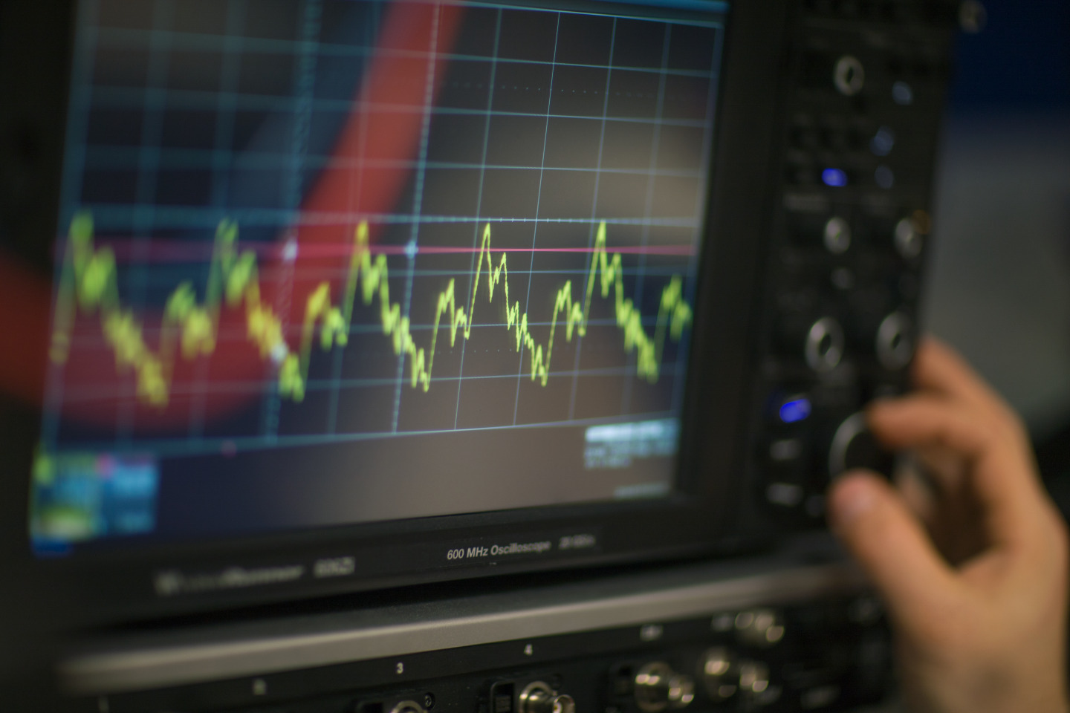
Finding the common frequency

Slide 10

Building a team and flying in

Slide 11
Initial investigation report
Good overview
Too many issues included in one report
XXX
SIMbox

Slide 12
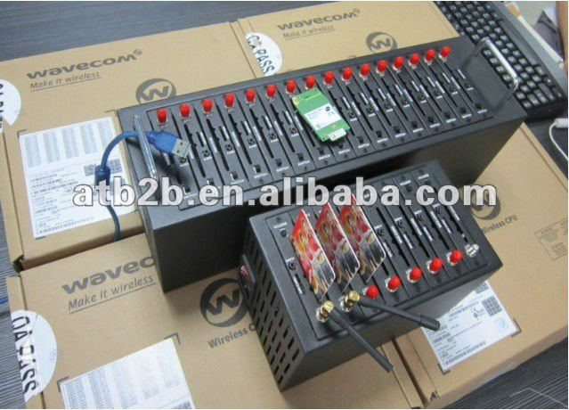
simbox

Slide 13
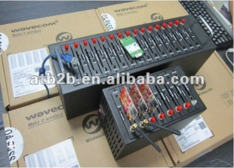
Simbox scenario
Operator A
Operator B
Subscriber A
Subscriber B
Internet

Slide 14

Blame game
Obvious from beginning
Operator blaming the MS Provider
MS Provider blaming the operator
Internal blame game in the Managed Service Provider

Slide 15
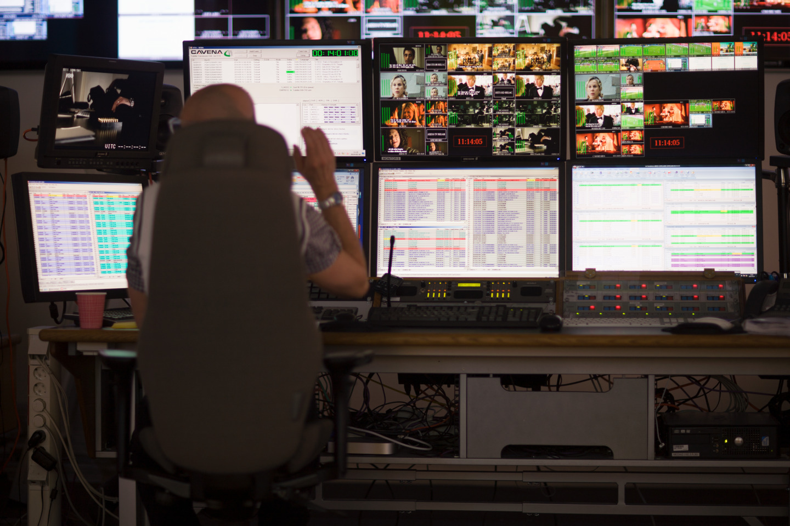
people
High pressure put on certain people
Afraid for their jobs
Defensive mode
How to get truthful answers?

Slide 17

Big pile of cra… findings
No policy
No screening of employees
No physical security
No processes
No assets
Unclear SLA
No responsible
No log monitoring
Shared accounts

Slide 18

Summary of findings
No technical vulnerability in the system itself
Aircraft carrier size holes in operational security
  Impossible to name culprits
  Shared root accounts etc…
Nice process! When is it created?

Slide 19
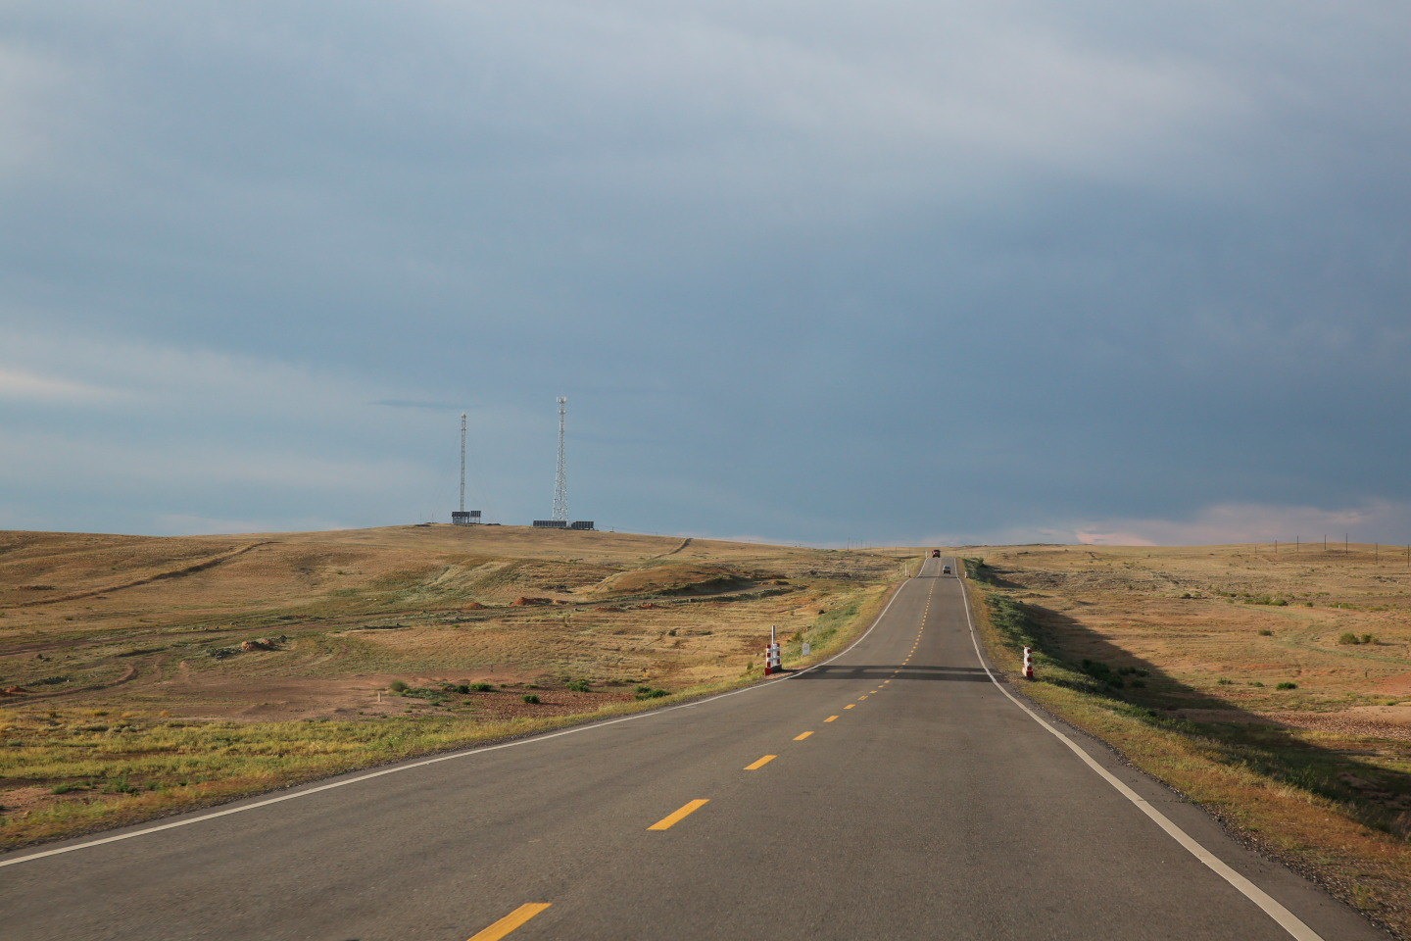
It’s a long way
It’s humans who run this show
Communication flows or doesn’t
Blame game takes time and energy

Slide 20
Thank you
Mikko Karikytö
Head of Ericsson PSIRT
mikko.tel

