Slide 1
Network security analytics today …and tomorrow
Aubrey Merchant-dest
Director, Security Strategies OCT)
June, 2014

Slide 2
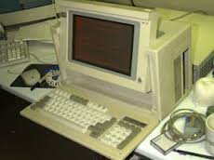
Brief history of network ‘analysis’
Before NetFlow…
Sniffers
Troubleshooting network applications
Very expense!
Then came Ethereal/Wireshark
SNMP
Capacity Planning
Ensuring business continuity
Adequate QOS for service levels
Little traffic characterization
No granular understanding of network bandwidth
This is how we did troubleshooting back in the day…
Still useful nowadays (Wireshark)

Slide 3
enter netflow
NetFlow appears…
Developed by Cisco in 1995
ASIC based
Catalyst Operating System
Answered useful questions
What, when, where and how
Became primary network ‘accounting’ and anomaly-detection tool
Addressed the following:
Network utilization
QOS/COS Validation
Host communications
Traffic anomaly detection via threshold triggering
Generally ‘statistical’ reporting
No 1:1 unless dedicated device present
Statistical reporting highly accurate but…
Not extensible

Slide 4
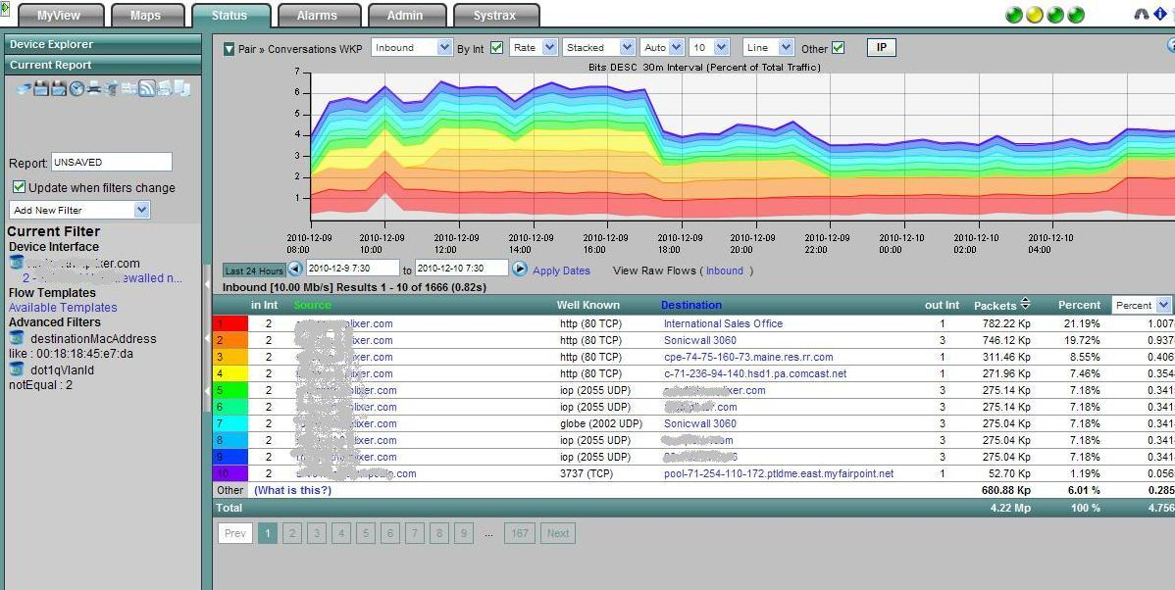
Representative netflow interface (plixer)
Note: Based on ‘well-known’ ports

Slide 5
ipfix offers advancements
IETF Chooses NetFlow v9 as standard in 2003
IPFIX is born (Flexible NetFlow):
Flexible, customizable templates
New data fields
Unidirectional protocol for export
Exporter -> Collector
Data format for efficient collection record collection
Similar format/structure
Self-describing
Uses templates
Purpose
Collector analyzes flow records
Conversations, volumes, AS, and hundreds of other information elements
A ‘sensor’ in each switch or router
Great visibility, even in ‘flat’ networks
Scales great

Slide 6
Network flow reporting (threshold alarms)
Useful for…
Profiling your network
What and how much
Who’s talking to whom
Top or bottom ‘n’ talkers
Understand application utilization
Protocol distribution
Performance of QOS policy
Troubleshooting
Capacity Planning
Network Security
A useful source of analytics… over time

Slide 7
Why the primer on flow data?
Todays Typical Enterprise…
Is under attack from multiple sources, varying motivations
Either has or is budgeting for current technology
Managing GRC
Focused on passing audits and protecting assets
Has one or more individuals focused on security
Supporting multiple OSes and compute surfaces
We need more context to stay in this fight!!!
Nation States
IPS
SIEM
Next Gen Firewall
Visibility
Web Gateway
Context
Adv. Threat Protection
Today’s Security Gap
Hacktivists
URL Filtering
Email Security
Inside Threats
Integrity
Availability
DLP
Host Firewall
Confidentiality
Encryption
Anti Spam
VPN
NAC
Cybercriminals

Slide 8
Post-prevention security gap
NGFW
IDS / IPS
Host AV
Web Gateway
SIEM
Email Gateway
DLP
Web Application Firewall
Advanced Threat Protection
Content
Detection
Analytics
Context
Visibility
Analysis
Intelligence
Threat Actors
Traditional Threats
Advanced Threats
Known Threats
Known Malware
Known Files
Known IPs/URLs
Nation States
Cybercriminals
Hactivists
Insider-Threats
Novel Malware
Zero-Day Threats
Targeted Attacks
Modern Tactics & Techniques
Signature-based Defense-in-Depth Tools
SSL
Notes:
So, we’ve talked about the threat actors and some of the advanced threats they pose and the attack methods they use. For years we have been trying to stop those threats with the “next new” technologies. We use next generation firewalls, hosted AV, SIEM, email gateways and many other point solutions to detect and block these threats. They can be effective in what they are designed to do, but unfortunately, they can only prevent what they know to stop and many threats today do get by and even using encryption to evade detection. What we need today is an Advanced Threat Protection solution that gives us the context, content, visibility, detection, analysis and real-time, evolving intelligence we need to have a fighting chance against today’s threats.

Slide 9
Time and the Window of Opportunity
Initial Attack to Compromise
Initial Compromise to Discovery
Compromised in Days or Less 90%
Discovered in Days or Less 25%
“…bad guys seldom need days to get their job done, while the good guys rarely manage to get the theirs done in a month of Sundays.”
Verizon 2014 Breach Investigation Report
Notes:
Why is a modern approach so important? Well, here’s an interesting perspective from the latest Verizon Data Breach Investigation Report on the time of the initial attack, relative to the discovery of the attack. On one hand, 90 percent of the attacks took days or less to successfully compromise their targets. They're very fast. They are successful. They are penetrating your network and you are compromised before you know it.
On the other side of it, only 25% of the attacks were discovered in days or less. It could take much longer…weeks, months…or as we’ve seen in some prominent attacks, even longer before they are uncovered. And so, we see a lot of breaches in the news today that have gone undetected for some time. The response we see is often… "Well, we're not sure we were breached. We think we were. We don’t have the details, we are looking into it, but can’t tell you any more at this time."
That's kind of code for, ”It’s bad…we've definitely been breached, but we don’t know how bad, and we don’t know what to do." And oftentimes you hear things like, "Well, the threat and the attackers were in the network for four months, six months, a year.” This is definitely an issue. We need to be able to see these attacks early, there’s no reason that today we can’t have full visibility into an attack.
“ It smacks us with the fact that the bad guys seldom need days to get their job done, while the good guys rarely manage to get the theirs done in a month of Sundays.”

Slide 10
Post-prevention security gap
60%
Percentage of Enterprise IT Security Budgets Allocated to Rapid Response Approaches by 2020.
— Gartner 2014
Notes:
A recent report from Gartner indicated that 60% of Enterprise IT security budgets will be devoted to rapid response approaches. It’s clear that protecting the organization’s critical digital assets will come by way of swift incident response, not merely blocking what we can already identify.

Slide 11
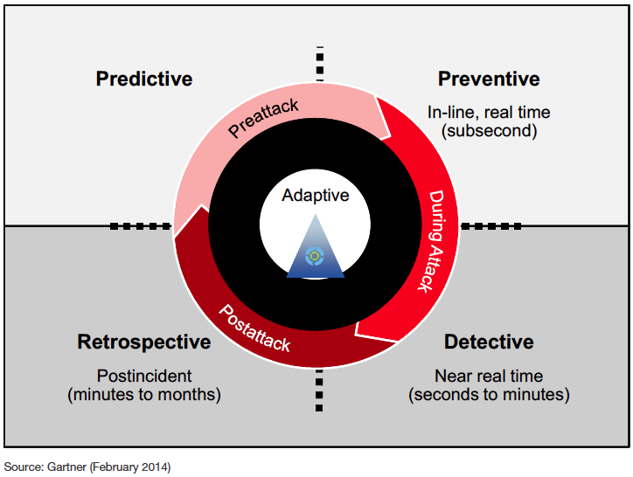
Gartner: adaptive security architecture
Source: Gartner (February 2014)
Notes:
Gartner proposes that Advanced Threat Protection is achieved through an adaptive security architecture. One where the end goal is that different capabilities integrate and share information to build a security protection system can adjust to threats and and is more intelligent overall. It addresses the entire lifecycle of a threat.

Slide 12
DPI and protocol parsing
Deep Packet Inspection
Comes in at least two flavors
Shallow packet inspection
Limited flow inspection (i.e., ‘GET’)
Magic
Byte value @ offset
Provides improved classification
May or may not use port numbers for some classification
Deep Flow Inspection (DPI+++)
Interrogates network-based conversations
No usage of port numbers for classification
State-transitioned classification
Supports re-classification
Treats applications as protocols! (wire-view)
Implements parsing mechanism
Performs reconstruction (post-process or NRT)
Allows extraction of artifacts (files, images, etc.)

Slide 13
Benefits of advanced parsers
Re-entrant
Protocols in protocols
State-transitioning
Efficient decoding
Look for metadata only where it should be
Conversation-based classification
Interrogate request and response
Extraction
NRT or post-process artifact reconstruction
Policy-based rules
Layer 2
MAC, VLAN, MPLS, LTE, MODBUS, DNP3, and others
Layer 3
IPv4, IPv6, BGP, OSPF, GRE, L2TP, IP/IP, and others
Database, Social Networking, Web, hundreds others
Customizable
Extraction/Reconstruction
Policy-based extraction and reconstruction
Application

Slide 14
Correlation temporal & flow_id
L2 Metadata
MIME Metadata
Files Metadata
L3 Metadata
User Agent Metadata
Geo-location Metadata
Classification Metadata
Reconstructed Artifacts
HTTP Metadata
Any to Any
Relationship
(From any one to
any/every other)

Slide 15
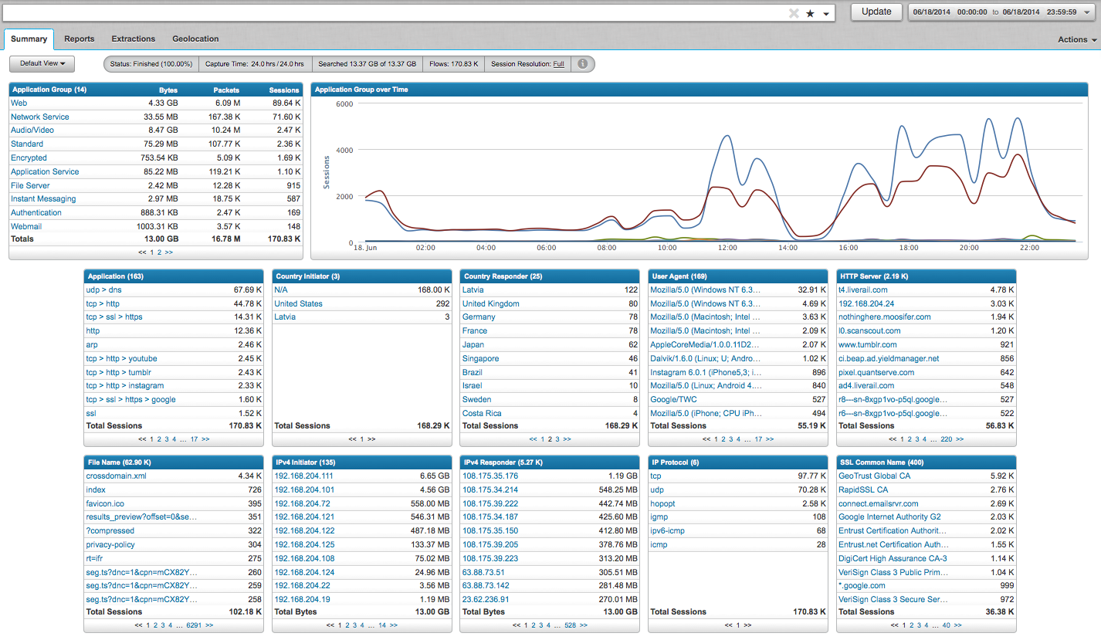
Deep Context via extracted metadata
What we have at our disposal
Precise application classification
Classified or Unknown
Unknown is interesting, too!
Metadata
Flow-based
Inter-relational

Slide 16
Drill-down on Context
What we have at our disposal
Precise application classification
Classified or Unknown
Unknown is interesting, too!
Metadata
Flow-based
Inter-relational

Slide 17
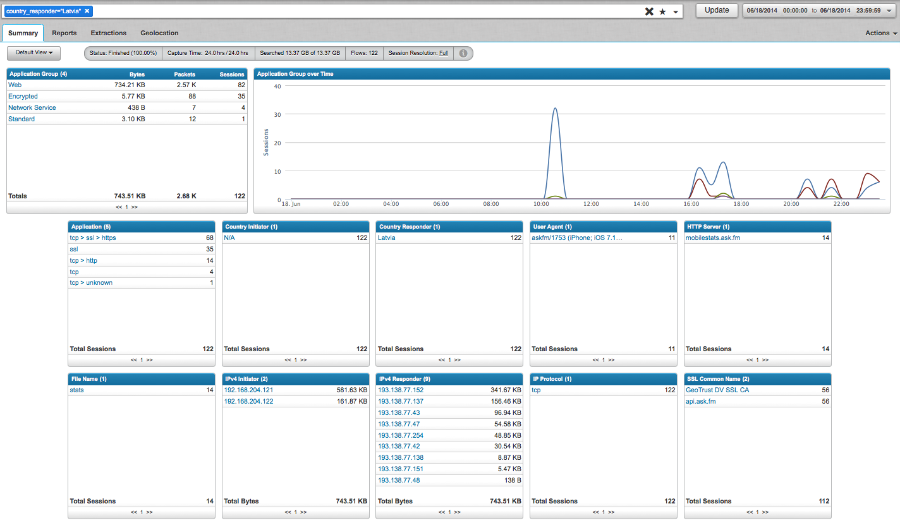
Correlated Context
What we have at our disposal
Precise application classification
Classified or Unknown
Unknown is interesting, too!
Metadata
Flow-based
Inter-relational

Slide 18
Example flow record
6/2/14 9:40:23.000 PM timestamp=Jun 02 2014 21:40:23PM, dns=gpnouarwexr.www.qianyaso.net,gpnouarwexr.www.qianyaso.net , application_id=udp , application_id_2=dns , connection_flags=unknown , first_slot_id=23063 , flow_id=20495454 , initiator_country=Azerbaijan , src_ip=149.255.151.9 , src_port=46614 , interface=eth3 , ip_bad_csums=0 , ip_fragments=0 , network_layer=ipv4 , transport_layer=udp , packet_count=2 , protocol_family=Network Service , responder_country=N/A , dst_ip=10.50.165.3 , dst_port=53 , start_time=1401766596:327447386 , stop_time=1401766611:597447252 , total_bytes=176

Slide 19
Full-state DPI parsers drive analytics
NRT and Post Process Reconstruction Benefits
Hashes
Fuzzy
MD5
SHA
Automated reputation
VirusTotal
Other details
Domain age
WHOIS
SORBS
SANS
3rd Party plugins
Automated delivery
Policy-based reconstruction and delivery
Sandbox
Additional ‘processing’ w/ other tools

Slide 20
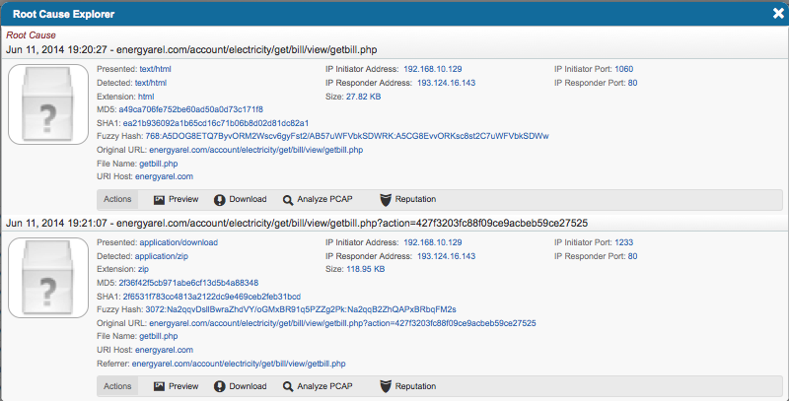
investigation
Malicious ZIP file is detected
Use flow records to link HTTP source (root)

Slide 21
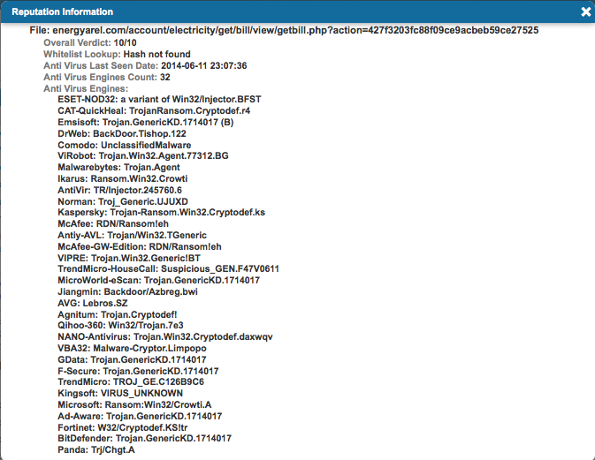
investigation
Hashes compared against reputation service sources
Looks like ransom-ware

Slide 22
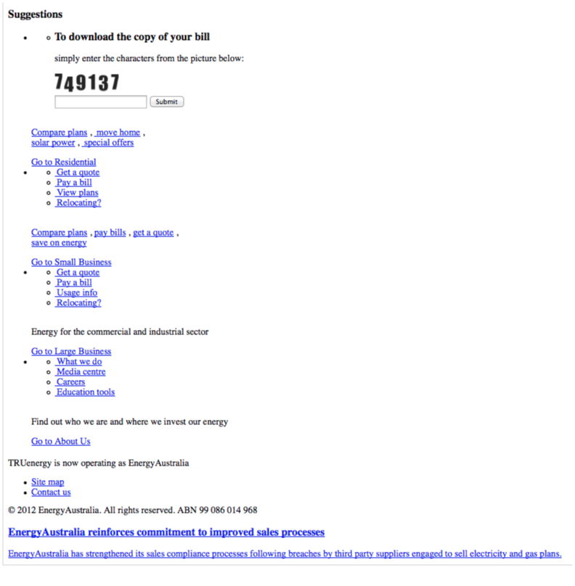
Investigation
Source of exploit determined
Energy Australia web page (reconstructed)
Requests ‘captcha’ for copy of bill
Interestingly, entering the wrong ‘captcha’ values reloads page
Correct entry starts exploit

Slide 23
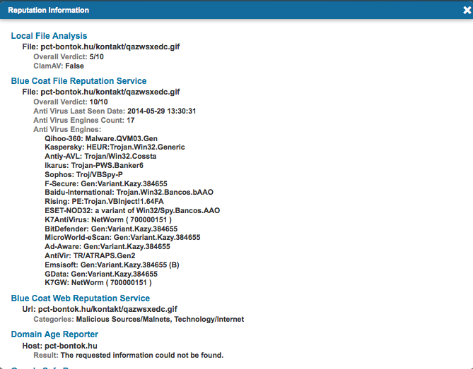
investigation
Other malware delivered
Presented on the wire as ‘.gif’
Decoded by DPI parser as ‘x-dosexec’
17 reputation know this as malicious
First seen in 5/29/14

Slide 24
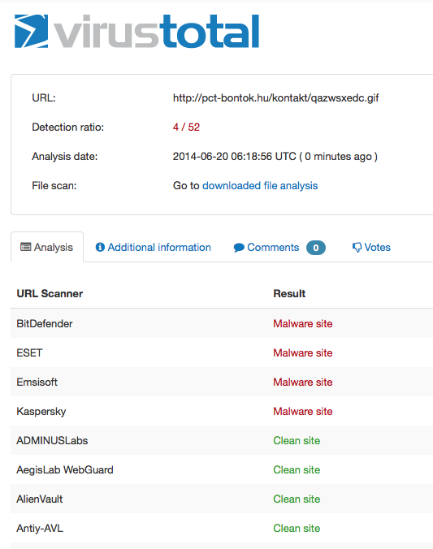
investigation
VirusTotal reports that 4 AV engines reporting site as malicious…

Slide 25
But so far we’ve talked about analysis…
Analytics vs. analysis
Analytics is a multi-dimensional discipline. There is extensive use of mathematics and statistics, the use of descriptive techniques and predictive models to gain valuable knowledge from data - data analysis. The insights from data are used to recommend action or to guide decision making rooted in business context. Thus, analytics is not so much concerned with individual analyses or analysis steps, but with the entire methodology. There is a pronounced tendency to use the term analytics in business settings e.g. text analytics vs. the more generic text mining to emphasize this broader perspective. There is an increasing use of the term advanced analytics, typically used to describe the technical aspects of analytics, especially predictive modeling, machine learning techniques, and neural networks.
Short definition
Multi-dimensional analysis to uncover relationships not present discretely, yielding insight

Slide 26
Multi-dimensional analysis
Application
Application Group
Email Recipient
Email Sender
Email Subject
SSL Common Name
File Name
Fuzzy Hash
MD5 Hash
MIME Type
SHA1 Hash
VLAN ID
VoIP ID
Country Initiator
Country Responder
DNS Query
Ethernet Destination
Ethernet Destination Vendors
Ethernet Protocol
Ethernet Source
Ethernet Source Vendors
Interface
IP Bad Checksums
IP Fragments
IP Protocol
IPv4 Conversation
IPv4 Responder
IPv4 Initiator
IPv4 Port Conversation
IPv6 Conversation
IPv6 Initiator
IPv6 Responder
IPv6 Port Conversation
Packet Length
Port Initiator
Port Responder
Size in Bytes
Size in Packets
TCP Initiator
TCP Responder
Tunnel Initiator
Tunnel Responder
UDP Initiator
UDP Responder
Password
Social Persona
User Name
File Analysis
Malware Analysis
URL Analysis
URL Categories
Database Query
HTTP Code
HTTP Content Disposition
HTTP Forward Address
HTTP Method
HTTP Server
HTTP URI
Referrer
SSL Cert Number
User Agent
Web Query
Web Server

Slide 27
Multi-dimensional analysis
Application
Application Group
Email Recipient
Email Sender
Email Subject
SSL Common Name
File Name
Fuzzy Hash
MD5 Hash
MIME Type
SHA1 Hash
VLAN ID
VoIP ID
Country Initiator
Country Responder
DNS Query
Ethernet Destination
Ethernet Destination Vendors
Ethernet Protocol
Ethernet Source
Ethernet Source Vendors
Interface
IP Bad Checksums
IP Fragments
IP Protocol
IPv4 Conversation
IPv4 Responder
IPv4 Initiator
IPv4 Port Conversation
IPv6 Conversation
IPv6 Initiator
IPv6 Responder
IPv6 Port Conversation
Packet Length
Port Initiator
Port Responder
Size in Bytes
Size in Packets
TCP Initiator
TCP Responder
Tunnel Initiator
Tunnel Responder
UDP Initiator
UDP Responder
Password
Social Persona
User Name
File Analysis
Malware Analysis
URL Analysis
URL Categories
Database Query
HTTP Code
HTTP Content Disposition
HTTP Forward Address
HTTP Method
HTTP Server
HTTP URI
Referrer
SSL Cert Number
User Agent
Web Query
Web Server
Any to any/many

Slide 28
Multi-dimensional analysis
Application
Application Group
Email Recipient
Email Sender
Email Subject
SSL Common Name
File Name
Fuzzy Hash
MD5 Hash
MIME Type
SHA1 Hash
VLAN ID
VoIP ID
Country Initiator
Country Responder
DNS Query
Ethernet Destination
Ethernet Destination Vendors
Ethernet Protocol
Ethernet Source
Ethernet Source Vendors
Interface
IP Bad Checksums
IP Fragments
IP Protocol
IPv4 Conversation
IPv4 Responder
IPv4 Initiator
IPv4 Port Conversation
IPv6 Conversation
IPv6 Initiator
IPv6 Responder
IPv6 Port Conversation
Packet Length
Port Initiator
Port Responder
Size in Bytes
Size in Packets
TCP Initiator
TCP Responder
Tunnel Initiator
Tunnel Responder
UDP Initiator
UDP Responder
Password
Social Persona
User Name
File Analysis
Malware Analysis
URL Analysis
URL Categories
Database Query
HTTP Code
HTTP Content Disposition
HTTP Forward Address
HTTP Method
HTTP Server
HTTP URI
Referrer
SSL Cert Number
User Agent
Web Query
Web Server
Any to any/many
Flow-based

Slide 29
Multi-dimensional analysis
Application
Application Group
Email Recipient
Email Sender
Email Subject
SSL Common Name
File Name
Fuzzy Hash
MD5 Hash
MIME Type
SHA1 Hash
VLAN ID
VoIP ID
Country Initiator
Country Responder
DNS Query
Ethernet Destination
Ethernet Destination Vendors
Ethernet Protocol
Ethernet Source
Ethernet Source Vendors
Interface
IP Bad Checksums
IP Fragments
IP Protocol
IPv4 Conversation
IPv4 Responder
IPv4 Initiator
IPv4 Port Conversation
IPv6 Conversation
IPv6 Initiator
IPv6 Responder
IPv6 Port Conversation
Packet Length
Port Initiator
Port Responder
Size in Bytes
Size in Packets
TCP Initiator
TCP Responder
Tunnel Initiator
Tunnel Responder
UDP Initiator
UDP Responder
Password
Social Persona
User Name
File Analysis
Malware Analysis
URL Analysis
URL Categories
Database Query
HTTP Code
HTTP Content Disposition
HTTP Forward Address
HTTP Method
HTTP Server
HTTP URI
Referrer
SSL Cert Number
User Agent
Web Query
Web Server
Any to any/many
Flow-based
Time-stamped

Slide 30
analytics

Slide 31
Stix + analytics

