Slide 1
A Forensic Analysis of APT Lateral Movement in Windows Environment
AhnLab
Junghoon Oh
jh.oh@ahnlab.com
Notes:
Good Afternoon~^^
My name is Junghoon Oh from AhnLab, South Korea.
Thanks for inviting me. This is the biggest conference I’ve ever had.
Today, I’ll make a presentation about a forensic analysis of APT lateral movement in windows environment.

Slide 2
01 02 03 04 05
Introduction
Method of Lateral Movement
Forensic Analysis for Lateral Movement
Case Study
Conclusion
Notes:
This presentation is in following order.
First, I introduce need for forensic analysis of APT lateral movement.
Then I explain about method of lateral movement that attacker use commonly these days.
And I explain how to analyze this lateral movement.
Lastly, I introduce real case in South Korea.

Slide 3
Introduction
Notes:
First, Let’s see why digital forensics is needed to analyze APT Lateral movement…

Slide 4
Introduction
Lateral Movement ?
Accomplishing Goal of Attack~!!
Initial Breach~!!!
Lateral Movement
Notes:
(Click)
As you know, lateral movement is one of APT phases.
It means attacker’s movement in internal network after initial breach.
The goal of this movement is searching targeted system. For example, Database system.

Slide 5
Introduction
Need for Tracing Lateral Movement
Detecting Attack~!!!
Finding Root
Cause~!!!
Tracing Lateral Movement
Notes:
So, Why is tracing this lateral movement necessary(required)?
(Click)
If the root cause of initial breach is found by this tracing, and able to be removed, we won’t be attacked by same method.
In case of removing only backdoor, we will be attacked by same method because attacker will use same root cause.
This lateral movement generally uses windows authentication protocol and network share.
So, it is hard to distinguish between this movement and normal behavior.
To distinguish these things, we need a in-depth analysis like digital forensics.

Slide 6
Method of Lateral Movement
Notes:
Then, Let’s see common methods of lateral movement these days.

Slide 7
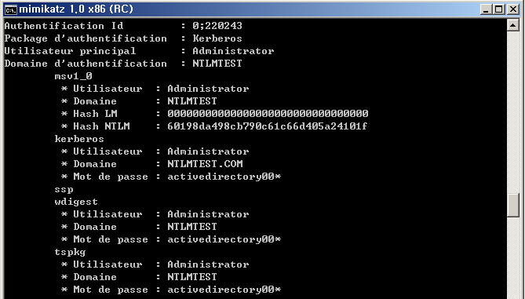
Method of Lateral Movement
Active Directory Environment( in Same Domain )
Administrator System
Using Domain Administrator’s
NTLM Credentials for SSO(Single Sign-On)
or ID/PW Directly
Stealing
Domain Administrator’s
Decrypted ID/PW or NTLM Credentials From Memory
Domain Administrator’s NTLM Credentials is saved
in Memory(Msv1_0.dll)
Using Domain Administrator Account
RDP
Domain Administrator’s encrypted ID/PW is saved
in Memory(Kerberos.dll, Wdigest.dll, tspkg.dll)
Network Share Point
Copy Backdoor
Run Backdoor
Normal System
Normal System
Compromised System
Compromised System
sc, at, wmic, reg, psexec, winrs
Notes:
I think most of you guys know this attack method and principle.
However, for the person who doesn’t know yet, I will explain it briefly.
Lateral movement is divided into two cases, active directory environment and non-active directory environment.
(Click)
In active directory environment, administrator connects some system by RDP with domain administrator’s account.
(Click)
At this moment, Domain administrator’s NTLM credentials and encrypted ID/PW remain in memory space of each SSP(Security Support Providers).
SSP means some kind of windows module taking charge of authentication.
NTLM credentials is some kind of information used by NTLM SSP and consist of Domain name, Account name, NT, LM hash of passwords.
(Click)
In this situation, if attacker dominates this system with local administrator authority, attacker can easily steal domain administrator’s NTLM credentials or decrypted password like this.
This picture is result of mimikatz, well-known hacking tool
(Click)
And then, attacker can connect network share and copy backdoor to targeted system by using this information(NTLM Credentials for SSO or Decrypted ID/PW directly).
Especially, in case of using NTLM Credentials, SSO(Single Sign-On) technology is used.
SSO means that using authentication information saved in logon session whenever user access local or remote resource after logon success.
It makes that user doesn’t need to enter their ID/PW whenever they access resource.
Therefore, if attacker steals domain administrator’s NTLM credentials and overwrites their own credentials with this stolen credentials, attack can access any resource without entering ID/PW due to the SSO.
Because attacker has domain administrator’s authority in this situation.
(Click)
Also attacker can run backdoor by creating service(sc), registering job(at), using wmi protocol(wmic) and so on.
This job uses SSO of NTLM Credentials or decrypted ID/PW, too.
In many cases, attacker commonly uses the method of creating service and registering job because they can run their backdoor with SYSTEM authority by these methods.
As you know, SYSTEM authority is higher than administrator authority.

Slide 8
Method of Lateral Movement
Multi-Domain Environment
A Domain
Trust Relationship
B Domain
DC
DC
DC
DC
Notes:
(Click)
Therefore if attacker dominates a system in some domain and domain administrator’s credentials or encrypted ID/PW remains in this system’s memory,
(Click)
attacker can take all systems in same domain.
(Click)
Also, if some domain has trust relationship to the domain taken by attacker,
(Click)
attacker can dominate all systems in that domain. too

Slide 9
Method of Lateral Movement
Non-Active Directory Environment
All Systems have same Local Administrator Account
(Same ID/PW)
Stealing Local Administrator’s ID/PW(Kerberos.dll, Wdigest.dll, tspkg.dll)
and
NTLM Credentials(Msv1_0.dll)
From Memory
Using Local Administrator’s NTLM Credentials or ID/PW
Network Share Point
Copy Backdoor
Run Backdoor
Compromised System
Normal System
sc, at, wmic, reg, psexec, winrs
Compromised System
Notes:
(Click)
In non-active directory environment, there are many cases that all systems have identical local administrator’s ID/PW, regardless of using this account.
Maybe you can’t understand that all system has same local administrator account…
But, many administrator use identical local administrator account for their own convenience in South Korea.
Also, they use same Ghost image to creating new system. it makes all systems have same local administrator account.
(Click)
In this situation, if attacker steal local administrator’s NTLM credentials or Decrypted ID/PW,
(Click)
all systems can be dominated by attacker.

Slide 10
Forensic Analysis
Notes:
Next, Let’s see how to find the trace of lateral movement~

Slide 11
Forensic Analysis
Layout of Lateral Movement
Escalation of Privileges
NetworkShare Point
Copy Backdoor
Run Backdoor
Attacker System
Victim System
sc, at, wmic, reg, psexec, winrs
Anti Forensics
Notes:
To sum up the overall lateral movement,
(Click)
If attacker acquires Domain administrator’s authentication information,
(Click)
attacker can connect to targeted system by network share, and copy backdoor and run backdoor with domain administrator’s authority.
(Click)
In addition, attacker tries to remove their trace.
In this presentation, the system dominated by attacker is called “Attacker System”.
And the system targeted by attacker is called “Victim System”.

Slide 12
Forensic Analysis
Program Execution
Location : Attacker System
Artifact
Prefetch
Shim Cache( in Registry )
UserAssist( in Registry )
Attacker System
WCE Execution ~!!
Cain&Abel Execution~!!
Notes:
As I said, attacker run their backdoor in lateral movement, so analyst have to confirm program execution artifact.
With this artifact, analyst can find backdoor or hacking tool and it’s creation time.
And then, this creation time is used as time point to analyze another artifact like Event Log.
There are many artifacts to confirm program execution in windows.
(Click)
Prefetch is the most common artifact to find program execution.
I think all of you know this artifact well. So I omit explanation of this artifacts.
WCE stands for Windows Credentials Editor, and this tool is used to steal NTLM Credentials.
(Click)
Shim cache in registry is useful artifact, too.
This artifact contains information of program that occurs compatibility problem.
Most attacker’s tool are not adapted into various windows versions. It occurs compatibility problem and makes a record of the trace of attacker’s tool in Shim Cache.
So, analyst can find trace of backdoor execution by this artifact.
(Click)
In addition, If attacker use GUI hacking tool like Cain&Abel, analyst can find this trace in UserAssist registry.

Slide 13
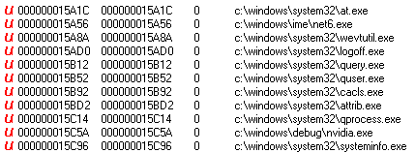
Forensic Analysis
Program Execution
Location : Attacker System
Artifact
RecentFileCache.bcf
Strings in Memory
Attacker System
Launching Job Scheduler for Installing Malware
and
Erasing Event Log
With wevtutil
Launching Malware for Stealing NTLM Credentials
Launching WCE~!!
Notes:
(Click)
RecentFileCache.bcf file is very similar to Shim Cache.
It contains full path information of program that occurs compatibility problem.
Contrary to Shim cache, It doesn’t contain time information, so analyst can just find execution order like this.
(Click)
(Click)
In this case, attacker run net6.exe by “at” command and remove event log by wevtutil command.
(Click)
And then net6 creates and executes nvidia.exe malware which performs stealing NTLM Credentials.
(Click)
And In memory, some string related to hacking tool can be found.
Below picture is output strings when WCE is executed.
Many attackers use well-known tool like wce, mimikatz through their manual packing method, so analyst can find strings of these well-known tools in memory after unpacking.
This means that some backdoor or these well-known hacking tool is executed in this system.

Slide 14
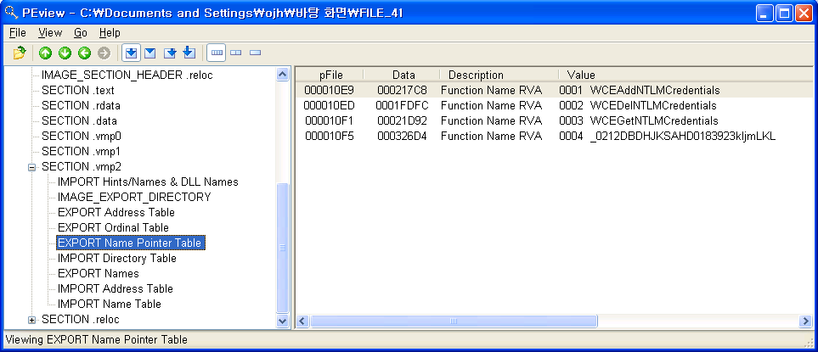
Forensic Analysis
Program Execution
Location : Attacker System
Artifact : wceaux.dll
Dropped DLL from wce.exe
This DLL is injected to LSASS.EXE and used for acquiring/replacing Credentials.
Usually malware saves this dll in it’s resource area and use dll’s export functions.
Attacker System
Malware uses these functions~!!
Notes:
The another thing analyst should confirm is DLL used by well-known hacking tools.
WCE uses wceaux.dll

Slide 15
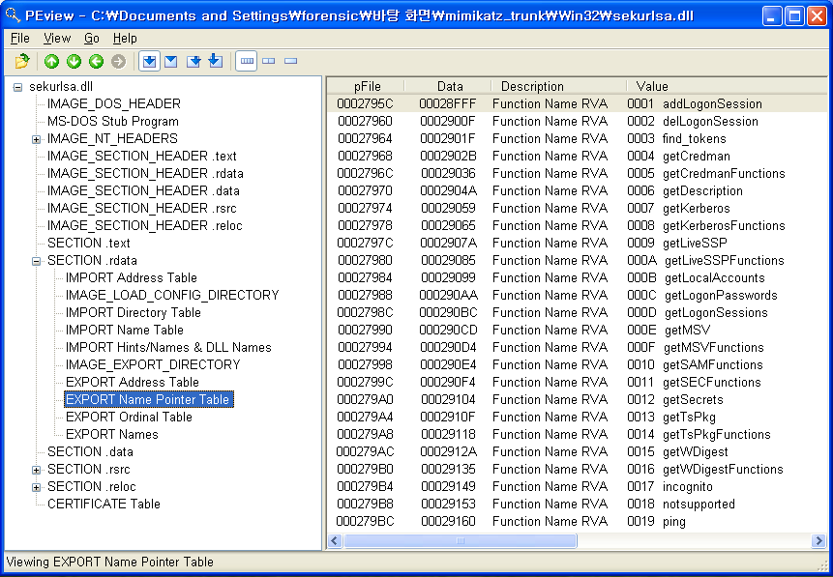
Forensic Analysis
Program Execution
Location : Attacker System
Artifact : sekurlsa.dll
DLL used by mimikatz.exe
This DLL is injected to LSASS.EXE and used for acquiring/replacing Credentials and Password
This DLL is used by malware like wceaux.dll.
Attacker System
Malware uses these functions~!!
Notes:
And mimikatz uses sekurlsa.dll.
In many cases, attacker includes these DLL into their backdoor and call these DLL’s exported functions.
So, if analyst finds these function names in disk or memory, they can confirm that attacker performs stealing credentials or ID/PW.

Slide 16
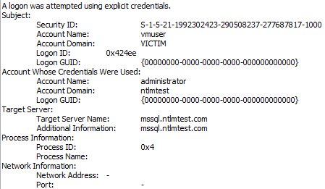
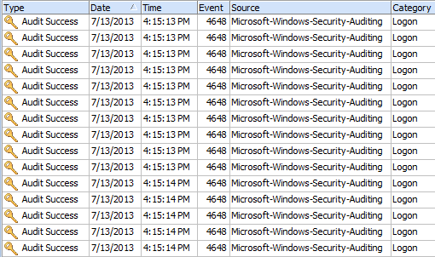
Forensic Analysis
Logon Attempt
Location : Attacker System
Artifact : Security Event Log
The event occurs when attempting to logon to another system ➔ ID : 552(evt) or 4648(evtx)
A logon was attempted using explicit credentials(using ID/PW).
Information
Targeted system name
Process information
Process ID, name
Normal case : lsass.exe(to Remote), winlogon.exe(to Local), taskhost.exe(to Local), consent.exe(to Local)
Suspicious case : 0x4(system), cscript.exe, svchost.exe(to Remote)
There is no information whether logon succeeds or not.
Attack Automation
Attempting 10 times logon per second through automation
Attacker System
Attack Automation~!!
Notes:
Event Log is important artifact to find the trace of lateral movement.
(Click)
In system that performs attack, the analyst can find event of attempting logon to another system in security event log.
In APT attack, this means that attacker tries to connect network share to another system with ID/PW.
If process information of this event includes system or cscript or svchost.exe, it can be considered as suspicious behavior.
Because, most backdoors are in operation as service or task job with SYSTEM authority.
With this event, the analyst can find out that this system has backdoor and backdoor tried to connect another system and which system is attacked.
But there is no information whether logon succeeds or not. This event has only attempting event.
(Click)
Additionally, in most cases, attacker automates this attack.
In this case, there are continuous attempting logon events in event log, average 10 times per second.
Each event means the attack to separate systems.
So, if the analyst see this continuous attempting logon events, they can suspect lateral movement.

Slide 17
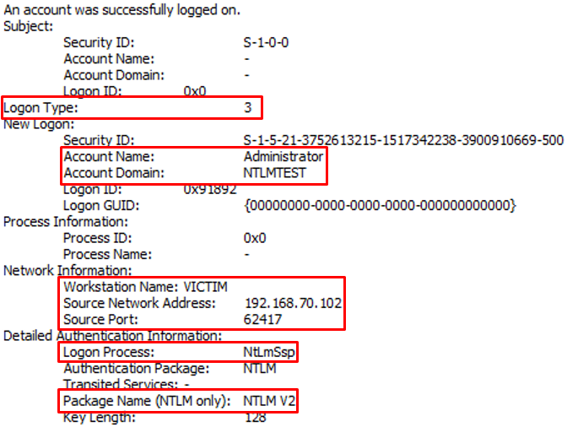
Forensic Analysis
NTLM Authentication
Location : Victim System
Artifact : Security Event Log
Network Logon through NTLM authentication ➔ ID : 540(evt) or 4624(evtx)
Condition
Logon Type : 3
Logon Process : NtLmSsp
Package Name : NTLM V2 ➔ In Case of XP SP3, NTLM
Information
New Logon : Account Name, Domain
Network Information : Workstation Name, IP, Port
Victim System
Using NTLM Authentication~!!
Notes:
Then, what event is left in the system that was attacked?
(Click)
In this case, Network logon event is left in security event log.
It means that some system tries to connect network share or perform copying backdoor and running backdoor through SSO to this system.
With this event, the analyst can find which system tries to attack to this system.
It is the most important event to trace lateral movement.
(Click)
But, the another important thing analyst should focus is that this event includes NTLM information like “NtLmSsp”, “NTLM V2” or “NTLM”, because attacker use NTLM authentication when they try to connect network share, copy backdoor and run backdoor.

Slide 18
Forensic Analysis
NTLM Authentication
Real Case : Finding Lateral Movement
Online Game Company
The Security Event Log of Compromised DC(Domain Controller) Server ➔ 3158244 records
The filtering result with “Logon Type : 3” keyword(Network Logon) ➔ 176006 records
The filtering result with “NTLM V2” keyword ➔ 2 records
Performing cross analysis with other artifacts ➔ second record includes attack event~!!
Victim System
Notes:
So, let’s see the real case of finding lateral movement.
(Click)
System was Domain Controller and there were a lot of events in security Event Log.
When I tried to find just network logon event, there were still a lot of events.
(Click)
But when I tried to find network logon event with NTLM information like “NTLM V2”, I could find just 2 event.
Of course, all network logon events with NTLM information are not attack event.
But analyst can suspect and confirm this event by cross analysis with other artifacts.
(Click)
By this process, I found second record was attack event and which system attacked to this system.

Slide 19
Forensic Analysis
Remote service registration/execution
Location : Victim System
Artifact : Security Event Log
Service Installation ➔ ID : 4697(Not Default)
Information
Account Name, Domain
Service Name, Service File Name
Victim System
Notes:
And if all audits in audit policy are turned on, the analyst can find the trace of creating service to run backdoor in Security Event Log.

Slide 20
Forensic Analysis
Remote service registration/execution
Location : Victim System
Artifact : SYSTEM Event Log
Service Installation ➔ ID : 7045
Information
Service Name
Service File Name
Changing Service State ➔ ID : 7036
Information
Whether backdoor is executed or not
Victim System
Notes:
In System Event Log, the analyst can find this event by default.

Slide 21
Forensic Analysis
Remote job schedule registration, execution and deletion
Location : Victim System
Artifact : Task Scheduler Event Log(since win7)
Registering Job schedule ➔ ID : 106
Account Name used to registration
Job Name : Usually “At#” form
Starting Job schedule ➔ ID : 200
The path of file executed for job
Deleting Job schedule ➔ ID : 141
Account Name used to registration
Victim System
Notes:
From Windows 7, Task scheduler event is saved.
So, the analyst can find the trace of running backdoor through “at” command.
There are continuous registering, starting and deleting job events in this event log.
In most cases, attacker doesn’t make specific name of job, so job name is like this. At1, At2.….
So, If analyst find job name like At1, At2 in this log, they can suspect this event.

Slide 22
Forensic Analysis
Remote job schedule registration, execution and deletion
Location : Victim System
Artifact : Tasks Folder
Creating “At#.job” file under “Tasks” folder
Changing time information of “Tasks” folder
This occurs by creating “At#.job” file.
Last Written
Last Accessed
MFT Entry Mdofied
Victim System
Notes:
Also, this event creates job file under “Tasks” folder and changes “Tasks” folder’s time information.

Slide 23
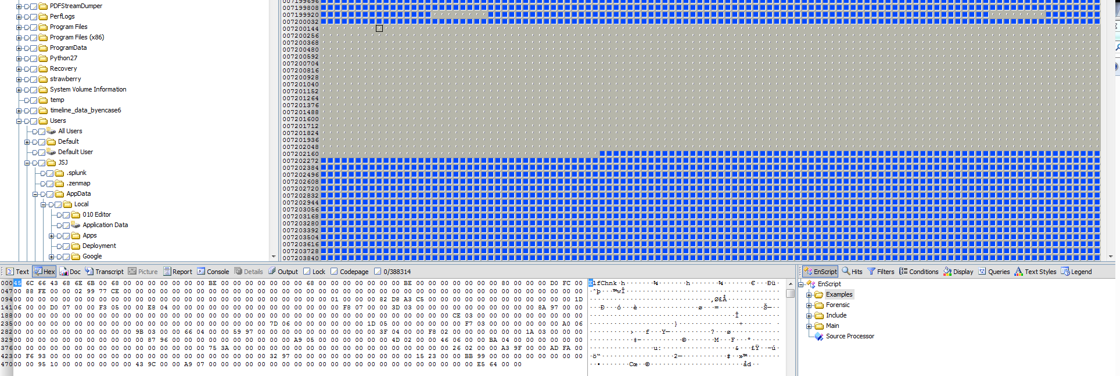
Forensic Analysis
Countermeasure for Anti Forensics
Anti Forensic behavior
After installing backdoor, attacker deletes of “Event Log”, job file and backdoor installation file
Countermeasure
Recovering Deleted Event Log
There are event log records in unallocated space, after deleting with “wevtutil cl”➔ Record Carving~!!
Victim System
Notes:
(Click)
As I said, attacker tries to remove their trace.
they delete initial installation binary, event log file and job file.
Below picture is batch script file used by attacker in real case.
(Click)
Hence, how can analyst counteract this anti forensic behavior?
In case of Deleting event log, analyst have to recover event log records from unallocated space.

Slide 24
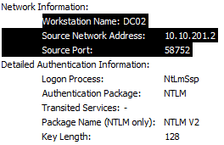
Forensic Analysis
Countermeasure for Anti Forensics
Recovering Deleted Event Records
Back-Tracking~!!
Pass the Hash
Network Share
Unallocated Space
Record
Header
Record
Record
Record
Record
Record
Record
Footer
Record
Notes:
(Click)
In most cases, attacker use “wevutil” command with “cl” options to delete event log.
(Click)
In this case, many event records are left in unallocated space after deletion.
In most cases, recovering event log by file unit carving is impossible because the log file is fragmented.
So, analyst have to perform record unit carving by each record’s signature.
(Click)
With this method, analyst can recover deleted event log and performs back-tracking.

Slide 25
Forensic Analysis
Countermeasure for Anti Forensics
Countermeasure(continue…)
Deleting job file
Job file is in $MFT with form of resident file due to the file size( < 870 byte ) ➔ Searching within $MFT
“MFT Modified Time” of “Tasks” folder is used to find attack time
Victim System
Notes:
In case of deleting job file,
(Click)
The analyst can find job registration time through “Tasks” folder’s time information.
As I said, creating job file changes “modified time” of “Tasks” folder.
In this timeline, winhlp64 is backdoor, so analyst can find out that attacker use “at” command to execute backdoor. Or can suspect the created file just after modifying “tasks” folder’s time information. In this case, winhlp64 can be suspected.

Slide 26
Forensic Analysis
Countermeasure for Anti Forensics
Countermeasure(continue…)
Deleting malware file
Analyzing file system log($LogFile, $UsnJrnl)
NTFS Log Tracker : https://sites.google.com/site/forensicnote/ntfs-log-tracker
Victim System
Notes:
In case of deleting binary,
(Click)
The analyst can find the trace of deleted file in NTFS file system log like $LogFile or $UsnJrnl.
These files contain all file system history including creation, modification and deletion of file or folder.
So, if analyst cannot find trace of deleted malware in $MFT, they can find that trace in this NTFS file system log.
And I developed “NTFS Log Tracker” to analyze these log files. This tool can be downloaded from this URL.
So, with this information, The analyst can find out when the backdoor is installed exactly.
Also, file name is useful.
In some cases, attacker or backdoor uses same file name continuously, so if The analyst find file names used by attacker, They can use this file names as keyword to analyze other systems.

Slide 27
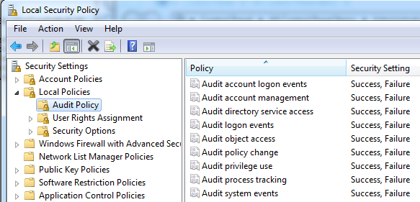
Forensic Analysis
Forensic Readiness
Event Log
Audit policy : Turn on all audits
Changing size of event log
Remote backup Server
Real-time Backup
The backup server should be excluded in domain.
Notes:
Unfortunately, default setting of artifacts I have explained is not suitable to trace the lateral movement.
For example, log size is too small and there are not various events in log.
So, some preparation is needed for future analysis. It is called forensic readiness.
(Click)
In case of Event log, All audits should be turned on and size of event log has to be changed more large.
(Click)
The best thing is event log backup.
It should be remote and real-time backup.
It makes tracing possible when the recovering deleted event log fails.
If this all jobs is conducted well, analyst can easily trace lateral movement in internal network.

Slide 28
Forensic Analysis
Forensic Readiness
$LogFile, $UsnJrnl
Changing size of log file
$LogFile : chkdsk /L:<size>(KB)
Usually 64M ➔ log data is saved for about 3 hours
One percent of volume size is recommended.
$UsnJrnl : fsutil usn createjournal m=<size>(byte) a=<size>(byte) <volume>
Usually 32M ➔ log data is saved for about 1~2 days
One percent of volume size is recommended.
Notes:
Also, the size of NTFS file system log has to be changed.
Basically, the size of these log is very small.
In case of $LogFile, it has events for about 3 hours.
In case of $Usnjrnl, it has events for about 1 or 2 days.
As I said, these log file contains all file system event, so it is very important to trace process of backdoor installation.
The more event is saved in these log files, the easier analyst can trace.

Slide 29
Forensic Analysis
Summary
Attacker System
Behavior | Artifact | Detail
Escalation of Privileges | Prefetch | Program Execution
 | Application Compatibility Cache | Program Execution
 | RecentFileCache.bcf | Program Execution
 | wceaux.dll | DLL of WCE
 | sekurlsa.dll | DLL of Mimitakz
 | Memory | String search
Attempting Logon | Security Event Log | Attempting Logon to another system with explicit credentials ID : 552(evt) or 4648(evtx)
Notes:
This is summary table I have explained so far.
There are another information I didn’t explained in consideration of short presentation time.
Just refer this information to your analysis.

Slide 30
Forensic Analysis
Summary
Victim System
Behavior | Artifact | Detail
NTLM Authentication | Security Event Log | Network Logon( ID : 540 or 4624 ) Logon Type : 3 Logon Process : NtLmSsp Package Name : NTLM V2 or NTLM
 | Network Traffic | Protocol : SMB2 Characteristics SessionSetup : NTLMSSP_NEGOTIATE SessionSetup : NTLMSSP_AUTH, Domain, Username TreeConnect : \\<IP or Host Name>\IPC$
Copying Backdoor | Security Event Log | File Share( ID : 5140 )
 | Network Traffic | Protocol : SMB2 Characteristics TreeConnect : \\<IP or Host Name>\<Share Point : C$, D$ … > Create Write
Remote service registration/execution | Security Event Log | Installing Service( ID : 4697 )
 | System Event Log | Installing Service( ID : 7045 ) Changing Service State( ID : 7036 )
 | Network Traffic | Protocol : SVCCTL Characteristics OpenSCManager CreateService or OpenService, StartService CloseSeviceHandle

Slide 31
Forensic Analysis
Summary
Victim System (continue…)
Behavior | Artifact | Detail
Remote job schedule registration and execution, deletion | Task Scheduler Event Log | Registering Job( ID : 106 ) Starting Job( ID : 200 ) Deleting Job( ID : 141 )
 | Tasks folder | Changing time information of “Tasks” folder by Creating “At#.job” file
 | Network Traffic | Protocol : ATSVC Characteristics : JobAdd
Remote execution with wmic | Security Event Log | Creating Process( ID : 4688 ) ➔ WmiPrvSE.exe
Remote registry registration | Software Registry | HKLM\SOFTWARE\Microsoft\Windows\CurrentVersion\Run
 | Network Traffic | Protocol : WINREG Characteristics OPENHKLM CreateKey QueryValue SetValue CloseKey
Remote execution with psexec | Security Event Log | File Share( ID : 5140 ) ➔ $ADMIN share Creating Process( ID : 4688 ) ➔ PSEXESVC.EXE
 | System Event Log | Changing Service State( ID : 7036) ➔ starting PsExec service
 | Network Traffic | Protocol : SMB2 Characteristics 1. TreeConnect : \\<IP or Host Name>\ADMIN$ 2. Create : PSEXESVC.EXE 3. Create : svcctl 4. Create : Target file

Slide 32
Forensic Analysis
Summary
Victim System (continue…)
Countermeasure for Anti Forensics
Forensic Readiness
Behavior | Artifact | Detail
Remote execution with winrs | Security Event Log | Creating Process( ID : 4688 ) ➔ winrshost.exe
 | Network Traffic | Protocol : HTTP Characteristics NTLMSSSP_NEGOTIATE : /wsman NTLMSSP_AUTH : Domain, Username
Behavior | Response | Detail
Deleting Event Log | Recovering Event Log | Record Carving
Deleting Job file | Keyword Search | Searching within $MFT
 | Confirming MFT Modified Time of Tasks folder | Guessing creation and deletion time of job file
Deleting file | Analyzing File System Log($LogFile, $UsnJrnl) | Using “NTFS Log Tracker”
Target | Response | Detail
Event Log | Remote Backup Server | Real-time backup Backup server not included in domain
 | Setting Audit Policy | Turn On all audits
 | Changing size of event log file | wevtutil sl
$LogFile, $UsnJrnl | Changing size of log file | $LogFile ➔ chkdsk $UsnJrnl ➔ fsutil

Slide 33
Case Study
Notes:
Next is real case analysis performed by our team based on the methodology I’ve explained

Slide 34
Case Study
Case Study 1 : Defense Contractor in South Korea
“This system is compromised.”
From. Mandiant
: Back Tracking
Office Network
(Not AD Environment)
All systems have same local administrator ID/PW…
Military Research Institute’s Web Server
➔ Watering Hole Attack~!!
Drive by Download
Notes:
First case is Defense Contractor in South Korea.
(Click)
Initial Detection of attack was notified from Mandiant.
Mandiant probably found some IPs of this contractor during their analysis.
So, we performed forensic analysis to this case.
(Click)
Unfortunately, all systems in this company have same local administrator account for management purpose.
This account is used by only administrator, not user. But attacker could use this account for lateral movement.
(Click)
After back tracking lateral movement, we could find that initial breach was “drive by download” from a specific website.
(Click)
But, this website was military research institutes, so employee of this company cannot help visiting this website for their job.
(Click)
Yes, it was a watering hole attack.

Slide 35
Case Study
Case Study 2 : Online Game Company in South Korea
: Back Tracking
Fiddling
Game Money~!!
Server Farm
(AD Environment)
Office Network
(AD Environment)
Analyzing
FTP Log
Opening Malicious Mail Attachment
DB
Using Domain administrator’s Credentials…
File Server
DB
Downloading
Nvidia Driver Installation Program (Malicious)
Recovering
Deleted
Event Records
Gateway Server Connected to Office Network
Gate Way
Private Line
Using Domain administrator’s Credentials…
Keylogging
Notes:
Second case is online game company.
(Click)
Initial Detection of attack was fiddling game money in Data base.
In this point, you probably don’t understand why hacker fiddles game money.
The reason of this attack is that online game money can be exchanged real money, big money in China due to the difference of exchange rate between South Korea and China.
So, we performed forensic analysis to this case.
(Click)
In this case, attacker deleted event log after each lateral movement, so we had to recover deleted event records.
(Click)
In the Server Farm, attacker use domain administrator account for lateral movement.
(Click)
After Back-tracking, we found gateway server connected with management system in office network through Private Line.
(Click)
And then, in management system, we found that attacker performed keylogging to acquire ID/PW for connecting gateway server.
(Click)
Also, attacker used domain administrator account for lateral movement in office network.
(Click)
After Back-tracking, we found that user downloaded Nvidia Driver Installation program from File Server.
This program contained malware.
At that time, Our client wondered why attack continued after formatting all client systems in office network.
This was the reason that attacker could dominates systems after all client systems were formatted.
Yes, user installed Nvidia Driver after formatting their system.
(Click)
So, we analyzed FTP log and found the system uploading this program.
(Click)
In this system, we found trace of opening malicious mail attachment pretending Security Manger like “Execute attachment for regular security check” in Korean…
I think there were someone who can speak Korean in attacker’s group.
This social engineering was the initial breach of this attack.

Slide 36
Conclusion
Notes:
Next is Conclusion.

Slide 37
Conclusion
APT Lateral Movement
Moving laterally to find targeted server in internal network
Using windows authentication protocol ➔ Difficulty of classification
Necessity of Forensic Analysis ➔ Removing Root cause through tracebacking.
Forensic Analysis
Tracing NTLM Authentication
Finding Malware
Countermeasure for Anti Forensics
Forensic Readiness
Notes:
(Click)
APT Lateral movement is spreading backdoor to search targeted system in internal network.
And it is difficult to distinguish from normal behavior, because attacker uses normal windows authentication protocol.
So, we have to use digital forensic skills to trace this movement.
(Click)
In forensic Analysis,
analyst have to focus NTLM authentication event and malware execution.
And we should prepare the attacker’s anti forensic behavior.
In addition, if we can perform forensic readiness for future analysis, it is the best way to prepare analyzing APT Lateral movement.

Slide 38
Notes:
Thank you.
This is end of my presentation.
I hope my presentation will be helpful to your future analysis.

Slide 39
Q&A
blueangel1275@gmail.com

Slide 40
Reference
Mimikatz : http://blog.gentilkiwi.com/mimikatz
WCE : http://www.ampliasecurity.com/research/wcefaq.html
Authenticated Remote Code Execution Methods in Windows : http://www.scriptjunkie.us/2013/02/authenticated-remote-code-execution-methods-in-windows/
Mitigating Pass-the-Hash (PtH) Attacks and Other Credential Theft Techniques : http://www.microsoft.com/en-us/download/details.aspx?id=36036
Trust Technologies : http://technet.microsoft.com/en-us/library/cc759554(v=ws.10).aspx

