Slide 1
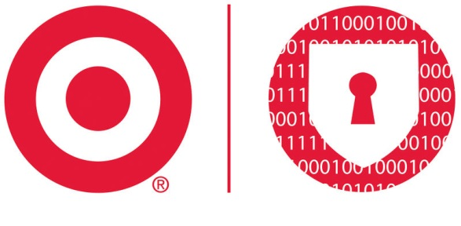
FIRST CTI – LONDON Target Cyber Threat Intelligence (CTI) Team: BUILDING, RUNNING & MAINTAINING A CTI PROGRAM MARCH 2019

Slide 2
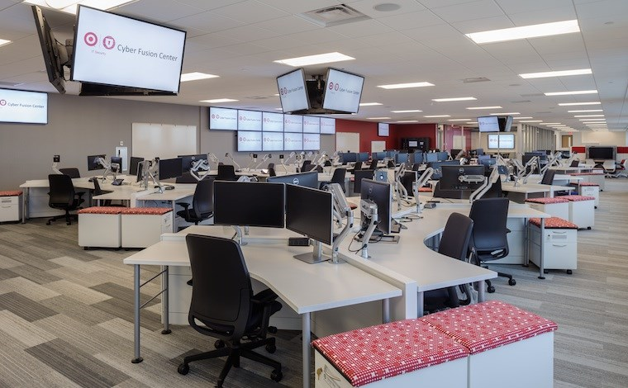
WHO ARE WE?
MICHAEL SCHWARTZ
Target Corporation – Director
Threat Intelligence & Detection Engineering
20+ yrs Information Technology / Security
FBI
Lookout
RYAN MILLER
Target Corporation - Sr. Manager
CTI (Strategic Intelligence)
16+ yrs Intelligence Analysis (8 Cyber)
USG: Cyber Intel Analyst
US Army: Intelligence Collection / Analyst
Who Are WE?
Target: Cyber Threat Intelligence Team (CTI)
Fusion Center Model / CFC
Strategic Threat Intel Team
Threat Intelligence & Detection Engineering (TIDE)
Reactive // → Very Proactive // + Predictive
Notes:
This report contains CONFIDENTIAL material and is not authorized for external disclosure. Do not distribute outside of the Cyber Fusion Center

Slide 3
ESTABLISHING A THREAT INTEL TEAM - INTRO

Slide 4
ESTABLISHING A THREAT INTEL TEAM
Establishing a CTI Program is Not Easy…
Establishing a Successful CTI Program is Hard…
Why Do You NEED Intelligence?
Does Your Organization Need a CTI Function?
Notes:
Why do you need intelligence?
Do you know your whole threat landscape?
Do you know what threats to be concerned with?
Do you know threat actor tactics? Capabilities?
Does your org even need a CTI function?
Do you need a team? One analyst?
Is CTI mandated? Supported
Are you fighting to educate up?
Is intel driven by media / vendors?
Is your SOC generating an overload of alerts w/ no way to prioritize?
Do you have a realistic way of justifying CTI need/spend?
We (the CTI community) like to compare CTI programs…
“My CTI program is this big. We ingest XX million IOCs per day. We generate thousands of alerts.” – all of these are examples of the wrong way to go about justifying your program.

Slide 5
ESTABLISHING A THREAT INTEL TEAM
Many Approaches
Many Definitions
Many Analytical Models
Many Maturity Models
Lots of Confusion

Slide 6
Most Common Misconception
External Data Feeds
Internal Log Data
Technology Platform
CYBER THREAT INTELLIGENCE
+
+
=
Purely Technical
Often Misses Strategic Intel Aspects
Inherently Reactive
Notes:
Most from a purely technical background view threat intel as this

Slide 7
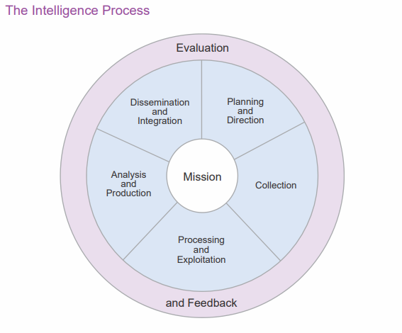
The “IC” Misconception
Production Driven
Often Lacks Deep Technical Analysis
Vendor Reliant

Slide 8
ESTABLISHING A THREAT INTEL TEAM - BASICS

Slide 9
Simplified Maturity Model
Reactive
Proactive
Predictive
No One Right Way To Run An Intel Program…
Plenty Of Ineffective Ways
Notes:
Prediction Does Not Require Machine Learning & Artificial Intelligence
Never underestimate the power of an analyst with an excel spreadsheet – and TIME.

Slide 10
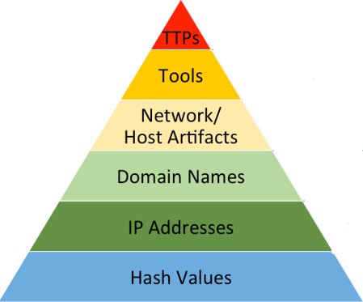
TASKS / PRIORITIES
Building a threat intel TEAM
PIRs
Strategic Analysis
Intel Production
Threat Landscape
Actor Tracking
Threats / Trends
Vulnerability Tracking
External Engagement
CUSTOMERS
Global Threat Landscape
Campaign Analysis
Intent / Capability
TTPs
Threat Actor Tracking
InfoSec / Ldrs
IT / Infra
BISO / LOB
TIDE
Broader Org
Intelligence Skill Set
TTPs
Strategic Team
TTPs
Tools
Network Artifacts
Atomic IOCs
Event Details
Technical Team (TIDE)
Cyber Security Ldrs
CSIRT
Red Team
Strategic CTI
Target CTI Model
Technical Analysis
CSIRT / Case Support
Phishing Tracking
Infra Tracking
Detection Signatures
Detection Engineering
Technical
Skill Set
CUSTOMERS
TASKS / PRIORITIES
Notes:
This report contains CONFIDENTIAL material and is not authorized for external disclosure. Do not distribute outside of the Cyber Fusion Center

Slide 11
Building a threat intel TEAM
Global Threat Landscape
Campaign Analysis
Intent / Capability
TTPs
Threat Actor Tracking
Greater Threat Landscape Visibility
Threat Actor Prioritization & Tracking
Phishing / Malware Tracking
Full Intelligence Lifecycle Analysis
Kill Chain Analysis
Predictive Analysis
ENABLES
TTPs
TTPs
Tools
Network Artifacts
Atomic IOCs
Event Details
Target CTI Model
Notes:
This report contains CONFIDENTIAL material and is not authorized for external disclosure. Do not distribute outside of the Cyber Fusion Center

Slide 12
Building a threat intel TEAM
You Have The Most Data
Narrow Scope & Focus
Technical Analysis Before Analytic Production
Dedicated (Templates) Over Undefined Processes
Continually Refine Processes
Automate Wherever Possible
Share!
Reward, Train, Explore
8 Basic Principles
Notes:
This report contains CONFIDENTIAL material and is not authorized for external disclosure. Do not distribute outside of the Cyber Fusion Center

Slide 13
ESTABLISHING A THREAT INTEL TEAM - EVOLUTION

Slide 14
0.5 - 1 FTE
Vulnerabilities
Vulnerability Tracking & Analysis
Dedication To Vulnerability Tracking Can Help Prioritize Threats
Supports Developing Mitigation Controls
Notes:
Nearly every environment benefits from vulnerability analysis.
How many of you out there have some sort of vulnerability management team?
How effective would you say they are at prioritizing vulnerabilities to be patched?
Do you think they are lacking information to do so?
I would argue that the most valuable and perhaps highest ROI for any intel program is your relationship with your vuln management team.
Prioritization of key vulnerabilities
Quicker mitigation
Supports Developing Mitigation Controls:
Is there something you can turn off?
Something you can block?
Something you can stop from running in environment?
This relationship also allows you to build compensating controls. Is there something we can turn off? Most of the recent Microsoft Office abuse could be dealt with by making some registry changes, sometimes with no effect to the end user.
There’s load of value here. One person, not writing strategic intelligence, just focused on vulnerability analysis. This will get you started.

Slide 15
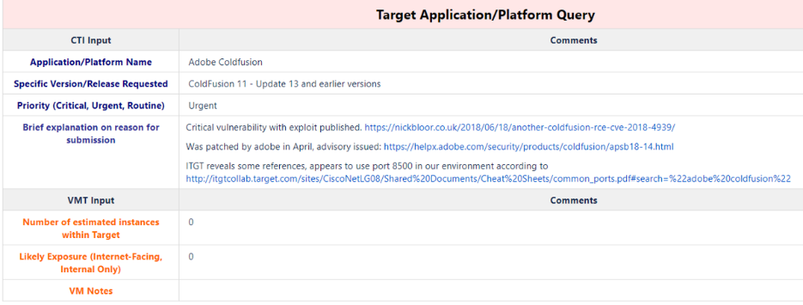
Developing Processes ENABLES Consistent & Repeatable Actions
Vulnerability Tracking
Notes:
Repeatable Actions → Proactive Analysis → Escalate Patching
A dedicated analyst ca hunt for threat characteristics:
Dark Web Intelligence → Early Warning
Which Vulnerabilities are Gaining Interest?
POC or Exploit?

Slide 16
2 FTEs
Vulnerabilities
Phishing
Phishing Analysis
Analyzing Phishing Data Can Outline Your Active Threat Landscape
Supports Developing Mitigation Controls
Notes:
If you’re not analyzing phishing, you likely have little knowledge about the single most persistent & utilized infection vector
Do you know about all the campaigns that hit your org?
Payloads / Commodity malware / Frequency
Targeted phishing vs widespread?
Analyzing Internal Phishing Data Can Help:
Understand its active threat landscape
Generate intel / IOC generation
Identify gaps in security
Track persistent threat actor TTPs
Supports Developing Mitigation Controls:
Domain / infrastructure tracking
Early alerting
IOC correlation / connections

Slide 17
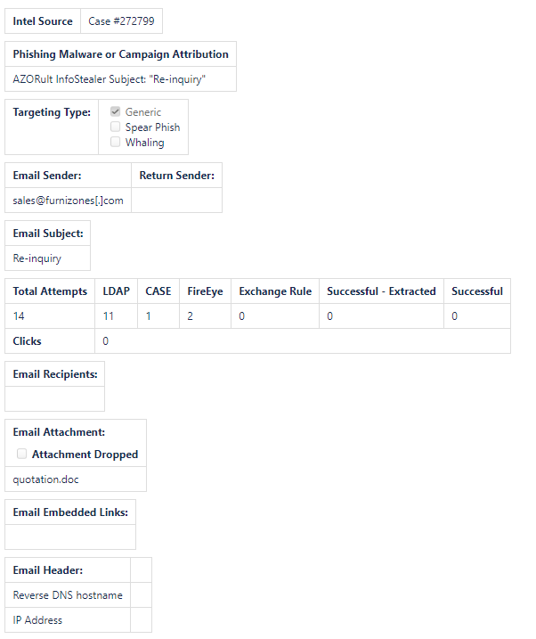
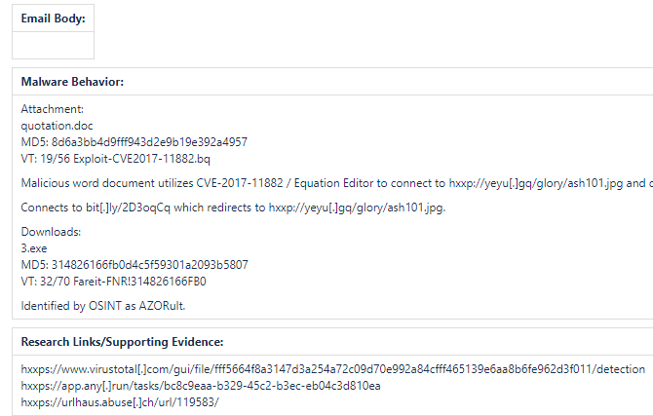
Developing Processes ENABLES Consistent & Repeatable Actions
PHISHING ANALYSIS
Notes:
Repeatable Actions → Catalogue data → Prioritize active phishing threats / intel & detection gaps
What Data is Most Important?
Campaign Correlation?
What can you share?

Slide 18
3 - 4 FTEs
Vulnerabilities
Phishing
Trend Analysis
Daily Intel
Threat Trends & External Intelligence Research
Analyze Captured Data For Trend Analysis
Current Threat Landscape Reporting That Is Actionable
Notes:
3 - 4 FTEs – Vulnerabilities / Phishing / Strategic Trends & Daily Reporting
Generating ANY intel reporting should only happen after basic technical analysis is routine
Trend Research / External Threat Landscape / IOC context
Maintain vulnerability & phishing intel
Begin prioritizing threat actors / develop process
Establish Daily Intel reporting
Participate in info sharing – SHARE intel to RECEIVE intel
Analyze data for trend analysis
Focus To Answer:
What adversaries are you most concerned about and why?
How can you track them?
Where are you getting intel? Buy? Build?
How can your team consume intel? Where is it stored? How is it actioned?
You don’t need an intel team to build a curated news feed. Stop this nonsense. If that’s what you want, setup an RSS feed, Google news filter, or peruse Twitter.
Try to answer these questions:
What adversaries are you most concerned about and why?
How can you track them?
Do you need to buy an intel feed or can you build something?
Once you have this intel, how can your tech team consume it?
How can the tech team action it?
Last note on building – You can have a fantastic intel team and produce great content, but if the other entities in your organization are not setup to consume it, you are placing a heavy burden on your intel team to succeed.

Slide 19
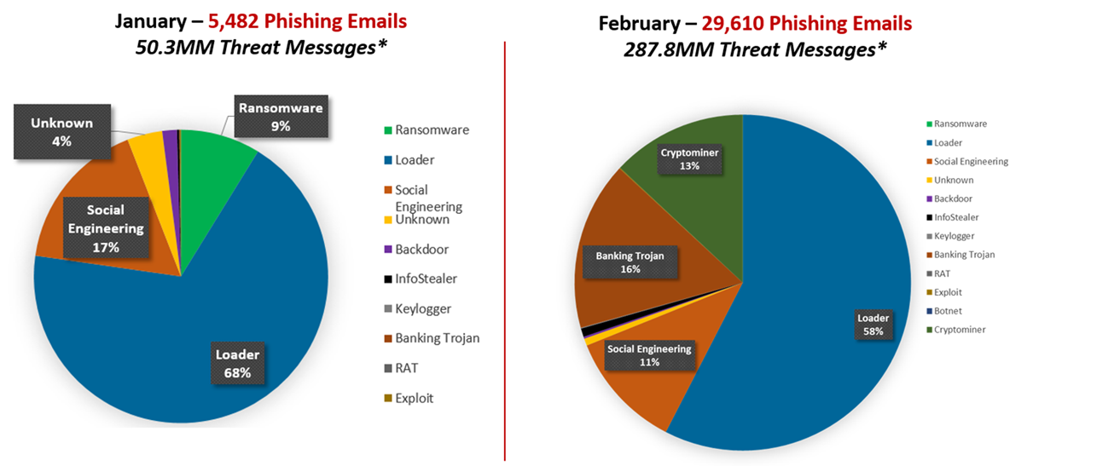
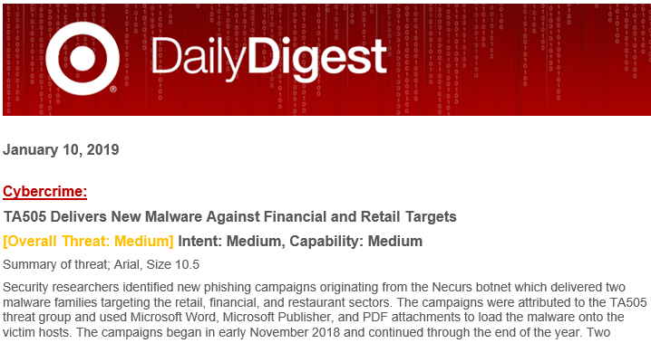
Deliver Specific & Tailored Intel To LEADERSHIP & Business Units
Trend Analysis
Daily Intel
Notes:
Trend Analysis → Easy Once Process Established

Slide 20
5+ FTEs
Vulnerabilities
Phishing
Trend Analysis
Daily Intel
Actor Tracking
Strategic Analysis
Fraud Support
Business Risk
Threat Actor Tracking / Strategic Analysis / Intel Support
Develop Workflow For Tracking Actors & Intelligence Production
External Team Support
Notes:
After you’ve established your technical intelligence team, you may proceed with building a strategic intelligence operation. This team can do many things, but where you’ll be the most effective is enumerating threat actors, prioritizing them, and developing a long-term tracking program that you’ll leverage your tech team for.
One of the LAST things a CTI program should do is generate / publish analysis.
Threat Actor Tracking / Campaign Analysis / Generating IOCs
Develop threat actor tracking workflow
Establish documentation / methods to capture data
Conduct behavioral analysis for enhanced detection
develop a long-term tracking program that you’ll leverage your tech team for.
Develop Workflow For Strategic Intelligence Production
Produce detailed analysis of key threats
Engage leadership with strategic production – impact / mitigation
External Team Support
Intel to business risk
Fraud / ATO
Red Team
You can have a fantastic intel team and produce great content, but if the other entities in your organization are not setup to consume it, you are placing a heavy burden on your intel team to succeed.

Slide 21
ESTABLISHING A threat INTEL TEAM - EVOLUTION
Growth of a CTI Team is a Step-by-Step Approach
FOCUS to stop REACTING
PRIORITIZE to Demonstrate VALUE
Focus on IMPACT not OUTPUT
SHARE & PARTICIPATE
Wash, Rinse, Repeat…
Summary
Notes:
This report contains CONFIDENTIAL material and is not authorized for external disclosure. Do not distribute outside of the Cyber Fusion Center

Slide 22
RUNNING & MAINTAINING A THREAT INTEL TEAM

Slide 23
Running & maintaining a threat intel team
Successful CTI Programs Require Leadership Support
CISO Should Drive Security By Threats (Over Risk)
CTI: Define Actual Threats → Replacing Hypothetical Risk

Slide 24
Running & maintaining a threat intel team
CTI Needs To Know ENTIRE Org
Assessing threats requires knowledge of EVERYTHING
Hardware / Software / Platforms / Vendors / Access / Initiatives
Developing a CTI Team is HARD WORK → Doing it Over is HARDER
Retention
Training? Education? Conferences? Freedom? Growth?
Employees Interests / Desires / Motivations
Everyone finds interest in different areas
Offer changes / growth
Summary
Notes:
CTI Needs To Know ENTIRE Org
Assessing threats requires knowledge of EVERYTHING
Hardware / Software / Platforms / Vendors / Access / Initiatives
Developing a CTI Team is HARD WORK → Doing it Over is HARDER
Retention / Development is KEY
What does your org offer team members?
Training? Education? Conferences? Freedom? Growth?
Employees Interests / Desires / Motivations
CTI can be monotonous → Everyone finds interest in different areas
Keep your analysts engaged
Offer changes / growth
Your program will likely fail or be rendered non-effective without the full support of executive leadership including the CISO. The CISO should actively be driving priority intelligence requirements. The oft used “What keeps me up at night!” Figure out what that is and how your CTI team can collect.
You will likely need your CISO to drive a strategic shift to primarily address threat rather than risk (don’t get me wrong, risk is still important, but not to your intel program). If your CISO makes you a priority, you’ll likely be one.
With this priority, engage business units, make in-roads, learn about your entire org as much as you can.
Ask yourself, what information do these units need (collection requirement) and what do you know about the threat that could affect this unit (e.g. Marketing wants to stand-up a Wordpress site in DigitalOcean to test… )
Wash, rinse, repeat
A couple words on maintaining
Retention and development will be your hardest job.
This market is hot and one can pretty much go anywhere.
Some aspects of CTI can be monotonous and simply be a turn-off after a couple of years. The same security issues happening over and over may break some.
Most intel teams will be small, which doesn’t leave a lot of upward mobility.

Slide 25
MEASURING SUCCESS OF A CTI PROGRAM

Slide 26
MEASURING SUCCESS OF A CTI PROGRAM
Qualitative vs Quantitative
How Do You Measure Intelligence?
Qualitative Measurements For CTI:
Was leadership surprised by an event?
Has CTI impacted business process to initiate change?
What business units have incorporated CTI into workflow?
Notes:
– How do you measure INTELLGIENCE?
Successful Intelligence: Measurement Of Leadership Awareness & Advanced Actionability / Detection
QUANTITATIVE Measurements Of Intelligence = Counterproductive
How many IOCs ingested? WRONG
How many alerts do we have? WRONG
How many products did we produce? WRONG
Qualitative Measurements For CTI:
Was your leadership ever surprised by a cyber event?
Has CTI impacted business process – initiated change?
What business units have incorporated CTI into workflow?
Does managing / mitigating incidents become more timely w/ intelligence?
Quantitative, meaningful metrics are extraordinarily hard to come by. However, there is some great work in this space that I was fortunate to be a part of. David Bianco built a framework for measuring an intel team from the inside. Essentially saying, How do we measure the retrievability of intelligence? How do we measure intelligence coverage against our highly-ranked threat actors? Try not to focus on measuring your output for outputs sake. Focus on measuring what your team has deemed high-priority and build lead measures around that.
Let’s quickly focu on the vuln management portion of your program. How many remediation cases was CTI involved in and what’s the percentage of total? – Time will tell you what this number should be. Then have vuln management give specifics on how CTI helped and where the wins occurred.
Let’s take a quick shot at quantitative metrics. Some of these don’t scale well without automation. How many threat actors groups and infrastructure are you tracking? Of the what you’re tracking, what’s the lead time to detect (e.g. from when you identified and deployed detection to when it hit your environment). How long does it take you to deploy detection once you’ve identified infrastructure? How long does intel sit in an unevaluated state (e.g. you have info on malware or a threat actor, but it’s sitting in a backlog waiting for further analysis)? Of the threats you track, what’s the percentage of infrastructure you’ve developed advanced warning on?

Slide 27
Final thoughts
CTI is Hard Work…
CTI is a Team Sport
Very Little History of CTI to Model After
Forge Your Own Path
Share Successes & Failures To Grow
Thank You!
Notes:
Sharing successes and failures allows others to level-up without the pain we went through.
This is important as the old adage goes “you don’t have to be the fastest, you just have to be faster than the slowest guy.”
However, I do not believe it is reasonable to leave someone behind to “figure it out” – basically chumming the waters and waiting for the sharks.
The more competent CTI programs out there, the more analysts that are tracking adversary activity, the more threat actor intelligence that is available, and thus – hopefully – a more secure environment is created through the sharing of this intelligence.

Slide 28
Bottom line
Highly Motivated, Sophisticated & Persistent Threat Actors Want To Steal Sensitive Data From Your Organization –
Competent & Effective CTI Programs Are Not Optional
Thank You!
Notes:
Sharing successes and failures allows others to level-up without the pain we went through.
This is important as the old adage goes “you don’t have to be the fastest, you just have to be faster than the slowest guy.”
However, I do not believe it is reasonable to leave someone behind to “figure it out” – basically chumming the waters and waiting for the sharks.
The more competent CTI programs out there, the more analysts that are tracking adversary activity, the more threat actor intelligence that is available, and thus – hopefully – a more secure environment is created through the sharing of this intelligence.

Slide 29
QUESTIONS?

