Slide 1
Security Boot Camp
Dr. Serge Droz
serge.droz@first.org

Slide 2
Copyright
Copyright © by Forum of Incident Response and Security Teams, Inc.
FIRST.Org is name under which Forum of Incident Response and Security Teams, Inc. conducts business.
This training material is licensed under Creative Commons Attribution-Non-Commercial-Share-Alike 4.0 (CC BY-NC-SA 4.0)
FIRST.Org makes no representation, express or implied, with regard to the accuracy of the information contained in this material and cannot accept any legal responsibility or liability for any errors or omissions that may be made.
All trademarks are property of their respective owners.
Permissions beyond the scope of this license may be available at first-licensing@first.org
Notes:
FIRST Training materials are available for non-commercial use under a CC license. We would appreciate if you let us know that you use it: Send a mail to first-sec@firtst.org with your feedback

Slide 3
What you will learn
The internet seems without boundaries, it’s essential for our work and it reaches nearly every corner of the planet. It is a great tool.
But the internet has its dark corners.
In this training you will learn what the internet is, how it functions and what you have to watch out for to move security.
Notes:
Foto © Serge Droz, Kara-Kum Desert, Turkmenistan

Slide 4
Program
Introduction
Basic functioning of the Internet
Illicit use of the internet
Best practices for a safe experience
If things go wrong: Incident response

Slide 5
What is FIRST?
Association of 420 incident response teams in 86 countries.
Improve incident response by:
  Making sure members can find help during an incident within our global community
  Ensure the teams ”speak the same language” (have a similar understanding of the world)
  Make sure they can focus on decision making and have access to tools to do the difficult work
  Ensure stakeholders understand what our members do, and why it is important
5

Slide 6
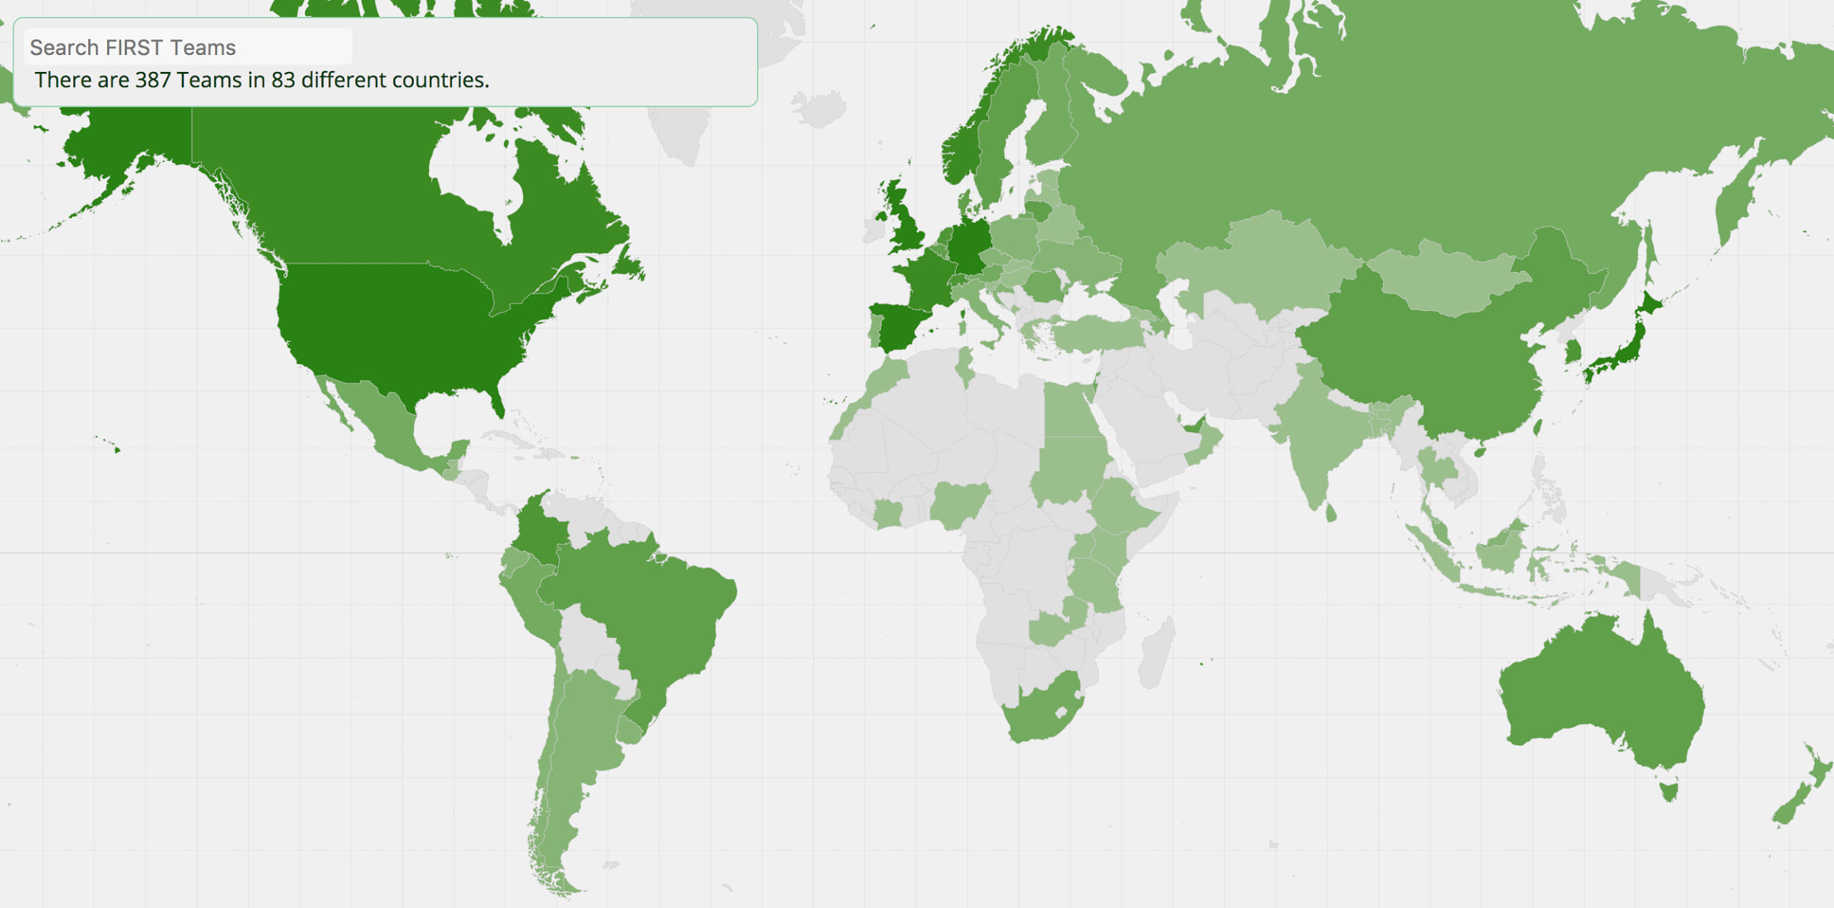
Membership
Global FIRST membership
420 teams in 86 countries
FIRST – A Global Community
6
Notes:
Note to Presenter: You can obtain the latest map / stats here - http://www.first.org/members/map
Today, FIRST is comprised of over 300 members in 70 countries.
6

Slide 7


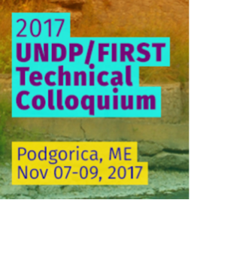
Events
Conference
Flagship event
Once per year, travels between regions
~500-800 attendees
Symposium
Four per year
Typically in each major region (Africa, Europe, Latin America, Asia)
Hosted by FIRST and often a partner
Technical Colloquium
Organized by individual members
National or regional event
Typically 10-15 events per year
Notes:
FIRST organizes three types of events annually: the conference, up to four symposia, which are typically regional, and many TC’s, which are organized by individual members.

Slide 8
Global events 2017-2018
Events

Slide 9
Training and education
FIRST maintains a CSIRT and PSIRT Services Framework
  Details all services typically offered by CSIRT
  Offers a roadmap and guide for CSIRT as they expand capability
FIRST develops training for individual services
  CSIRT Fundamentals, Incident Coordination, Information Sources
  All materials are Creative Commons licensed and available for free
FIRST delivers training with partners and at events
  Roster of trainer-practitioners

Slide 10
Other Players
FIRST primarily addresses incident responders. There are other organizations which have similar goals but different stakeholders. FIRST partners with many of those. Noteworthy are:
APWG is the international coalition unifying the global response to cybercrime across industry, government and law-enforcement sectors and NGO communities.
M3AAWG: The Messaging, Malware and Mobile Anti-Abuse Working Group (M³AAWG) is where the industry comes together to work against bots, malware, spam, viruses, DoS attacks and other online exploitation.
Notes:
There are other organizations with a similar goal, but a different focus
Antifishing Workign Group APWG, which runs stop.think.connect
The Messaging, Malware and Mobile Anti-Abuse Working Group (M³AAWG)

Slide 11
CC BY 2.0 Paul Downey
Notes:
https://www.flickr.com/photos/psd/4389135567
Introduction round: Rather than everyone saying his name we try to acitvate the group by aksing them a few questions hand have them move to either side of the room, depending on their answer. This visualizes answers and gets people talking.
Possible questions are:
Do you read more than two-three articles on cybersecurity?
Who comes from a country with a national CSIRT? Yes/No/I don‘t know
Who thinks government have a role in cybersecurity?
Who thinks governments can solve most cybersecurity problems?

Slide 12
Security Quiz
Have you ever been affected by a virus?
Do you know what 2 factor authentication is?
Do you use 2 factor authentication?
Are your sure you commuters are up to date?
All software on it?
Do you know how many devices you have that connect to the internet?
Notes:
In a classroom situation ask people to group according to answers. In the Video training ask people to reflect abut these question themselves.

Slide 13
Answers
Have you ever been affected by a virus?
A: Chances are you have: In some countries nearly 50% of the devices are infected with some form of malware
Do you know what 2 factor authentication is?
A: @FA requires a second factor, besides a password, to authenticate to a service, e.g. a smart card, or a code sent by SMS. Thus a compromised password sill does not let an attacker access your data.
Do you use 2 factor authentication?
A: You should: It’s easy to use and available in nearly all services today, such as gmail etc.

Slide 14
Answers
Are your sure you commuters are up to date?
A: Enable auto update on all systems possible
All software on it?
A: Many vulnerabilities occurs in Software, such as Word processors or web browsers. You will lean more about this, but make sure your software is up to date too.
Do you know how many devices you have that connect to the internet?
A: At a typical FIRST conference participants on average have about three devices with an IP address: Laptop, Phone, tablet, Photo cameras, …

Slide 15
Internet basics
Notes:
Image: CC0 https://pixabay.com/en/network-iot-internet-of-things-782707/

Slide 16
Internet Address
IPv4: 32 bits 123.4.122.112 → 43 Billion addresses
IPv6: 128 bits 2a02:168c:581:10:74b3:96d3:c75f:45d3
→ 3.4 x 10³⁸
Notes:
The basic addressing element in the internet is the, well, internet address. Most devices use IPv4 addresses, which have run out.
The IPv6, some tomes called new internet protocol, even though it about as old as the IPv4 protocol uses 128 bits, which allows for plenty of addresses. But this protocol, because it’s a bit more complicated is not yet widely used.

Slide 17
Internet Address-Ranges
123.4.122.112 = 01111011.00000100.01111010. 01110000
All addresses 123.4.122.*
01111011.00000100.01111010.00000000 -> Last 8 bit = 0
32-8 = 24
CIDR notation 123.4.122.0/24 = 123.4.122.0 - 123.4.122.255
Notes:
We often need to to have more than just one address, namely a collection or network of addresses (e.g. all computers on this floor). For this we use the cidr notation. It’s based on binary arithmetic and thus suitable for computers to work with.

Slide 18
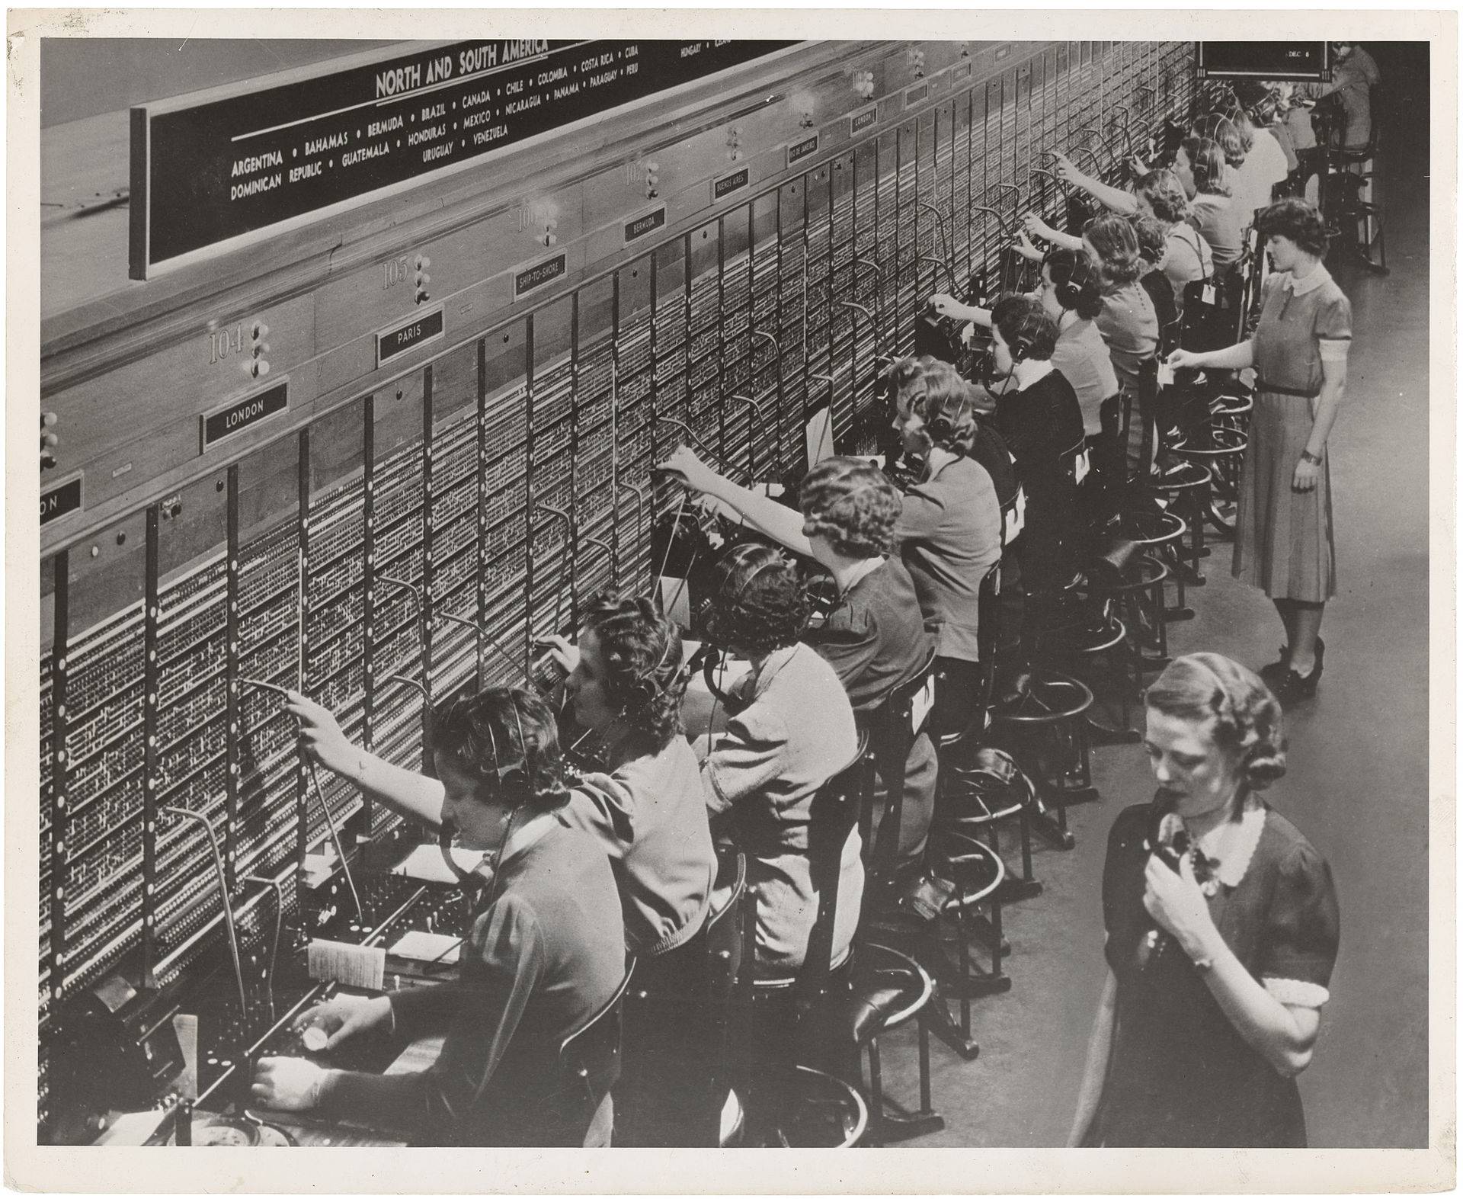

Connecting computers: Routing
Telephony: Switched routing: A fixed line is established between two endpoints
Internet: Packet routing
Data is split into packets and routed at the edges to the destination
Router
Notes:
In classical telephony a standing connection is established between two endpoints. In the internet however information is separated into chunks (a few hundred bytes), called packets. These are transported to a router, a computer specialized in handling this packet. It contains huge tables for all internet addresses that tell him where to send it. Once he figures out which the next router is the packet is handed over, until it reaches its final destination. This is much more efficient then a switched network, as a connection does not tie up resources and endpoints can have many connections open at the same time. (Just send out packets to different destinations.
Note, that the reply does not necessarily need to travel the same way
Copyright Foto: The U.S. National Archives @ Flickr Commons

Slide 19
Autonomous systems
Organisations typically manage many address ranges. These are collected into so called autonomous systems (AS)
AS2
AS3
AS1
AS4

Slide 20
Autonomous systems
Routing table
AS2 AS1 99.1.2.0/24
AS4 9.1.3.0/24
Routing table
AS4 AS3 1.2.3.0/24
AS4 9.1.3.0/24
AS2
AS3
AS1
AS4
Notes:
Routers now which network knows how to pass info on the the destination IP
Routers advertise what info they know (This is called the border gateway protocol, BGP)
Autonomous systems can be very small or very big and are not tied to national boarders, but rather to companies like ISP or organisations, like the UN

Slide 21
Some interesting AS
AS22723: United Nations
AS1: Level 3 Parent, LLC
AS48751: COLT -> Manages network for UN Geneva
AS9092: Open Systems AG
…..

Slide 22
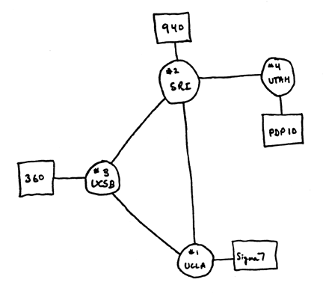
Global Topology (1969)
Source: https://www.darpa.mil/about-us/darpa-history-and-timeline?PP=2

Slide 23
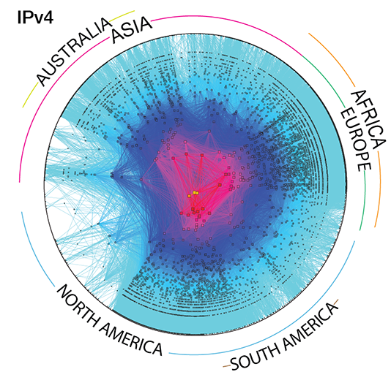
Internet Topology (2017)
Source: https://www.caida.org/research/topology/as_core_network/2015/

Slide 24
Notes:
Think of an internet address as a street name. There might be different ways to get there and there are different places to go to.
Image: CC0 https://pxhere.com/en/photo/86816

Slide 25
Protocols
The internet runs on the Internet Protocol
On top of this are different other protocols
TCP: Transmission Control Protocol
For stateful connections
UDP: User Datagram Protocol
For stateless conections
ICMP: The Internet Control Message Protocol
Control traffic

Slide 26
Ports
UDP and TCP user ports think street numbers
Each connection is a tuple:
Source IP, Source Port, Destination IP, Destination Port
What do I want
Where do I go to
Keeps track of connections
Where do I come from

Slide 27
Example https:
165.156.40.27:7550 -> 172.217.168.36:443
172.217.168.36: www.google.com
443: https
Others:
25: smtp →Simple mail transfer protocol
80: http (without the s for secure)

Slide 28
DNS
Who can remember the IP from the last slide?
Right, no one!
😃 www.un.org ← We need this
↓
Domain Name System
↓
😰 157.150.185.49 ← Computers need this
Notes:
The DNS is a globa distributed hierarchical database. For each level there is a server responsible

Slide 29
DNS
Root Servers | . | IANA
Toplevel Domains (TLD) | org. | Registries
Second level Domans | un.org. | .Org
Third level domain | www.un.org. | UN
Q: www.un.org ask Root server. A: I don’t know, but check Server for org. here
Q: www.un.org ask Org server. A: I don’t know, but check Server for un.org. here
Q: www.un.org ask UN server. A: Yep, that’s 157.150.185.49

Slide 30
Tunnels
Do you see a problem here?
AS2
AS3
AS1
AS4

Slide 31
Tunnels
Do you see a problem here?
The intermediary could eavesdrop on the traffic!
AS2
AS3
AS1
AS4

Slide 32
(one) Solution: VPNs
Encrypt traffic to specific destinations
→ VPN: Virtual Private Network
AS2
AS3
AS1
AS4

Slide 33
VPN Point of View
It looks as if all computers are in the same network
AS1
AS4

Slide 34
The dark side of the net
CC2.0 Diogo Rodrigues Gonçalves

Slide 35
Actors & Tactics

Slide 36
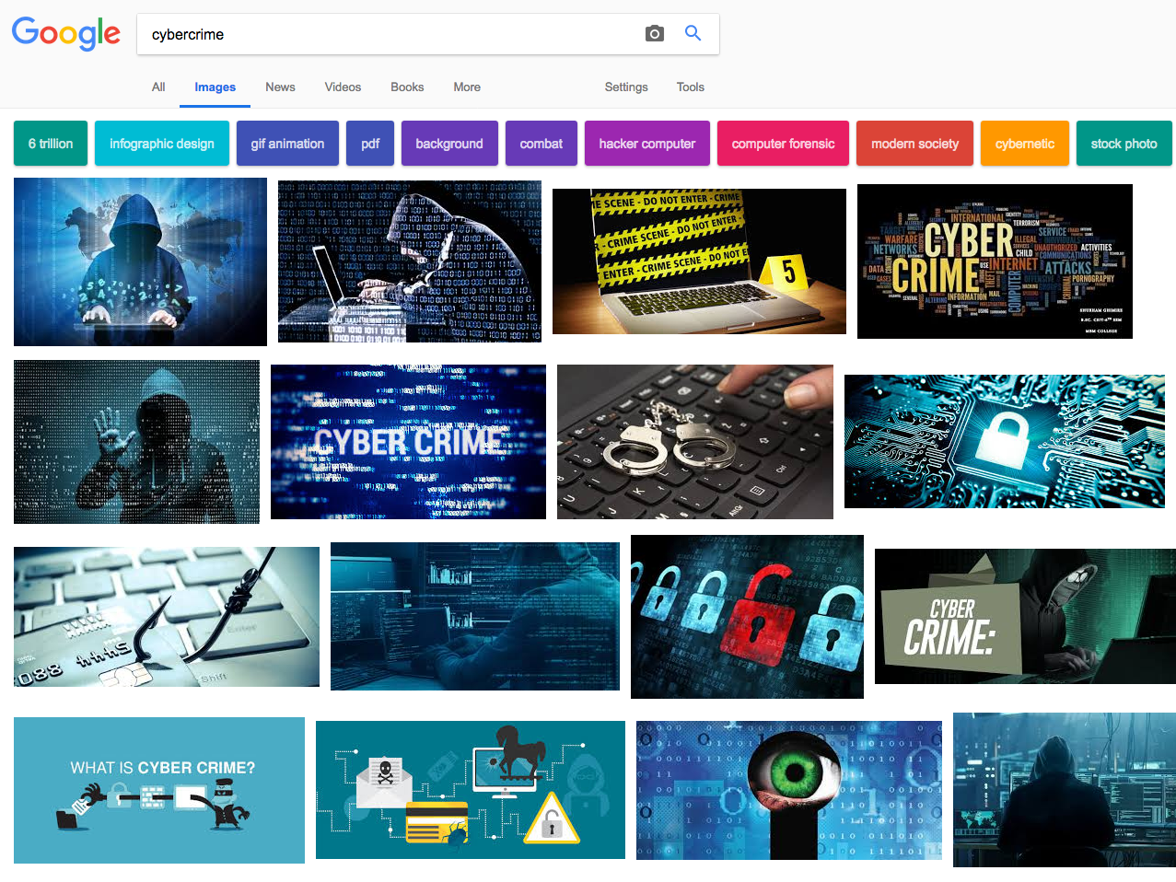
Notes:
Cybercrime is a big word, Google finds a gazillion hits. But are the bad guys really waring hoodies and baklavas?
Do they steal punched credit cards? What the heck are they doing?

Slide 37


Notes:
What are we talking about? This story begins, like so many in this game, with a hacked device. But what does it take to to hack this device? And why would you do this? Let’s explore these questions briefly!

Slide 38


Notes:
This you do with so called injects, all available in the under ground market.

Slide 39
From: tovis@bk.ru
To: info@hackingteam.com
Subject: 0-days
Hi, is your company interested in buying zero-day vulnerabilities with RCE exploits for the latest versions of Flash Player, Silverlight, Java, Safari?
All exploits allow to embed and remote execute custom payloads and demonstrate modern techniques for bypassing ASLR- and DEP-like protections on Windows, OS X and iOS without using of unreliable ROP and heap sprays.
From: d.vincenzetti@hackingteam.com
To: tovis@bk.ru
Subject: 0-days
Absolutely.
Would you please elaborate your offer?
Regards,
David
--
David Vincenzetti
CEO
Hacking Team
Source: Wikileaks
Notes:
Here is an example of how 0-days are traded. This is a shady Business with many plyers, most notably government players

Slide 40
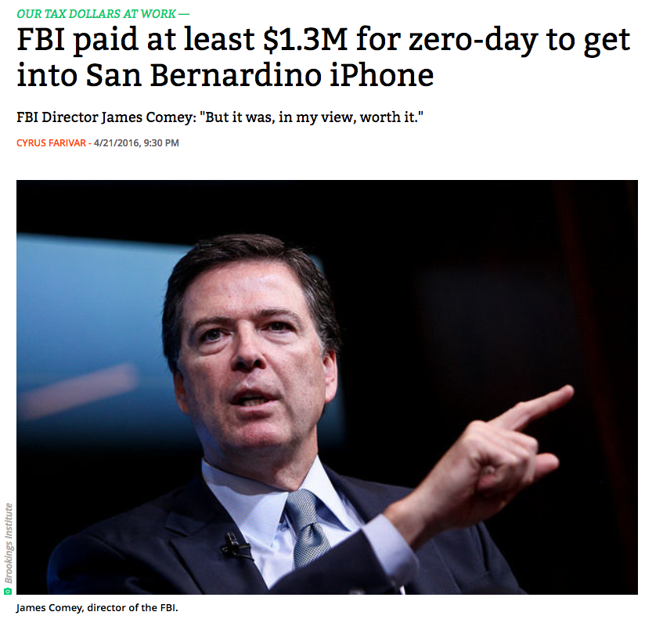
https://arstechnica.com/tech-policy/2016/04/fbi-paid-at-least-1-3m-for-zero-day-to-get-into-san-bernardino-iphone/
Notes:
E.g. the FBI payed 1.3 Million dollars to read one phone. This is a fairly high price, typically the prices are around 250‘000 $
Older exploits (~ 6 mt – 1.5 years) go for a few thousend $$

Slide 41

Notes:
So no you can exploit. You now need an infrastructure to deliver these to victim systems. This is a service, which goes under the name exploit kits.

Slide 42
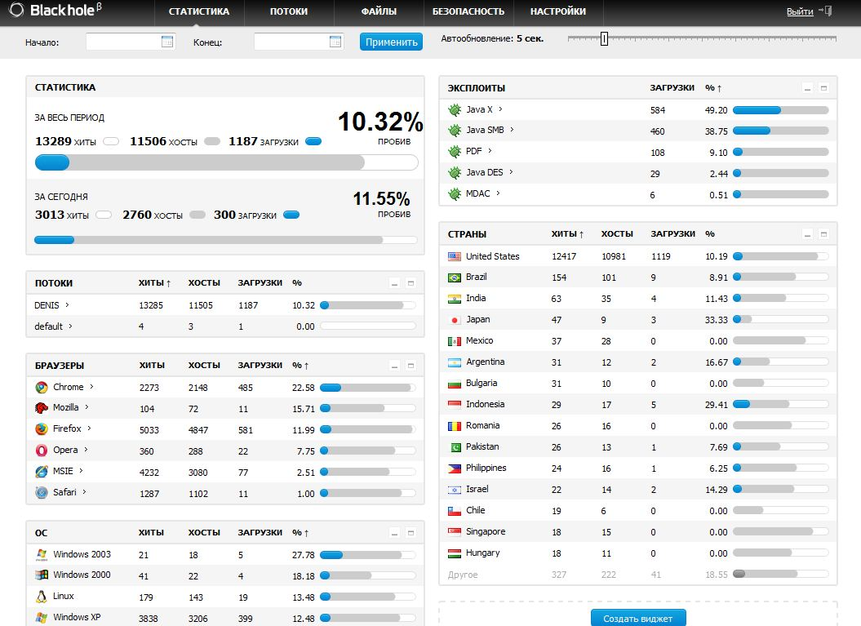
http://krebsonsecurity.com/tag/blackhole/
Notes:
Here an example: It comes with a GUI. You see where computers are hacked, which OS they run etc. Dending on the country you will deliver different malware (or rather you sell the hacked systems to some one else)

Slide 43
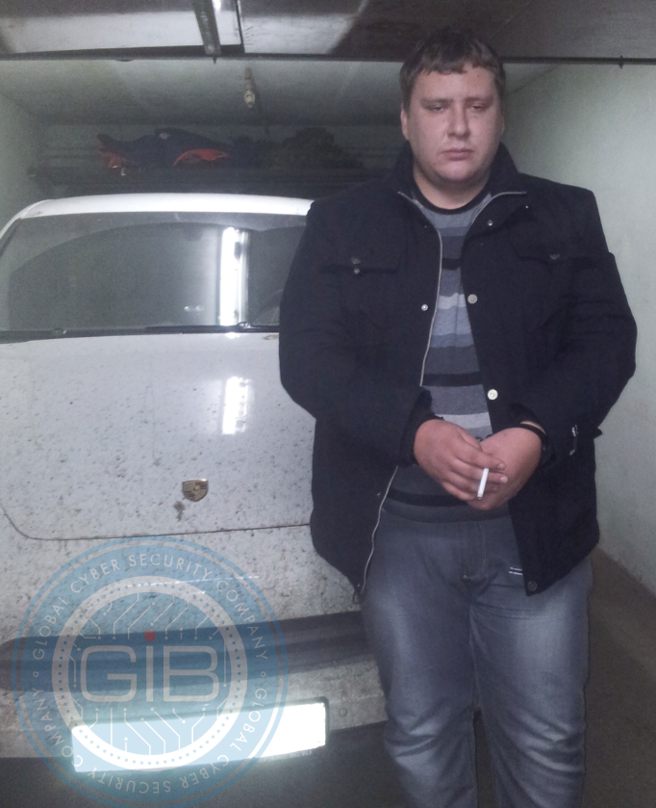
Prices: US$ 500 – 700/Monat
Customers: > 1‘000
Dimitry Fedotov aka Paunch
Arrested: December 2013
Dimitri‘s Porsche
Notes:
This is the author of the Blackhole kit.

Slide 44

Notes:
Now you can start installing malware, that is “viruses” Today they are frameworks that allow you to control the entries system

Slide 45
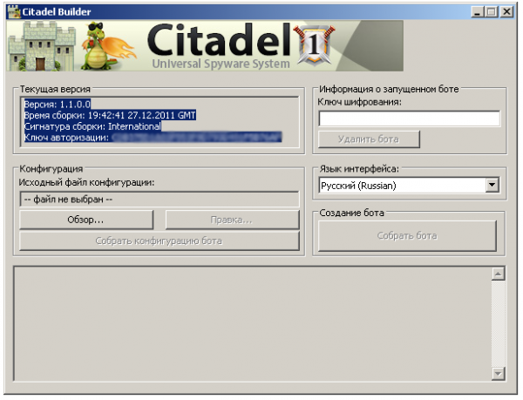
Botbuilder
Notes:
You configure these with GUIs too. These you can buy

Slide 46
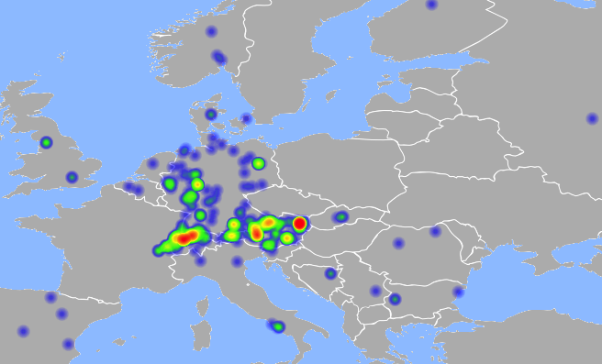
Regional Campaigns
Notes:
Old times: Author controled all, and had all security researchers at his neck
Today they sell/rent and many different groups operate these.
This is an example of Retefee, a banking trojan, which is mostly active in AT and CH

Slide 47

Notes:
Finally you need to have software for your exact goal, kind of like an App. These are called injects

Slide 48
Underground economy
Monday, 4 July 2011
Web Injects Zeus/Spyeye
Coder - mynetthebest
We sell already made webinjects for Zeus/Spyeye. We can develope webinjects to your needs if you provide logins for testing it. Injects can be made on for any country and any language if you provide details for it.
All injects are tested on accounts before selling. We can do injects in different languages, depending on your needs (you have to provide the text for fields)
Injects are sold encrypted and you can`t modify them.
…
EULA
6.) RESELL/SHARE IS NOT ALLOWED
Notes:
They come with an EULA
Question: How do you enforce this?
Answer: If violation is detected Code is submited to Virus totla -> Next day AV cleans this out.

Slide 49

Notes:
Now you need hosting infra. -> Bullet proof hosting

Slide 50
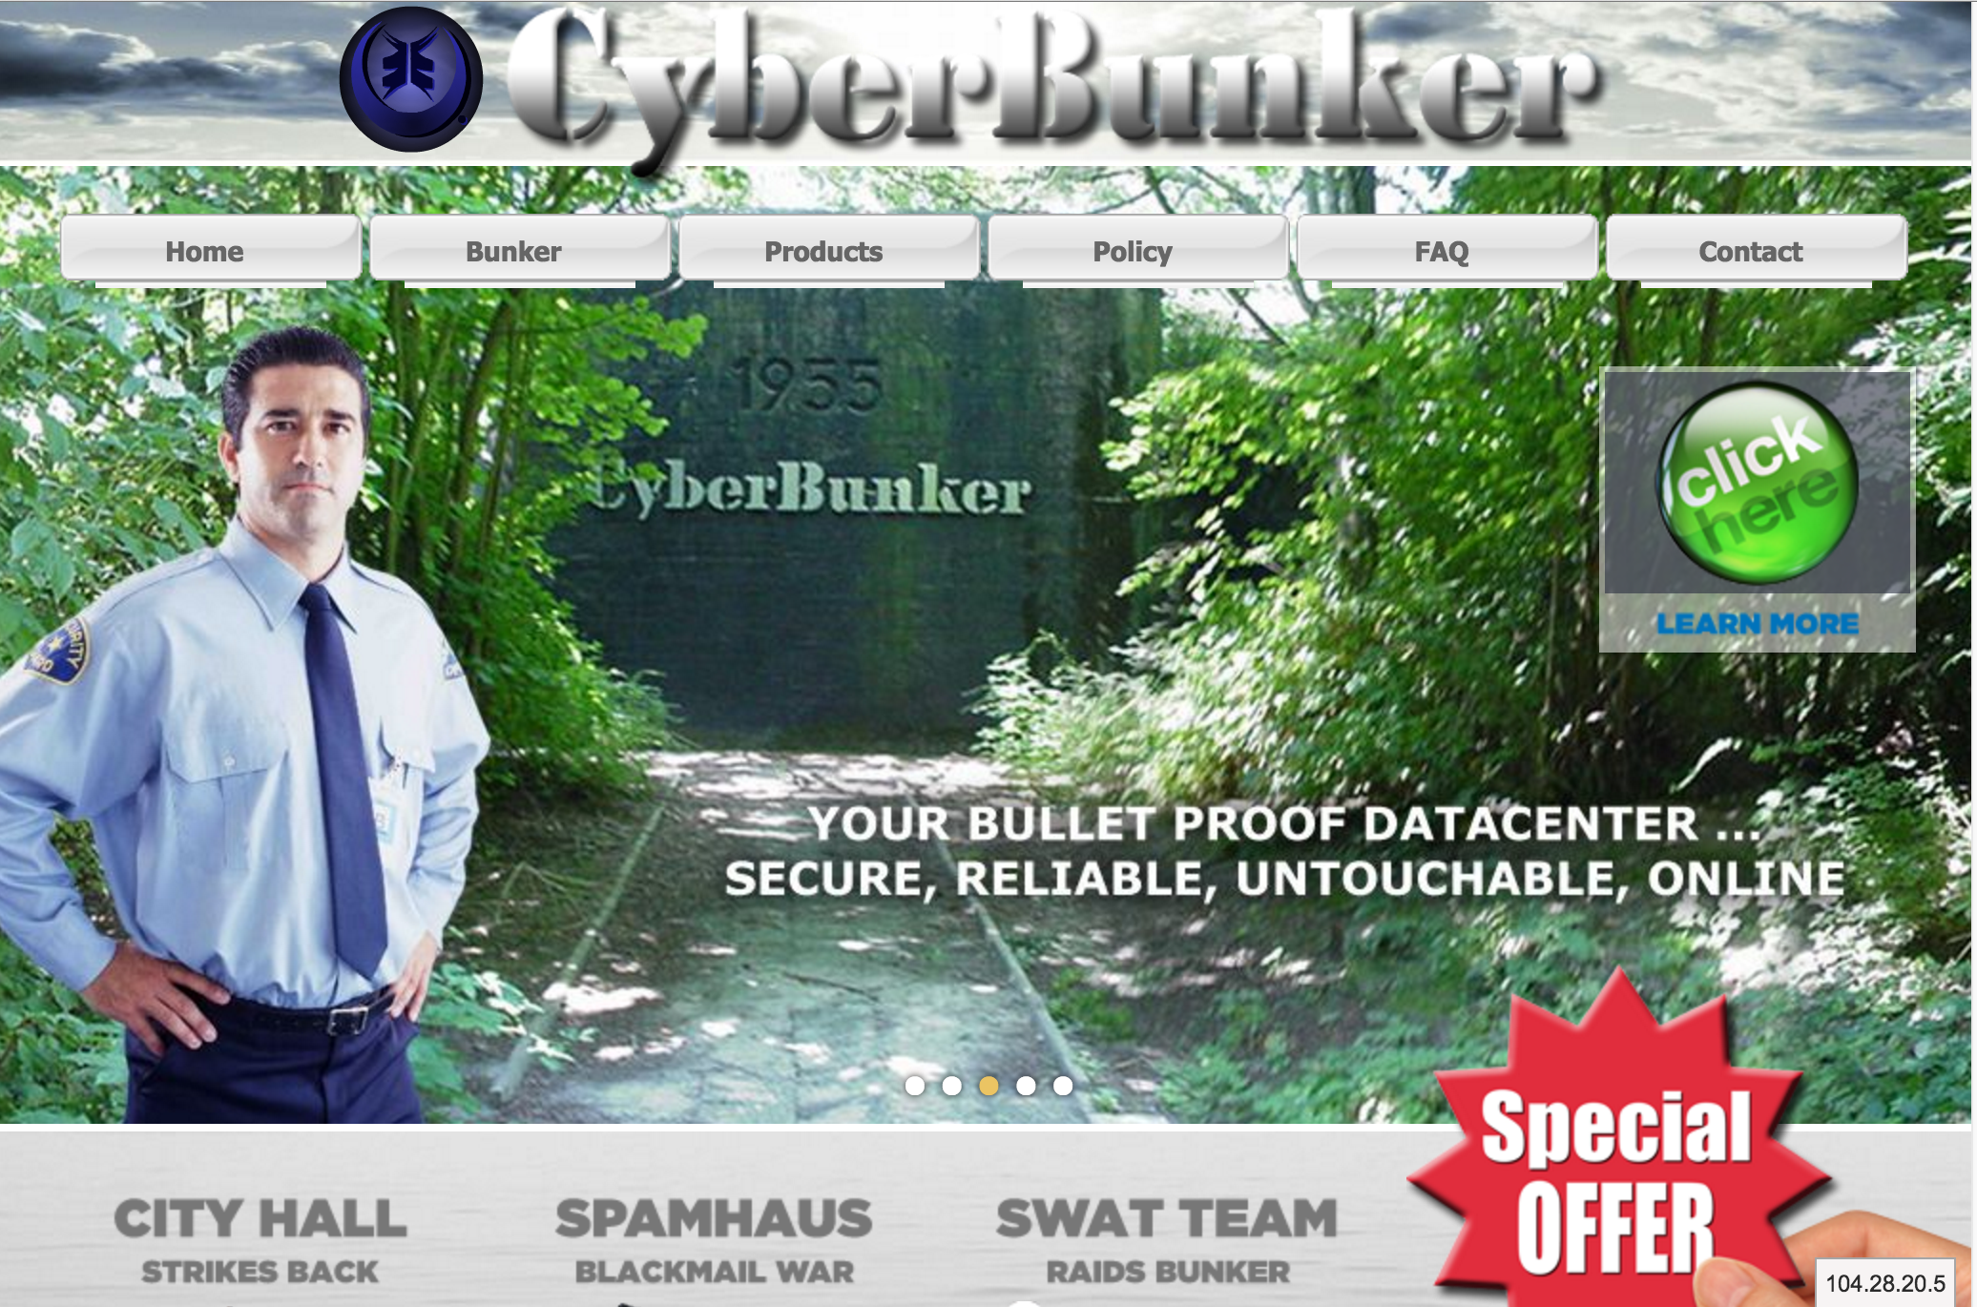
Notes:
Bullet proof hosting.

Slide 51

1
Cardz
+
Accounts
+
Mules
+
DDoS
+
Spam
+
…
+
Notes:
Now all is in place and you can start doing bussines:
Top Credit cards -> How much, do you think, does a fully working CC cost? Answer: USD 7, but 21 for CH CC Those are typically sold in batches of 100 or so on special undergorund markets (think amazon).
Accounts, such as gmail, etc. Would you like more twitter folowwers? You can get them.

Slide 52
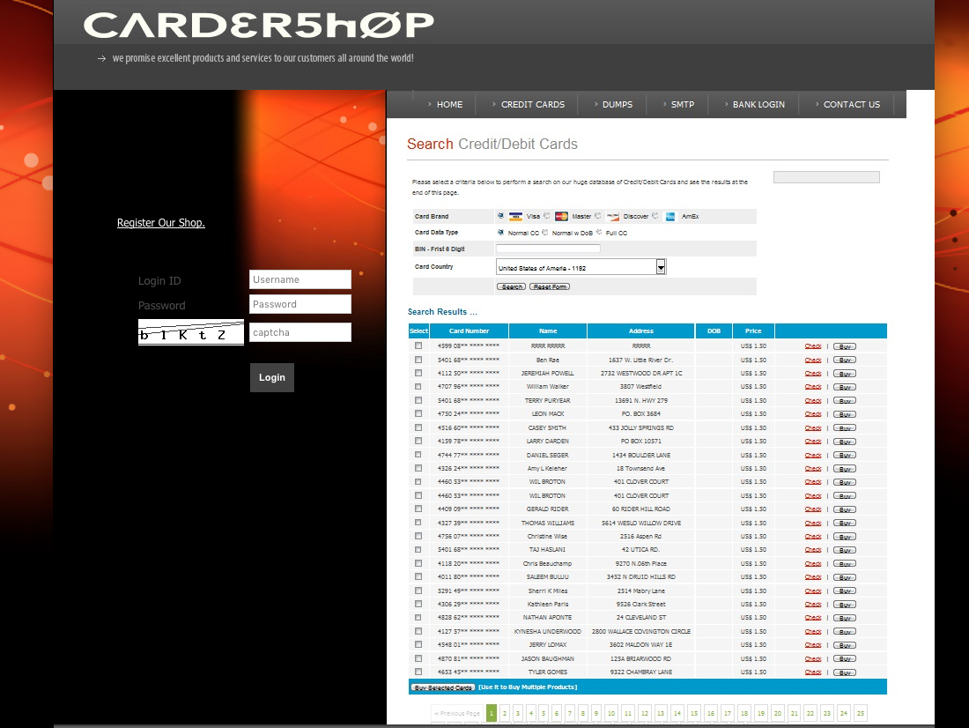

Slide 53
1
Cardz
+
Accounts
+
Mules
+
DDoS
+
Spam
+
…
+
Notes:
Now, if you buy these CCs you want to make them to money: Buy goods and sell them again. Don’t do this yourself, use a mule.

Slide 54
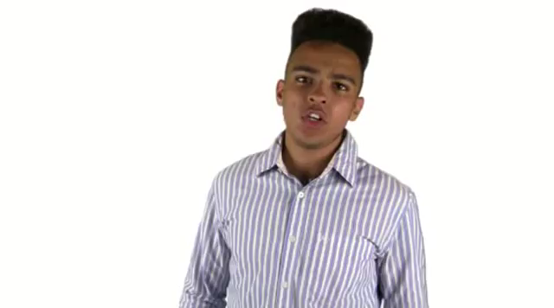
Gwapoo
Notes:
DDoS as a Service for $5
In NL students purchase this to avoid online exams (oder to your lap top -> WiFi congested, Exam off)

Slide 55
The internet underground is service oriented market economy!
Notes:
Take home message

Slide 56
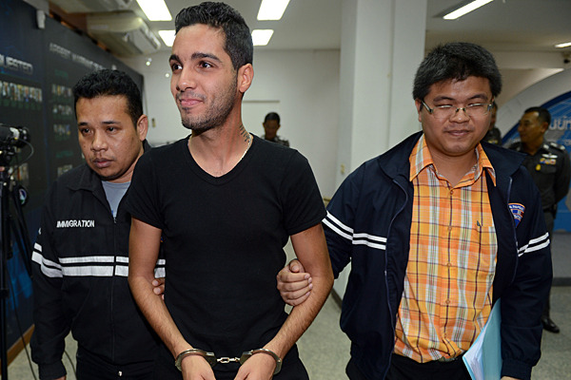
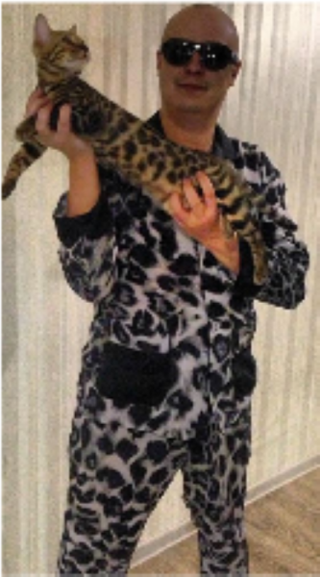
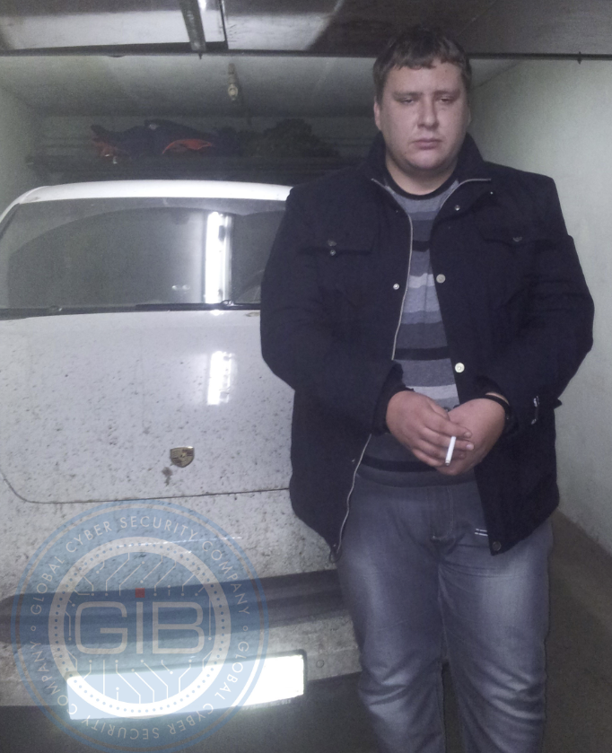
Notes:
So these are criminals, but there is more.
ZeuS and SpyEye: Hamza Bendelladj, 100 Milion Betrug 2013, Happy hacker
GameOver ZeuS: Eugeniy Bogachev, Kopfgeld 3 Millionen, -> Dyer
Black Hole Exploit Kit, Paunch aka Dmitry E. Fedotov

Slide 57
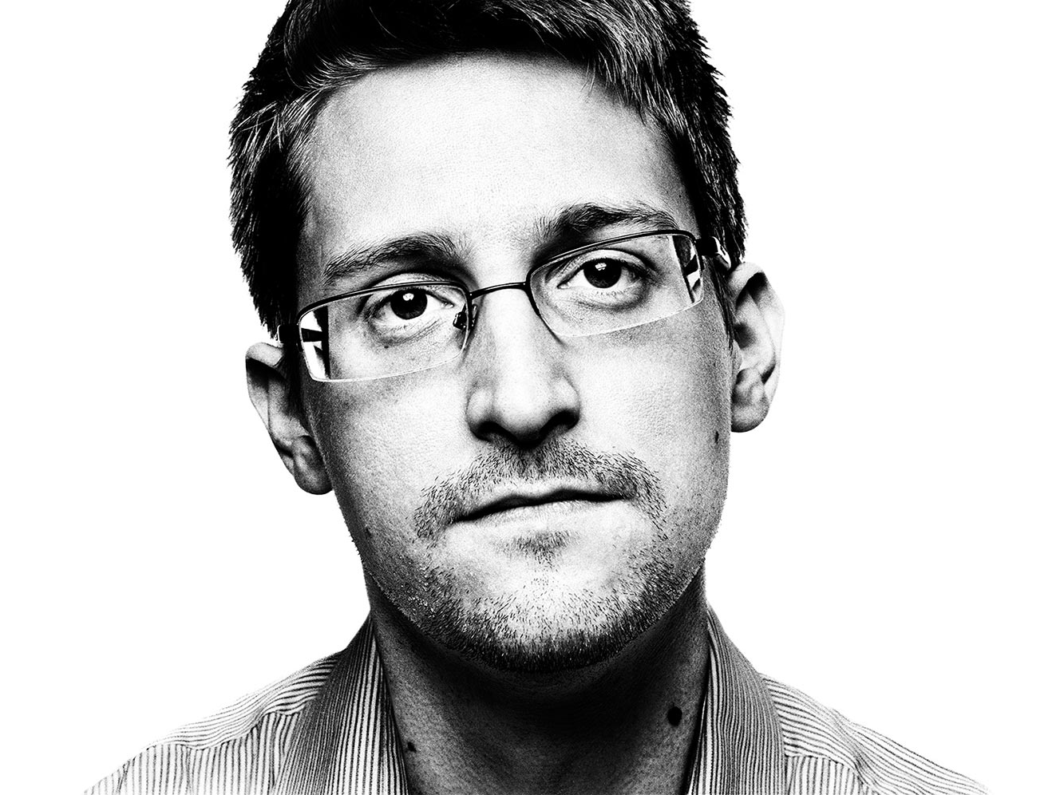
http://www.wired.com/2014/08/edward-snowden/
Notes:
Since Snowde it shold be cleare to everybody that also governments have realized that the internet exists.

Slide 58

2003: Titan Rain
Attribution: China
Target: US / Defense
Contractors
Notes:
First known: Classic hacking: Titan rain, CN group steals software from US Army

Slide 59
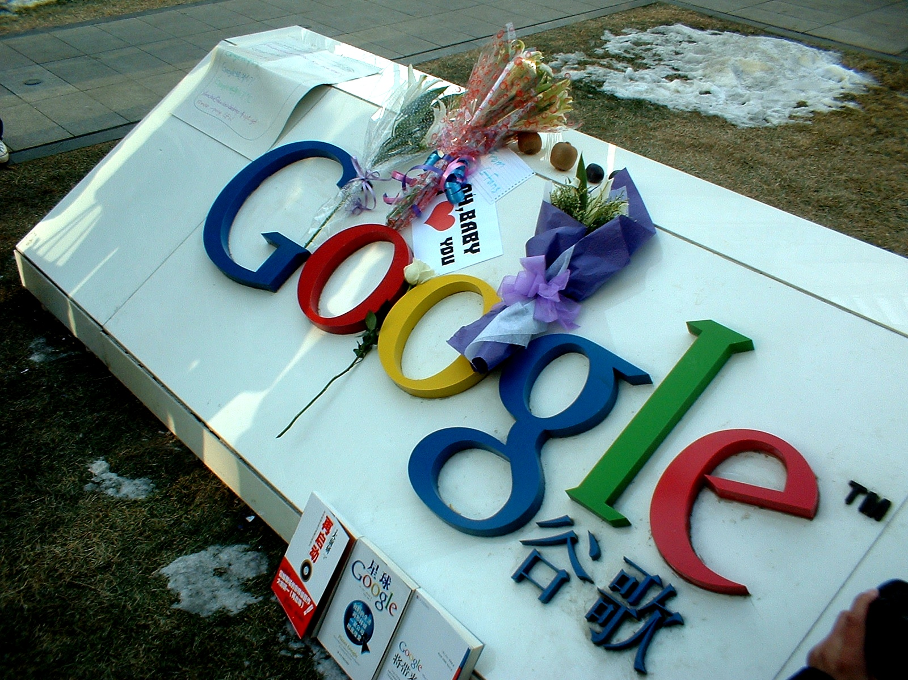
2009: Aurora / Ghostnet
Attribution: China
Target: Tibeten
Activists
Notes:
Aurora: Angriff auf Google mit dem Ziel e-Mail Konten von Dissidenten zu hacken
Ghostnet: Entdeckung bei den Leuten des Dalei Lamas aber nicht darauf beschränkt.

Slide 60
2013: Hangover
Attribution: Indien
Target: Pakistan
Energy
Telcos
NGO
Notes:
Why NGOs? This can be sold to interested paries.

Slide 61
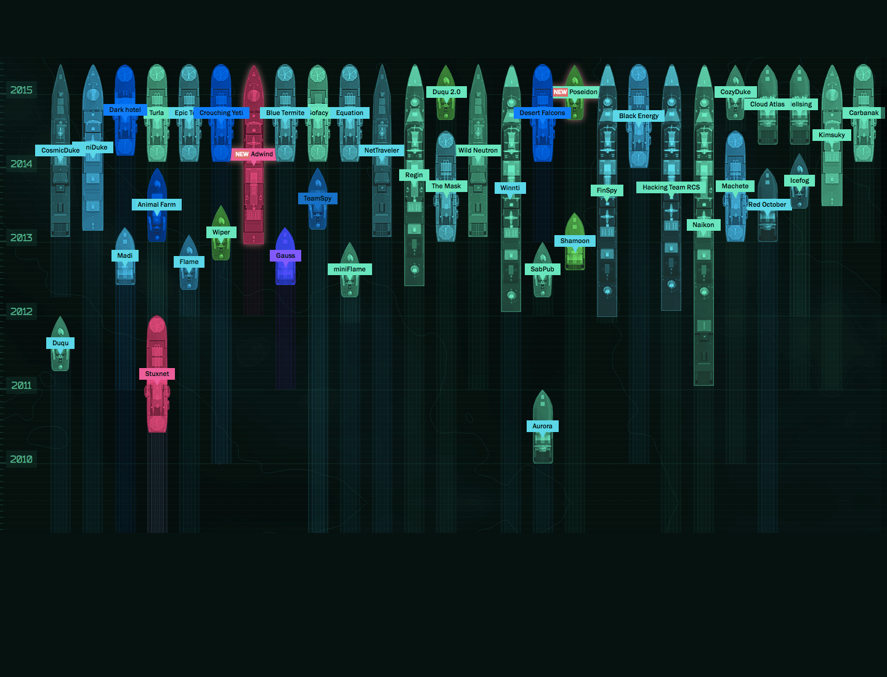
Attacker
Notes:
APTs werden normalerweise Staaten zugeschrieben

Slide 62
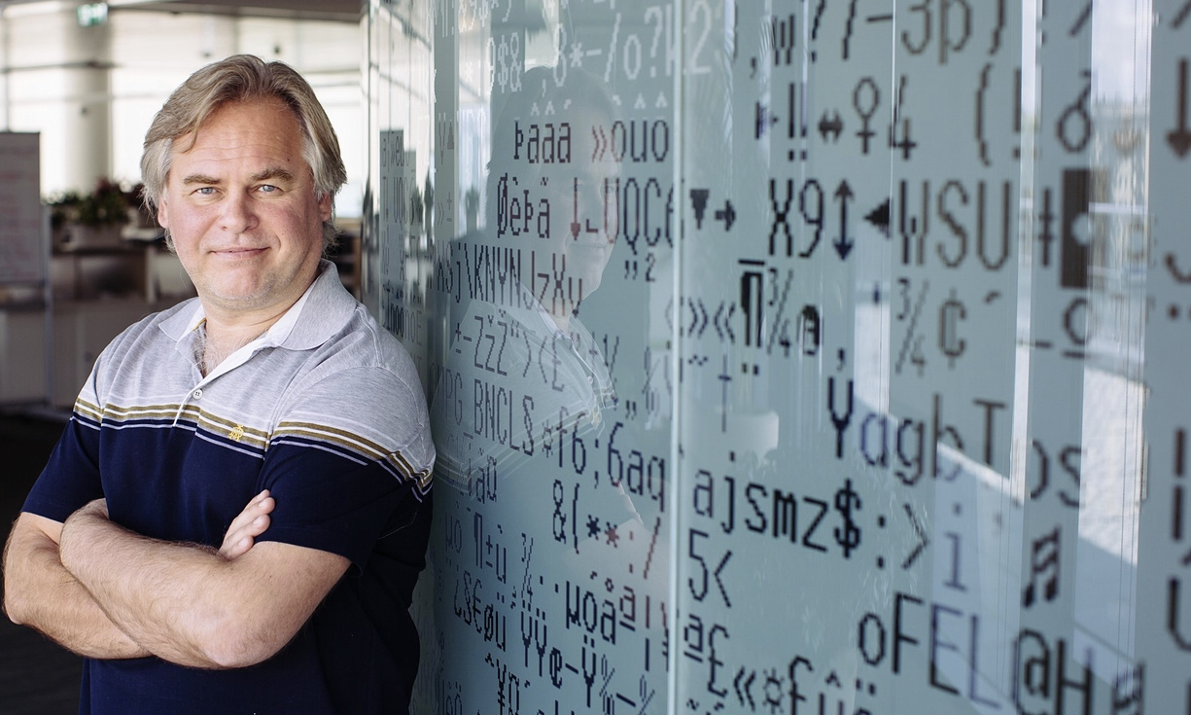
https://blog.kaspersky.com/kaspersky-statement-duqu-attack/8997/
Notes:
But Kaspersky was affected, and admitted it (Hats of for that). -> Hacked for 6 month by Duqu 2, the same Malware used to spy on the US-Iran negotioations in Lausanne

Slide 63
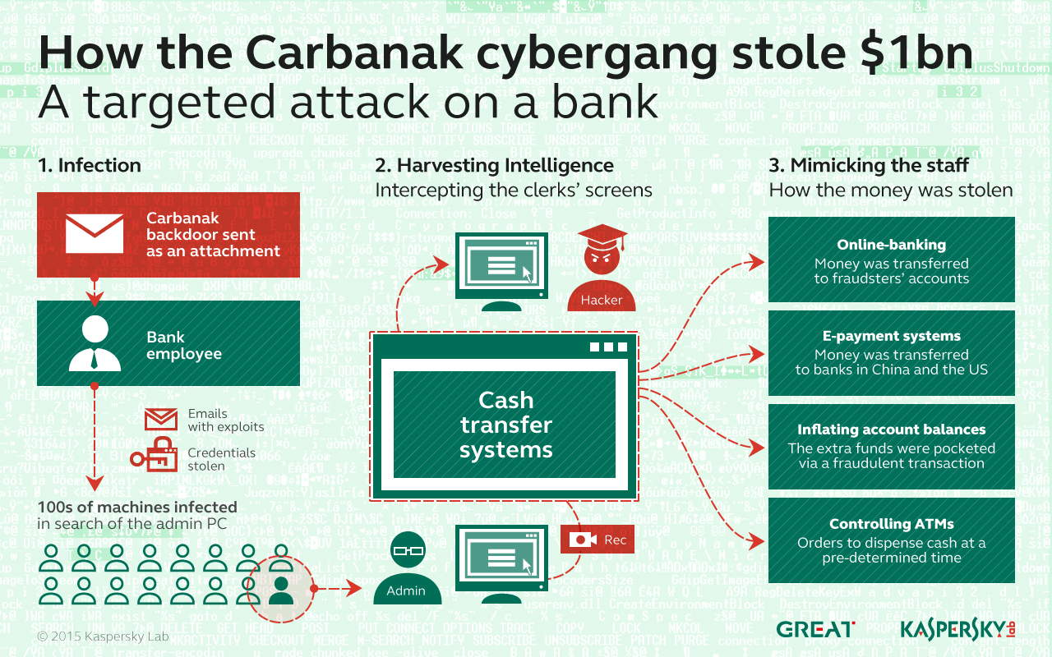
Notes:
APT normally attributed to Staats.
Wh has heard of Carbanack?
No one, keeps surprising me every time.
Attackes took 2 (!) years to infltrate Ukrainien and Russion banks. On day X they stole 1-2 billion (!) USD) by getting money out of ATMs, moving it around accounts, opening closing accounts.

Slide 64
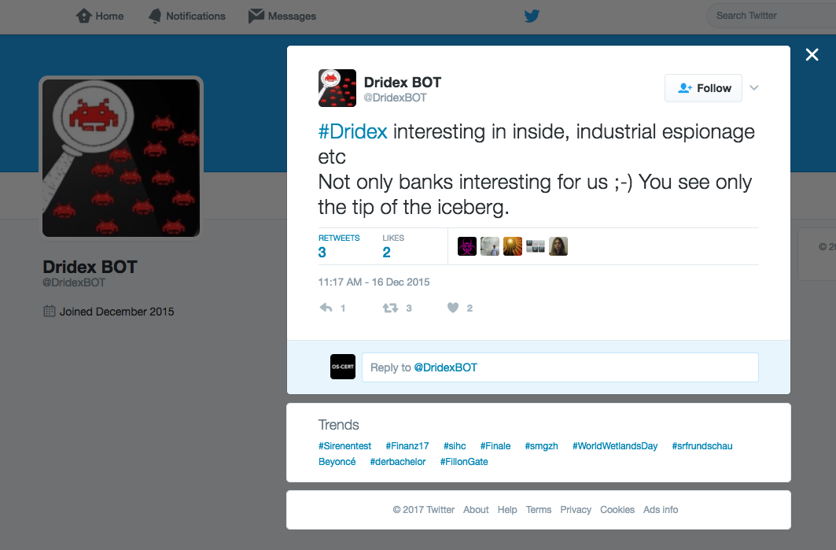
Notes:
In late August 2015, a 30-year-old Moldovan individual by the name Andrey Ghinkul was arested in Cyprus, Spams dropped. But Tote leben länger … Dridex ist immer noch aktiv and tweeting.

Slide 65

Espionage
Malware focused
Army style
classic hacking
Notes:
Trend „State sponsored / classical hacking -> Industrial espionage / Malware based) -> Professionalisation

Slide 66
Neue Zürcher Zeitung 1.11. 2015
Notes:
BTW: Staaten mischen hier mit. Not ok.

Slide 67
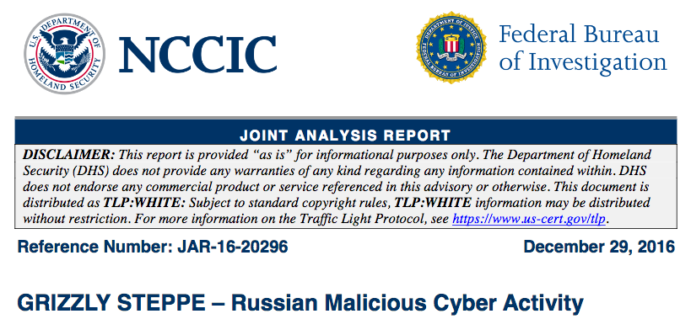
Grizzly Steppe
Notes:
And recently ….

Slide 68
Notes:
Kind of B2C or B2B. But what about N2N? (nation 2 nation)
In 2010 Stuxnet was discovered, in the Ukraine. Probably wen wild -> Movie Zero Days

Slide 69
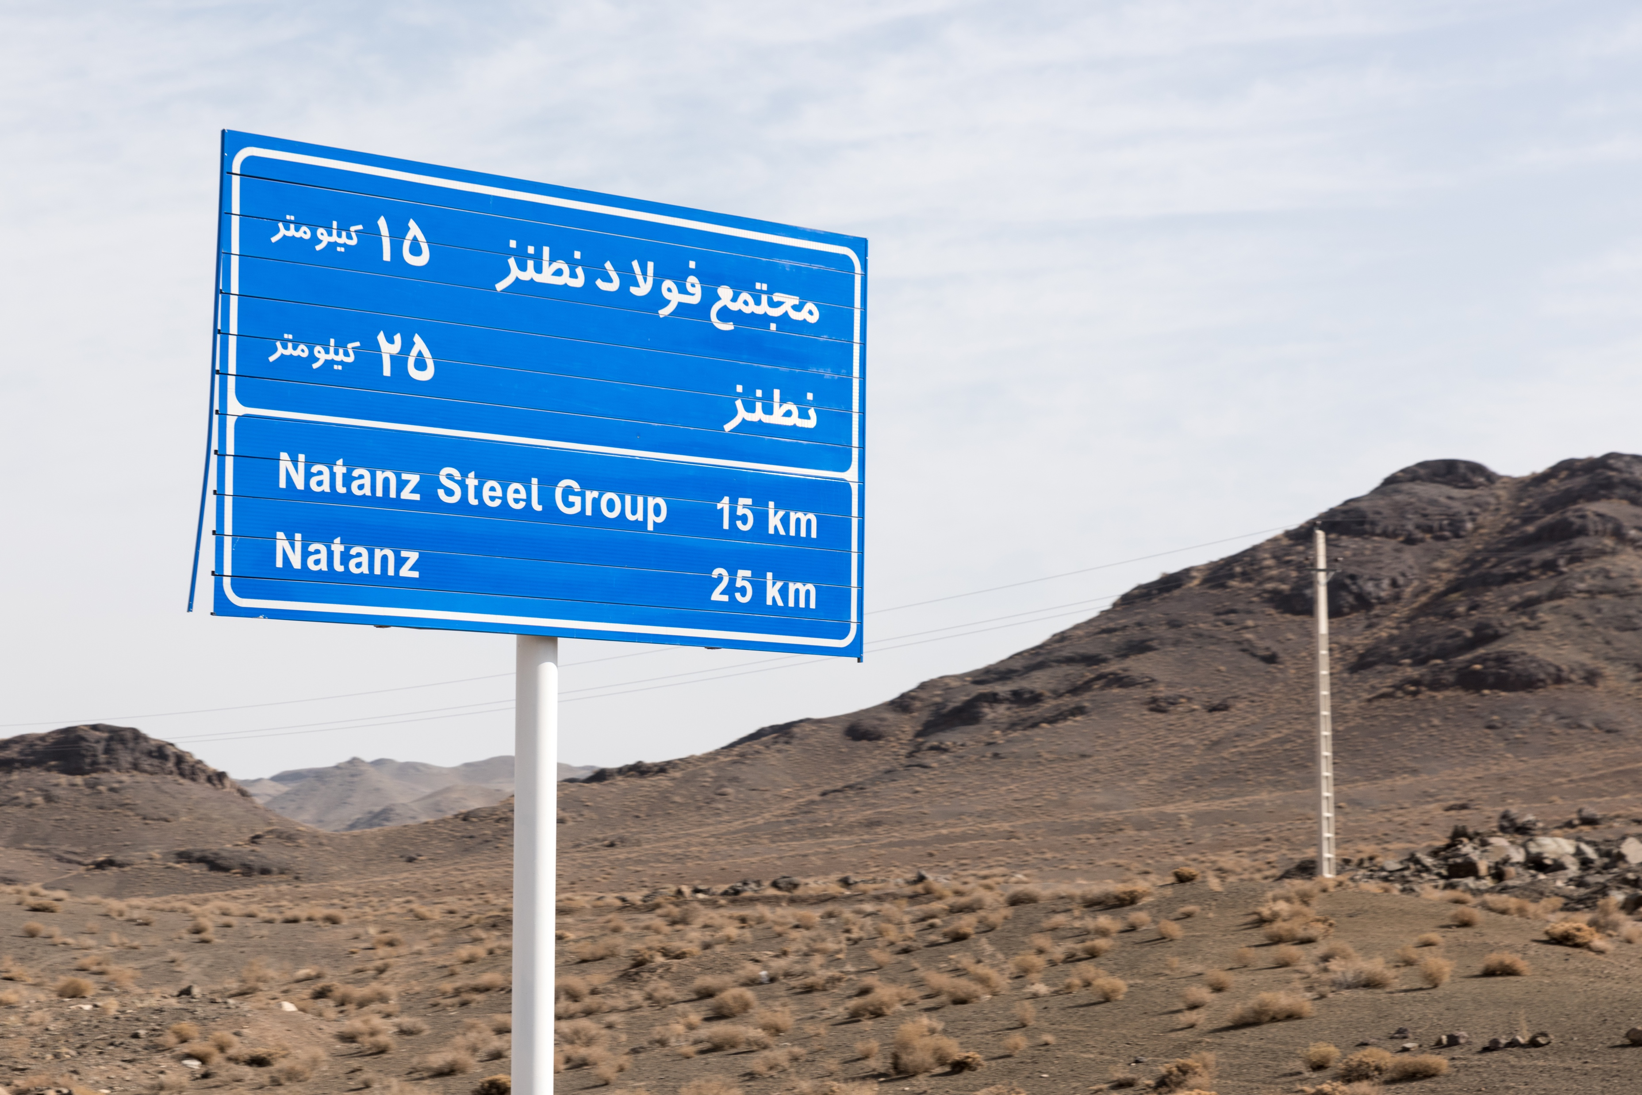

Slide 70
Notes:
Crimea on 23. December 2015 Crimea: Russia shuts down Ukrainien powerplants.

Slide 71
CC4 http://www.en.kremlin.ru
Notes:
Putin 1.6.2017, St Petersburg Economic Forum: Russia would never do something like this. But we cannot exclude that patriotic hackers would.
https://www.ft.com/content/f607ac6c-46e6-11e7-8519-9f94ee97d996

Slide 72
Attribution is hard
The boundaries between adversaries blur!

Slide 73
Tools and methods
Tools and Methods
Notes:
Image: CC0 https://www.publicdomainpictures.net/en/view-image.php?image=2680&picture=swiss-knife

Slide 74
Notes:
What are we talking about? This story begins, like so many in this game, with a hacked device. But what does it take to to hack this device? And why would you do this? Let’s explore these questions briefly!

Slide 75
Popular vulnerabilities
Most attacks use proven, year old vulnerabilities!
History teaches us, that history does not teach us!

Slide 76
Buffer Overflows
Program data
Program code
Enter username: aaaaaaaaaaaaaaaaaaaa … aaa
aaaaaaaaaa
aaaaaaaa
Enter username: aaaaaaaaaa%program code%
aaaaaaaaaa
%program code%

Slide 77
.:: Smashing The Stack For Fun And Profit ::.
.oO Phrack 49 Oo.
Volume Seven, Issue Forty-Nine
File 14 of 16
BugTraq, r00t, and Underground.Org
bring you
XXXXXXXXXXXXXXXXXXXXXXXXXXXXXXXXXXXXX
Smashing The Stack For Fun And Profit
XXXXXXXXXXXXXXXXXXXXXXXXXXXXXXXXXXXXX
by Aleph One
aleph1@underground.org
1996-11-08
http://phrack.org/issues/49/14.htm
Notes:
Elias Levy alias aleph1, founder and operate of the bugtraq mailinglist publishd in 1996 a step by step guide on buffer overflows.

Slide 78
Cross Site Scripting
Web browser based issue, XXS is the ability of an attacker to execute his JavaScript in a different web page.
Effect: The attacker can manipulate a third party, e.g. banking website.

Slide 79
SQL Injection
SQL = Sequential Query Language, the de facto database query language.
Typical call in a web app:
result = query(SELECT id FROM users WHERE users=‘%s’ AND password =‘%s’ ,username, password) ;
Now what happens if
Password = ’ OR ‘1’=‘1

Slide 80
SQL Injection
result = query(SELECT id FROM users WHERE users=‘%s’ AND password =‘root’ and password=‘’ or ‘1’ = ‘1’ );
This is always true!

Slide 81
Social engineering
The art of convincing some one to something he shouldn’t.
Notes:
Hacking computers becomes inquiringly more difficult as operating systems become more and more secure. Hacking humans on the other hand is still the same.

Slide 82

Social engineering
The art of convincing some one to something he shouldn’t.
CC2 DLG Images
Notes:
Hacking computers becomes inquiringly more difficult as operating systems become more and more secure. Hacking humans on the other hand is still the same. It’s been around since ever, (Joke alert: The snake taked Eve into eating the apple, creating the mess we have today).

Slide 83
Today
CEO Fraud
Microsoft Scam calls
419 Scams
Manipulated websites ….
Make sure you know who is on the phone!
Notes:
https://web.archive.org/web/20110927122343/http://forum.419eater.com/forum/viewtopic.php?t=184886#1545310

Slide 84
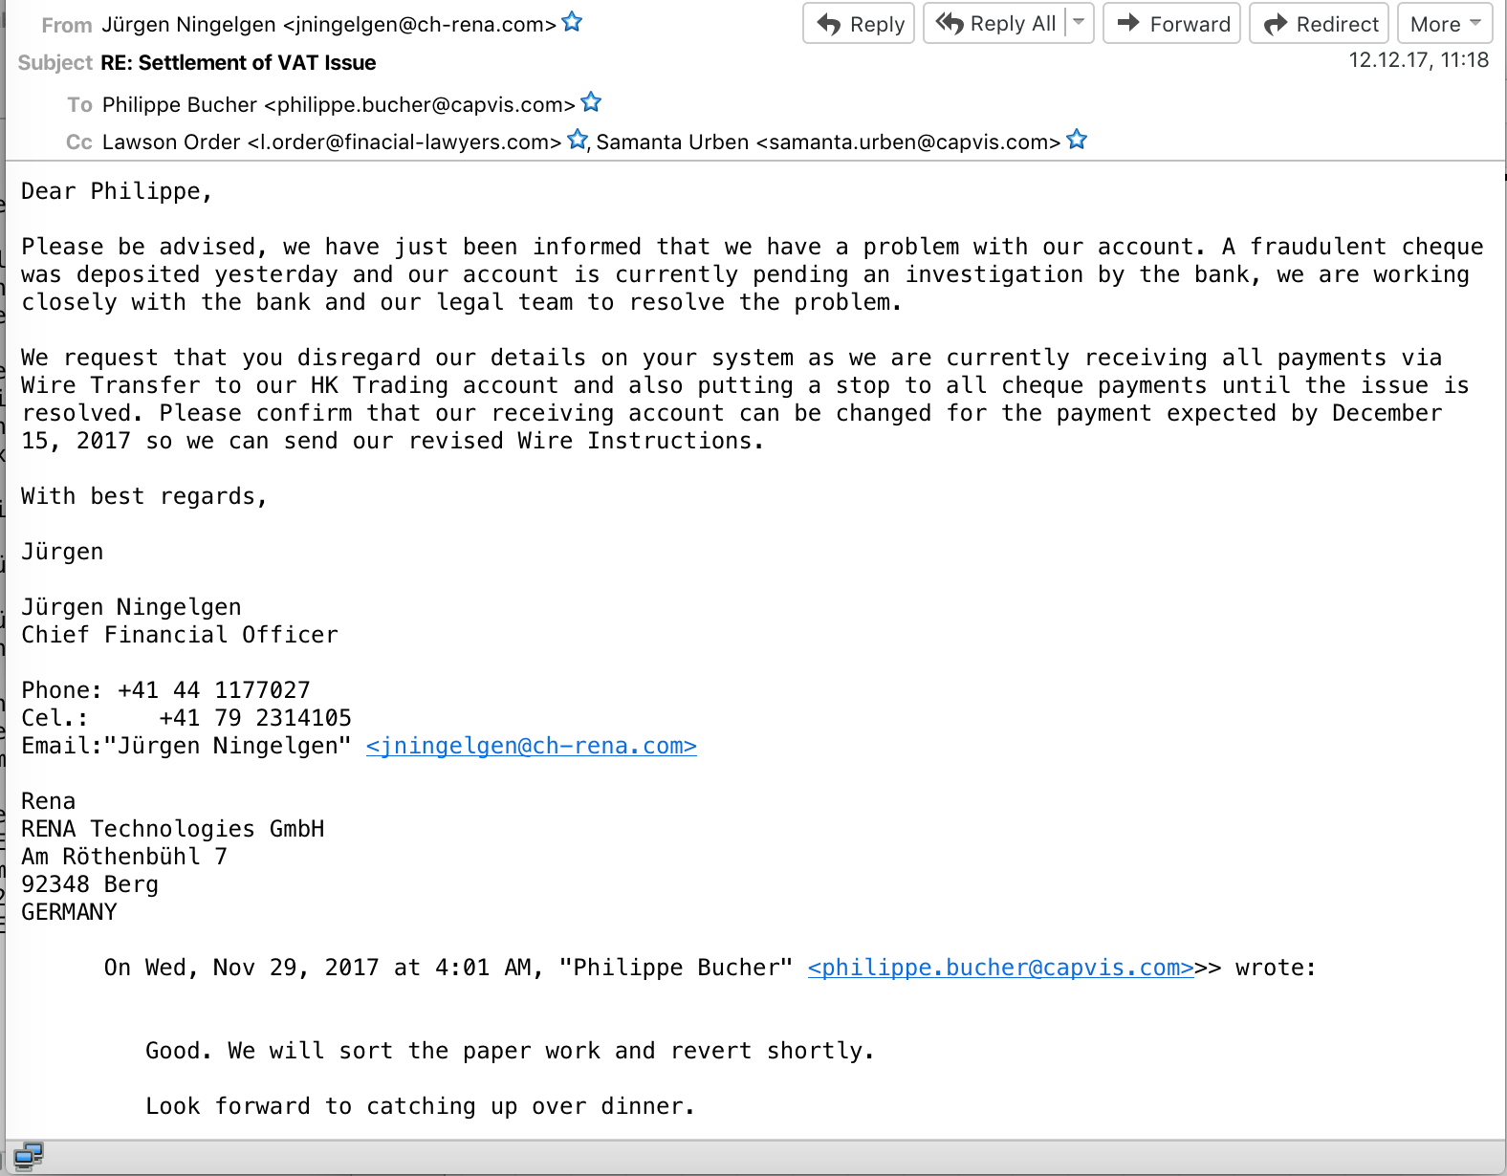
Notes:
Story:
Long negotiations
A lot of people in the e-mail thread
After clousure of the deal: One more mail, from a slightly different domain rena.com -> ch-rena.com
Please pay to another account.
Bumm 1.2 millions USD gone.
Above domain is from an example, nt the real one.

Slide 85

Malware distribution
www
Notes:
Malware is distributed through about half half through e-mail or the web, the later is called drive by. Hang on, we’ll explain how this works.

Slide 86

A bit of Taxonomy
We generally speak of malware as a generic term.
Special cases:
Worm -> propagates on its own
Virus -> Needs a host
Trojan -> Commonly used for backdoor
Not very helpful, so best ignored!

Slide 87
Malware distribution
www
Notes:
Malware is distributed through about half half through e-mail or the web, the later is called drive by. Hang on, we’ll explain how this works.

Slide 88
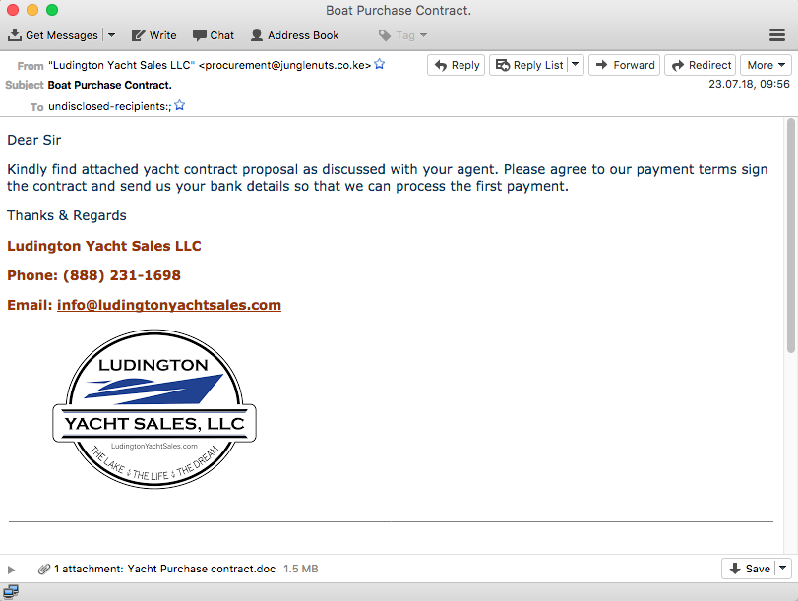
Notes:
Take this e-mail, there are a gazillion examples. It contains a word file.
So who thinks open a word file, or a PDF is an issue?

Slide 89
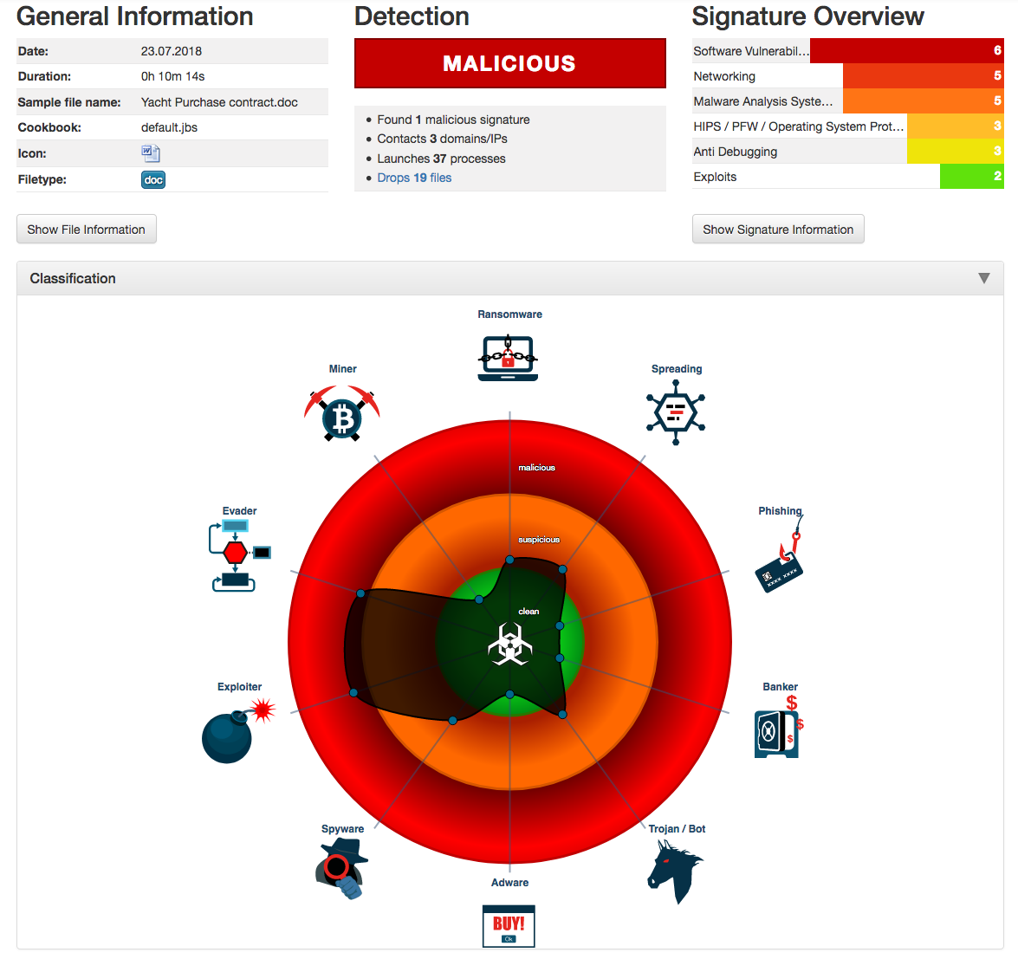
Notes:
Well, it is. This particular word file executes a macro which exploits a security vulnerability to escape the Word processor and downloads further malware.

Slide 90

Drive by
😃
Webserver

Slide 91
Drive by
😃
Webserver

Slide 92
Drive by
😃
Webserver

Slide 93
Drive by
Webserver
Notes:
Changes on the website are often subtle. Affected are all websites, not just the ones you don’t tell your parents about. An interesting variation is malverizing, where an Add provider is misused to distribute malware through the add. This is much harder to detect, as ads change.

Slide 94
Botnets
Notes:
One hacked computer is not particularly interesting

Slide 95
Botnets
Notes:
But thousands are

Slide 96
Botnets
Command & Control (C2)
Server
Notes:
But thousands are interesting. This is the great thing about the internet: Everything scales. Botnets can have from a few hundreds to millions of members. Being cynic one could say they were the first cloud services.

Slide 97
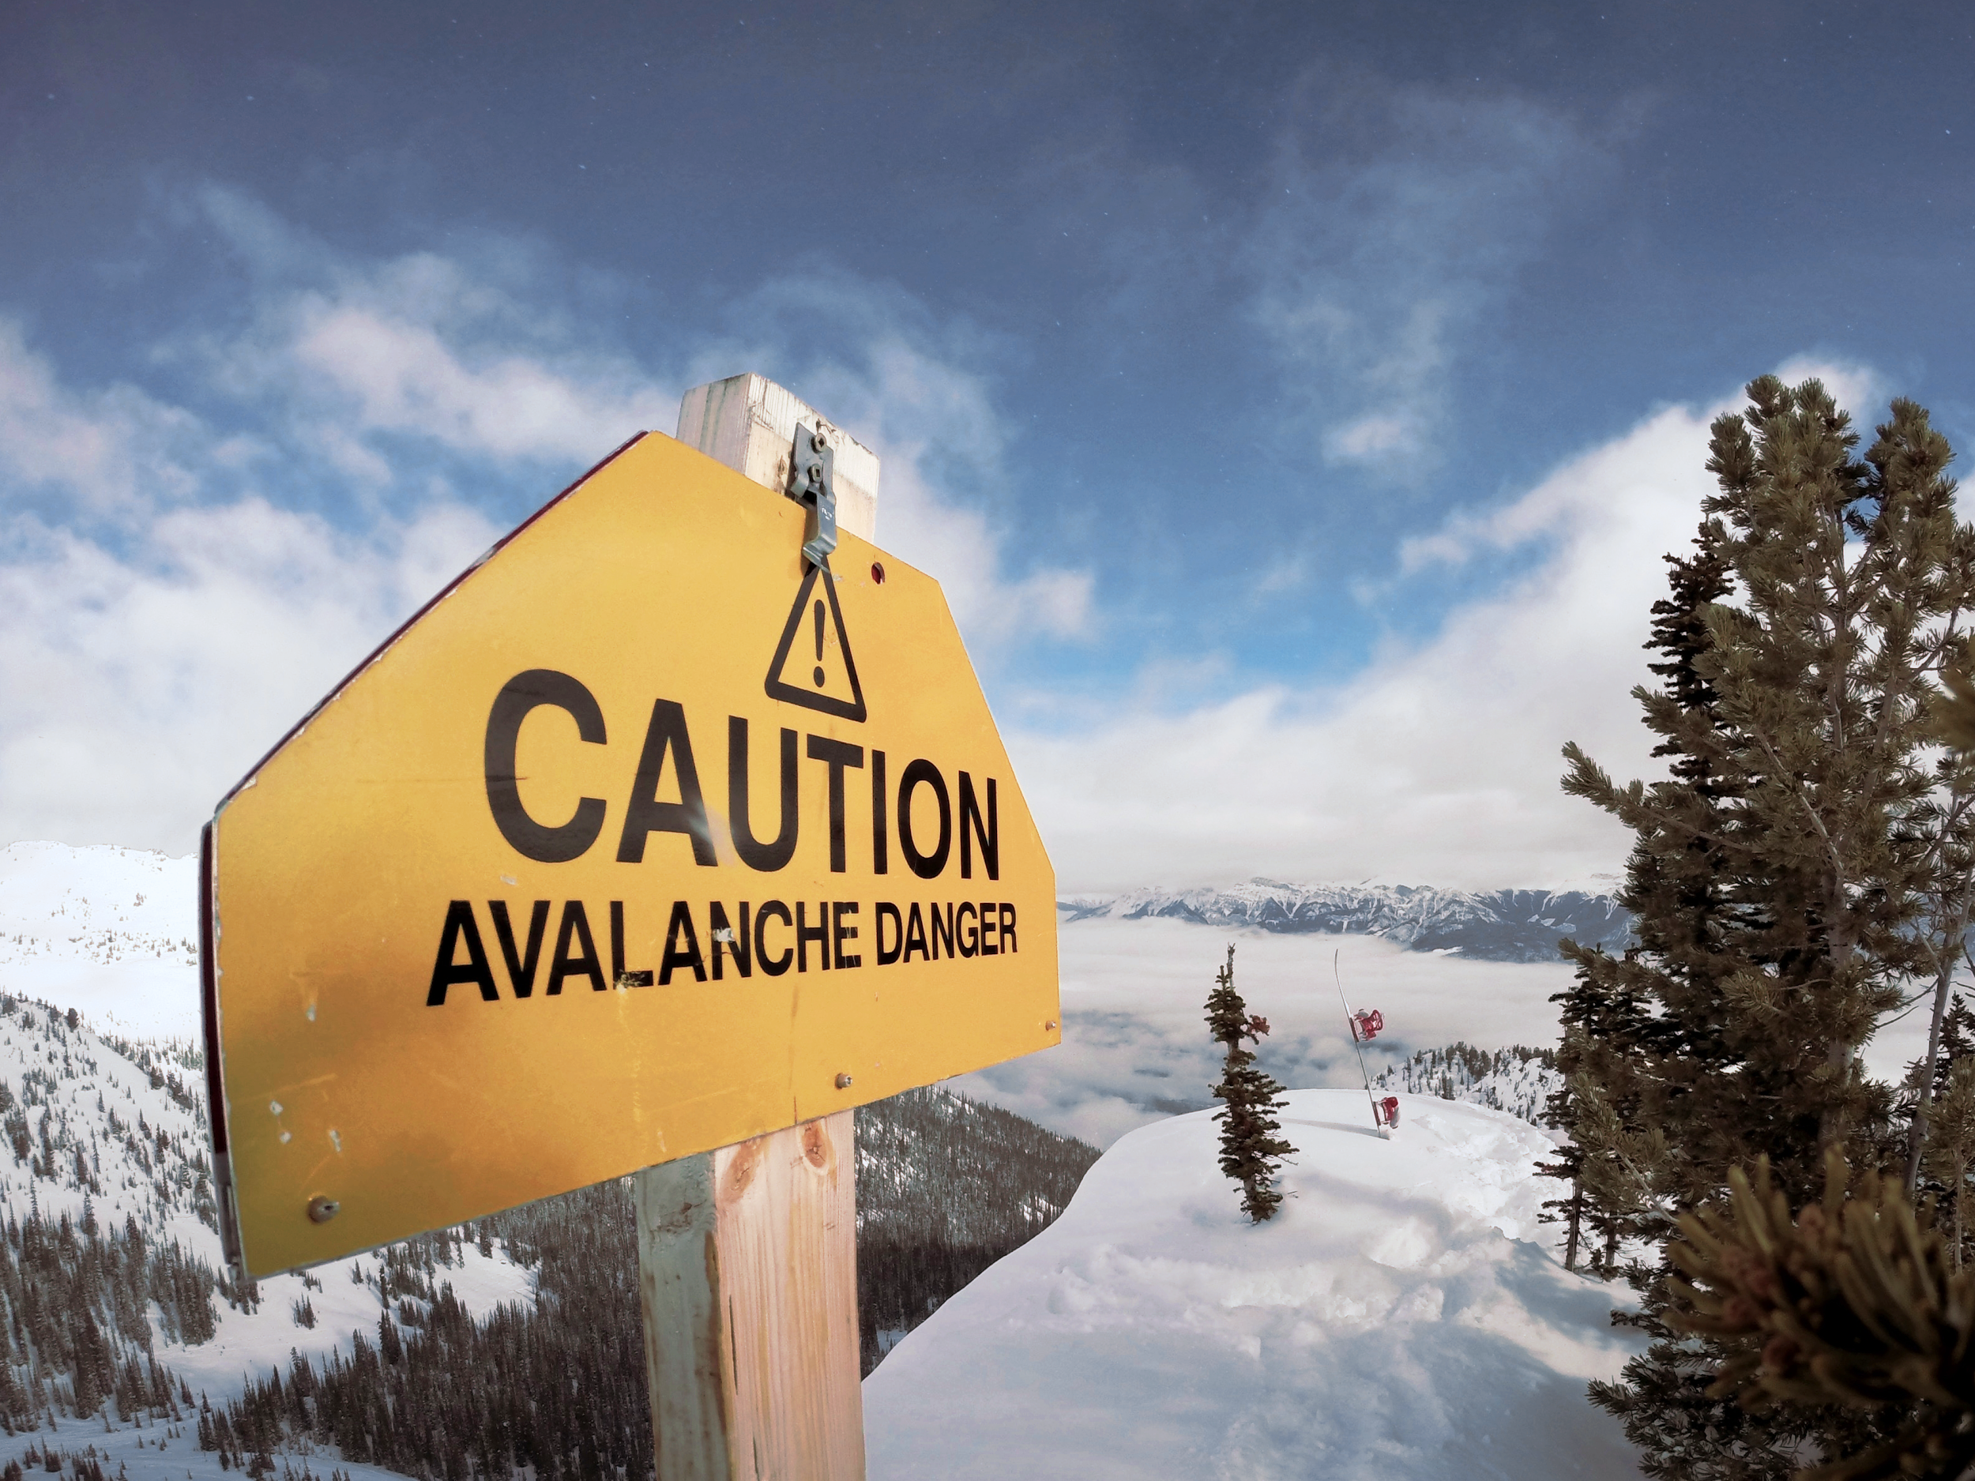

Avalanche Network
CC0 88101559 | Dreamstime Stock Photos
Notes:
Avalance Takedown
Avalance was a underground hosting infrastructure leveraging Domainnames (first.org) for robustness. To stop its operation 800’000 domain names had to be taken down in dozens of TLDs (.com, .ru). This requires the collaboration with many organisations not traditionally considered part of the CSIRT community. In particular registrars (the domain name eco system) as well as law enforcement.
Both these communites have very different rules:
Registras, in particular the ones responsible for ccTLDs are often very regulated and very reluctant to act.
Law Enforcement is bound very much by legal procedures and typically has a different goal: Arresting criminals vs getting the infrastructure back up.
This makes collaboration often difficult. Policy and law makers can help here. For example the close collaboration of the Registry CSIRT in Switzerland with the regulator has led to the creation of a law that allows the registry to effectively act against cyber crime.
THis was a long effort and required that all involved parties gain a common understanding of the issues.

Slide 98
Underground CDN
Hosting
Admins
Muling Ops
Double Fast Flux
Backend
Proxies

Slide 99
Conclusion
Hacking is an entire industry, with many specialisations. It’s not done by teenagers, but by professionals.

Slide 100
Protecting Yourself
https://www.stopthinkconnect.ch/

Slide 101

Updates
Keep your Operating System and software on all your devices up to date.

Slide 102

Backup
Ensure you have a backup of your data.

Slide 103

Strong Passwords
Use strong passwords. Don’t reuse them. Enable 2 factor authentication.

Slide 104

Reality check
Sounds too good?
Sounds too bad?
Sounds strange?
Check it out!

Slide 105

Help
You made a mistake?
Something not working?
Get help!

Slide 106

Follow guidelines
Follow cooperate guidelines. There are here for a reason.

Slide 107
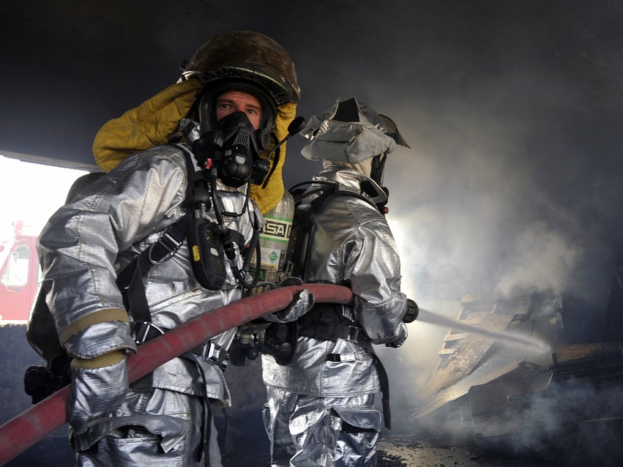
Incident Response
Notes:
CSIRTs are often compared to fire fighters. One could define them as a team of experts coming to action during a cyber security incident. This definition is probably to narrow, CSIRTs today take on many different task, both reactive and proactive.
CC0 https://pixabay.com/en/firemen-firefighter-fire-flames-78111/

Slide 108
CSIRT
Computer Security Incident Response Teams (CSIRTs) become active when an incident has been detected.

Slide 109
Global response
Source: https://www.darpa.mil/about-us/darpa-history-and-timeline?PP=2
Notes:
The internet used to be national, in 1969. Response was easy at the times, you just needed three other phone numbers ;-)

Slide 110
Global response
Source: https://www.caida.org/research/topology/as_core_network/2015/
Notes:
Not so any more. You need to act fast and across many borders.

Slide 111
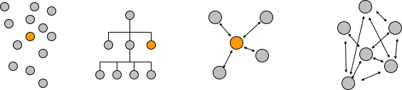
Models of cooperation (Governance)
Market
Hierarchy
Collaboration
Network
Notes:
There are different forms of governance. Common ones include Market (you pay for what you want), Hierarchy (Company's , Army), Collaboration, and lastly network govenance. 1-3 Don’t work: You can’t pay for a server to be taken down, you can’t order it (try it). Collaboration doesn’t scale, we are dealing with thousands of independent players (each of the dots on the previous figure). So let’s look at network governance

Slide 112
Network governance
Governance [is achieved] through relatively stable cooperative relationships between three or more legally autonomous organisations based on horizontal, rather than hierarchical coordination, recognizing one or more network or collective goals
Notes:
Here, we’re essentially saying that we work with other towards a common goal at eye level over some time, without any paperpwork.
Common examples: Disaster recovery (Haiti, New Orleans, Puerto Ricco, …) typically grassroot groups working together. In Haity the US Army relied on a google maps project run by a bunch of MIT students for their intel!

Slide 113
Two ingredients for successful coordination
A common goal
A high level of trust
Notes:
To be effective Networks need a common goal and a high level of trust.
Mind you: Networks are not feel good groups. Its often tough!

