Slide 1
Exfiltration
Eric Zielinski Mick Douglas

Slide 2
Problem statements
Exceptionally difficult to get enough qualified staff.
Many InfoSec tools are no longer working well against current attacks.
Cloud computing, BYOD, work from home, etc have greatly confounded our network topologies.
The “internet of things” will soon land in corporate environments
Notes:
(in some places it already has e.g.: SCADA/ICS)

Slide 3
Not enough people in our field
As of 4Q 2013, there are about 65K infosec workers in the US according to Bureau Labor Statistics
A number so small that “quarterly averages don't meet the bureau's publication standards” (need at least 75K – can do yearly reviews though)
http://www.bankinfosecurity.com/blogs/3-unemployment-among-infosec-pros-p-1400

Slide 4
Some tools are broken
“relying on protection from anti-virus companies, no matter how established their brand, is simply not enough. Comprehensive protection requires an entirely new approach.””
“Mr. Dye estimates antivirus now catches just 45% of cyberattacks”
- Brian Dye, SVP Information Security at Symantec
http://online.wsj.com/news/articles/SB10001424052702303417104579542140235850578

Slide 5
End result
Bad guys are on the networks.
“the year of data breaches”
But so was 2013, 2012, 2011…

Slide 6
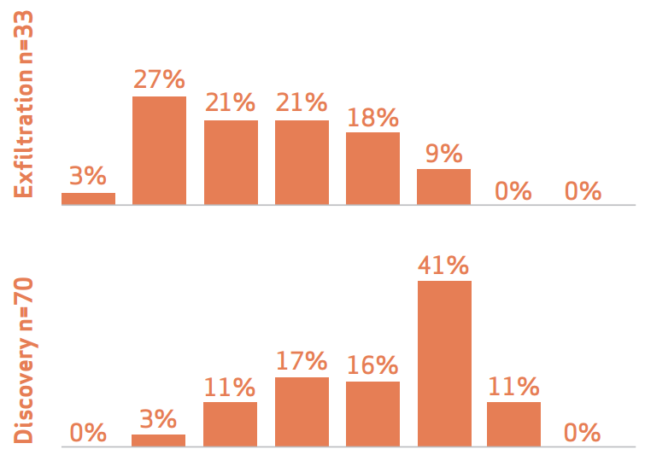
2014 Verizon Data Breach Report
Notes:
(Web Attack Section)
- Criticisms of report that people are saying:
- lacks breach impact or cost
- findings are skewed not holitic
- not enough "root cause" analysis and recomendations not specific enough
- every attack against critical infra only took (6 spear phishing message to get to 80% successful entry)
- Time span of incidents
- not smash and grab
- point of entry just under 7 months
- 66% of all victims found out from 3rd party
- more efficient at finding a quick way in
- 2 out of 3 involve weak or default credentials
- DNA of incident
- VERIS framework under intel sharing structure
- Pattern of Frequency
- Diagnose each category separately (short-long term containment)
- What your threat profile really is not what they think it is
- incidents and breaches are inverse
- Threat profiling
- how are you setup to deal with these issues

Slide 7
You’re in good company!
“The most sophisticated adversaries are going to go unnoticed on our networks”
Debora Plunkett, Head of Information Assurance Directorate, NSA
http://www.reuters.com/article/2010/12/16/us-cyber-usa-nsa-idUSTRE6BF6BZ20101216

Slide 8
More clearly stated than us
“Whether in detection, control, or prevention, we are notching personal bests, but all the while the opposition is setting world records.”
We Are All Intelligence Officers Now Dan Geer (28 February 2014) RSA, San Francisco, CA

Slide 9
Question for you…
What kind of problem is this?
A) Tool problem
B) Tool usage problem
C) People problem
D) Policy/governance problem
E) All of the above
F) All of the above and more!

Slide 10
Everything old is new again
There must be a better way….
“Comprehensive protection requires an entirely new approach”
“Know thy self, know thy enemy
A thousand battles, a thousand victories”
Sun Tzu

Slide 11
What you can do
Traditional defenses
Host based – detecting attacks
Misuse detection – previously defined attacks
Anomaly detection – signature based
Attack analysis, signature creation, blacklisting all these defenses are not solving the problem.

Slide 12
What this means
We are really bad at detecting incidents
There must be a different way
Know your network
Easier said than done, right?
You’re not going to buy a compliance appliance and ‘win’
Need to get creative.

Slide 13
Castles vs Casinos
Casino
Castle
Tightly control who can use systems
Everyone welcome!
Security increases as you get closer to the money
Especially true as more SOA/ESB systems come into being
Remember!!!
Attackers advantage
Need to move away from fortress mentality

Slide 14
Time Based Security
Common sense approach to risk
Detect time + React time = Exposure time
Can lower detection
Can lower reaction
Which is cheaper?

Slide 15
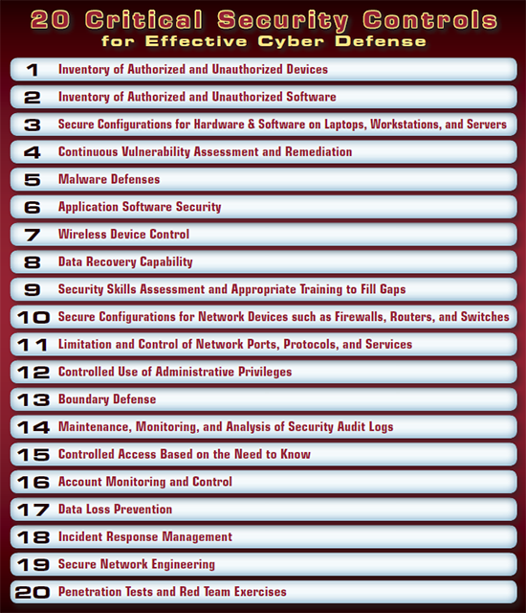
SANS Top 20 critical controls
Importance
What we’re doing!

Slide 16
Exfiltration Methods
Encrypted Backdoor: 1%
Native FTP: 1.5%
HTTP File upload: 4%
Malware IRC:2%
Malware FTP: 17%
MS Windows: 28%
Native Remote Access: 27%

Slide 17
Putting these together
Traditional way
Siloed tools
Wrong techniques
New approach
Right tools working in concert
Different techniques
Recognize & Respond
Understanding your data
Notes:
Recognize when you have a problem and respond

Slide 18
What if I told you..
Notes:
Recognize when you have a problem and respond

Slide 19
Baselines
Gain valuable information about your hosts on your network
Determine the utilization of the hosts resources
Make accurate decisions during response and investigation
Identify current host problems
Predict future problems.
Notes:
Explore logs to discover deviations
Manual review
Unusual pattern behaviors
Record evidence of known or unknown threats

Slide 20
Objectives
Asset Discovery & Network Mapping
Exfiltration Paths
Network Activity
Query Intelligence & Outliers
Host based review (Configuration/FIM/Forensics/Memory/Logging)
Application / Vulnerability assessment
Defensive controls (SEIM/IDS/Firewall)
User profiling
Notes:
Explore logs to discover deviations
Manual review
Unusual pattern behaviors
Record evidence of known or unknown threats

Slide 21
Actually kicking the tires
Asset Discovery & Mapping
(Nmap)
Exfiltration Paths
(Naisho / Firewalk)
Network Activity
(Snort / Bro / Wireshark)
Query Intelligence & Outliers
(Transaction logs / Ignite)
Host based review
(AIDE / CIS baselines / Ftimes)
Application / Vulnerability assessment
(Nikto/ Nessus)
Defensive controls (
(SEIM/IDS/Firewall/Tool tests)
User profiling
(baselines/log review)
Notes:
Explore logs to discover deviations
Manual review
Unusual pattern behaviors
Record evidence of known or unknown threats

Slide 22
Firewall validation with nmap
Demo
What is your outbound firewall policy look like?
Does everyone just walk out the door?
Do you even know?
Control the ways you can get out
Monitor paths of exfil

Slide 23
DLP evasion with Naisho
DLP only works for expected exfil methods.
How well protected are you?
Can you even kick the tires?

Slide 24
Database transaction logs
DEMO
Use your built in tools!
Everything is there… sadly all too often ignored.

Slide 25
Learn all windows stuff with wmi-linux client
Leverage the same API that many vendors are!
Network shares
Logged in users
Odd ports

Slide 26
New host-to-host communication with Bro
Understanding data flows is paramount.
Bro allows you to learn about the “story behind the story”
DEMO

Slide 27
Disk Evasion
Moving forward things are changing fast!
How can you put the story together if it’s not on the disk?
Next-gen analysis
Process injection loading DLL’s into memory without writing to disk
Truecrypt keys
SSD deleted data
If you don’t have memory you can miss a lot!

Slide 28
Forensic Baselines
Neanderthal method
Baseline method
Bang on keyboard and mouse until you find something
The baseline method will help you identify the outliers

Slide 29
Forensic Baselines
Identify your environment you want to baseline
Host Profile
Obtain clean build image
Acquire images
Hash file systems
Create various snapshots
Update baselines on regular basis
Network
What ports are listening / opened?
What services are running?
Why are these configured this way?
What are normal open files?
Users
Learn what users have logged into this system
Determine what activity they normally perform
Any Admin or Generic ID’s in use? Why?
User behavior patterns?
Email/Internet Usage/IM patterns?

Slide 30
Network Baselines
Identify a network that requires a baseline
Learn what traffic is flowing
Identify the reason for the traffic
Gain an understanding of all traffic flows to and from your hosts

Slide 31
Host + Network = Clarity
Might be able to hide in host
Might be able to hide in network
Unbelievably hard to do both at the same time!
Establish a host baseline for your environment
Understand the network activity for your hosts by building a network baseline.
Utilize this information together to give you a clear understanding of what is expected when you begin your analysis.

Slide 32
Query Intelligence
Not a lot of tools
Not mature enough
Back to the basics
Outliers
Tools (IDS (SHOW TABLES, SELECT *, GRANT, INTO TEMP)

Slide 33
Research - Gyrus Framework
A Framework for User-Intent Monitoring of text-Based Networked Applications
Captures users intent with interactions of applications
Output mapped back to user interactions
Email, IM’s, Social Network, Financial Transactions monitoring
Secure app with outgoing traffic that matches users intent
No delay in traffic, stops unauthorized connections
Defining and monitoring normal behavior
http://www.cc.gatech.edu/~yjang37/papers/gyrus.pdf

Slide 34
Exfiltration Matrix
Attack | Defense | Risk | Baseline | Analytics
Network | Segmentation, firewalls, IDS/IPS | Exfil, mass system breach | Flows, protocols, hosts | Visualization
Host Desktop/Server | AV, patches, HIPS | System compromise | FIM, user activity | Scorecard
Application | Input filtering, output encoding, strong server side logging | Account hijack, | App states, user behavior, | Log
Database | Parameterized queries, transaction logs | Data loss | Queries, users, roles, actions | transactions
People | Anti-SE | Mistake/malicious actor | RBAC | User profiling

Slide 35
Closing thought
“there is no such thing as ‘advanced’ just flawless execution of the fundamentals”
Chris Nickerson

Slide 36
Thanks for your time
Additional resources:
Schwartau, W. (1999). Time based security. Seminole, Fla: Interpact Press.
http://blogs.cisco.com/security/sensitive-data-exfiltration-and-the-insider/

