Slide 1
STINGAR: Enabling threat intelligence collection, use, and sharing in higher education
FIRST CTI 2019

Slide 2
Hi, my name is Jesse and I secure nightmare networks.
Notes:
Large R1 University ~= Large city
As many different activities
As much top-down control
“Historical Reasons”
Been here since the inception
Budgets
Uneven across higher ed
Trending the right way, but always tight

Slide 3
2014
“Automated Defense”
Scrape logs, filter, shove in border IPS
”Threat Intelligence”
…pull external TI data and also share our data
“Deception”
honeypots

Slide 4
2017
85% reduction in IPS alerts
10 million blocks-> 2.5 billion blocks
Sharing 17K unique IP/day

Slide 5
Random Points
Automated blocking, automated safelist
Safelist exception reports
Scanners aren’t worth blocking
They are if you’re fast, and you have an open network
Poor ISAC-level (automated) sharing
2014 Anecdata: 0.04% member contributed

Slide 6
Why isn’t everyone doing this?
…and can we help them?

Slide 7
What’s a STINGAR?
Collect
Action
Share
Shared
Threat Intelligence and Network Gatekeeping with Automated Response
Notes:
Make it easy for higher education institutions to collect, take action on, and share threat intelligence data
Collect
Honeypots provide easy data with low false positive rate
Action
Enabling data exports in formats easy to consume by devices
Share
Make sharing easy, and automatic
All of this is a stalking horse for giving orgs the building blocks for automated defense

Slide 8
Architecture
v1

Slide 9
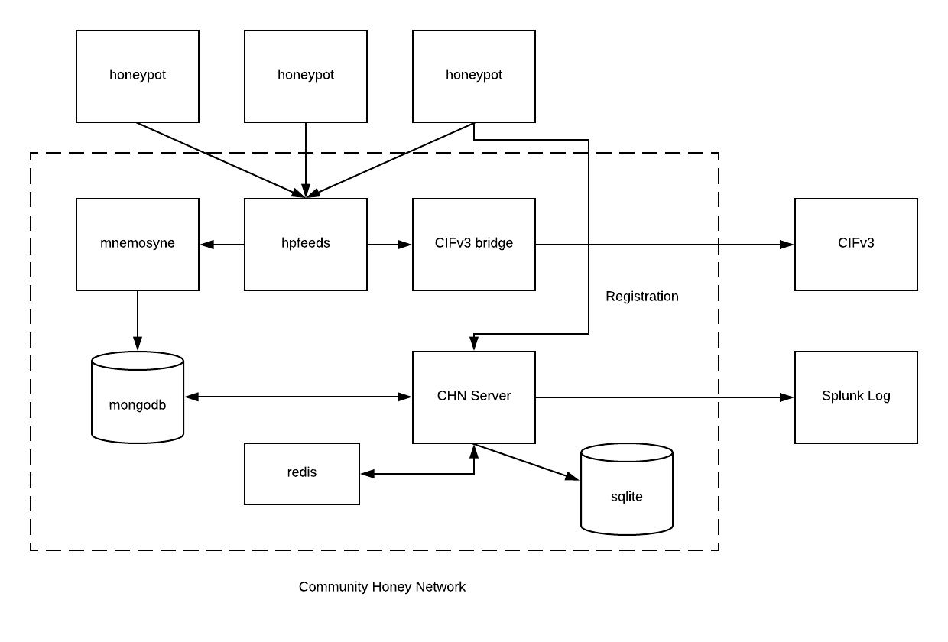

Slide 10
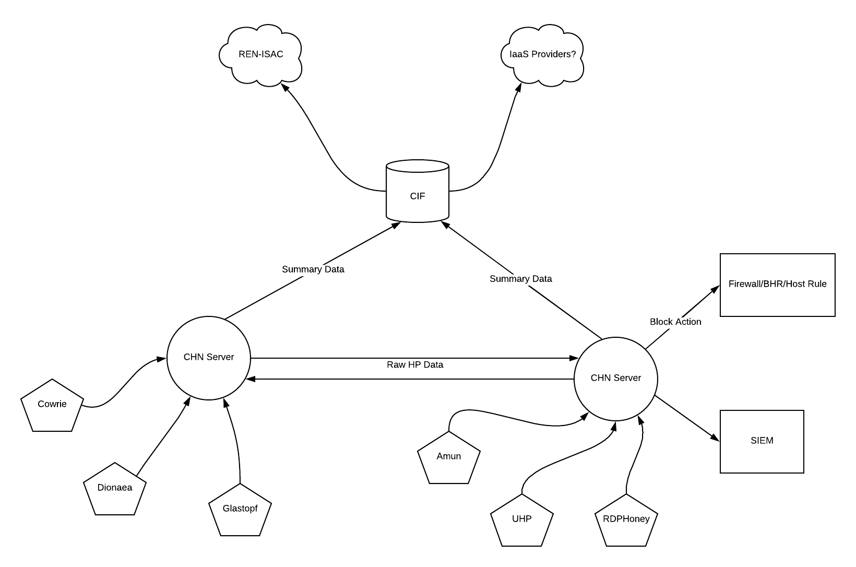

Slide 11
Architecture
v2

Slide 12
V2 will address…
Monitoring
Deployment is pull, not push
No (easy) honeypot customization
External Threat Intelligence not integrated
Data left on the table

Slide 13
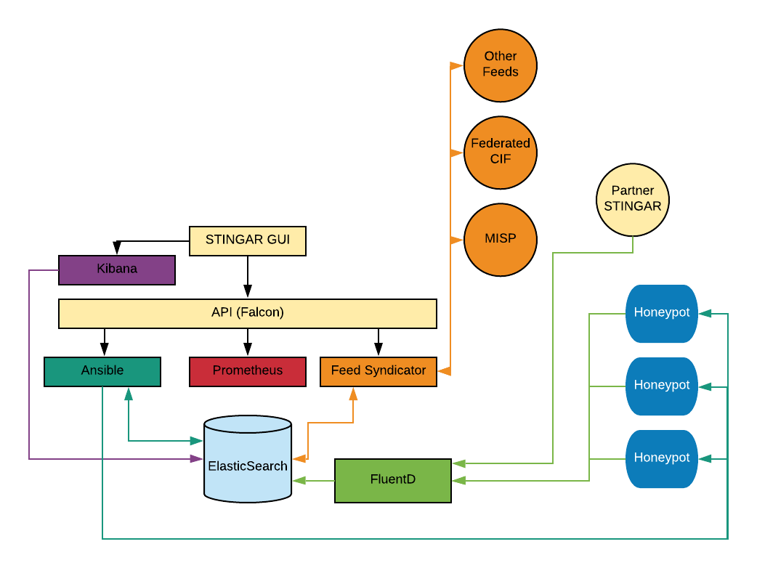

Slide 14
Data
Early metrics

Slide 15
…A month of data
Unique IP’s
197,564
Deployments
4
Sensors
65

Slide 16
Deployments
Partner | Sensor Count | Attack/Sensor | Unique IP/Sensor
Duke | 55 | 7808 | 3341
Partner 1 (M1) | 3 | 4625 | 2577
Partner 2 (R1) | 2 | 8097 | 5151
Partner 3 (R1) | 5 | 5600 | 3229

Slide 17
IP Overlap

Slide 18
Crosstab Unique IP
 | Duke | Partner 1 (M1) | Partner 2 (R1) | Partner 3 (Int)
Duke | 184,875
Partner 1 (M1) | 3,507 | 7,777
Partner 2 (R1) | 6,371 | 1,044 | 10,347
Partner 3 (Int) | 10,355 | 1,107 | 2,716 | 16,145

Slide 19
Benefits of Sharing
Notes:
Starting in December, this partner starting blocking solely on their own honeypot data and blocked on average 4.1 million connections per day.
After adding in the shared repository containing all the participants data, they blocked on average 11.7 million connections per day, a 2.8X increase.

Slide 20
Now you owe me
…isn’t that how this works?

Slide 21
Our asks
Code/ Architecture
Data use
Try + Complain
Contribute
MISP export?
Remediation Feed?
Dev War Stories

Slide 22
Thank you!
team-stingar@duke.edu
https://stingar.security.duke.edu

