Slide 1
Passive DNS SIG 2021 Updates
Aaron Kaplan (aaron@lo-res.org)
Alexandre Dulaunoy (alexandre.dulaunoy@circl.lu)
Paul Vixie (vixie@fsi.io)
Mailinglist: passive-dns@first.org

Slide 2
Agenda
History / SIG recap
Status quo
additions to the I-D Draft (version 07 to version 08 diff)
MISP – pDNS COF import module

Slide 3
History
Concept of passive DNS invented at BFK in 2005
First Presented at a FIRST conference in 2005
Idea of common output format (“COF”)
Client can connect to multiple pDNS servers and pull in all the data and diff and/or merge results and show it in a uniform way
Ended up standardizing farsight’s output format with additions

Slide 4
The Internet Draft (I-D) - Objectives
Consistent naming of fields across Passive DNS software based on the most common Passive DNS implementations
Minimal set of mandatory fields to be supported
Minimal set of optional fields to be supported
Way to add "additional" fields via a simple registry mechanism (IANA-like)
Simple and easily parsable format
A gentle reminder regarding privacy aspects of Passive DNS

Slide 5
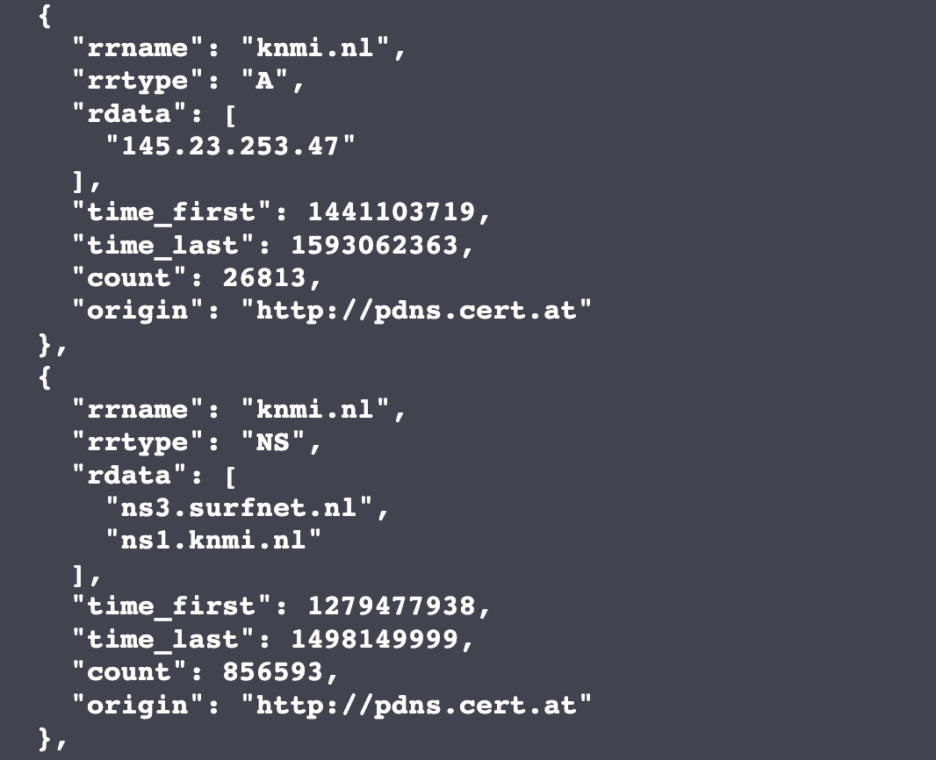
Example

Slide 6
Standard Development HOWTO
Reference: https://datatracker.ietf.org/doc/draft-dulaunoy-dnsop-passive-dns-cof/
Development on https://github.com/adulau/pdns-qof
We are fine? → DNSOP WG standards track

Slide 7
Status quo
Version 08 of DRAFT was submitted on 4th of May 2021
https://datatracker.ietf.org/doc/draft-dulaunoy-dnsop-passive-dns-cof/
Feedback from the last SIG meeting was incorporated.
We are requesting a “GO” for the IETF Standards Track Silence procedure started as of today. Deadline 19th of May

Slide 8
COF2MISP
New open source MISP import module [1]
Export data from passive DNS / dnsdb / dnsdbflex → import to MISP → correlate in MISP → use MISP expansion module to query passive DNS.
Idea: pivot back and forth.
[1] MISP modules: https://github.com/MISP/misp-modules

Slide 9
Live - Demo

Slide 16
Staying in touch
Mailing list: passive-dns@first.org
MISP modules: https://github.com/MISP/misp-modules
Ask first-sec@first.org for mailing list subscription

