Slide 1
Streamlining Container Security: The Power of VEX Inheritance in Container Ecosystems
Kaajol Dhana & Jessica Butler, NVIDIA Product Security | April 2025
Notes:
Kaajol is software engineer for NVIDIA’s Product Security Tools team. She is interested in container security and providing actionable and insightful reports for teams to be able to remediate security risks.

Slide 2
Agenda
Introduction
VEX Inheritance
Global VEX
Proposed Approach
System Overview: VEX Inheritance Process
Approved Parent Image tracking
Global VEX
Implementation Workflows
Register Parent Image
Parent Image Detection and Inheritance
Shifting Compliance Left
Implementation Limitations
Difficulty in tracking image lineage
Non-Inheritable VEX
Conclusion
Lessons Learned

Slide 3
Introduction
Mo’ OSS, Mo’ Problems?
Complexity of vulnerability management across containerized releases
Container images commonly have hundreds of vulnerabilities, requiring significant manual triage and tracking
Mutable tags may not reflect underlying changes in frameworks
VEX Inheritance
VEX inheritance is a process that automates the application of Vulnerability Exploitability eXchange (VEX) information from parent container images to their child images.
This approach streamlines vulnerability management by leveraging the layered structure of container images.
Global VEX
Tooling that enables automated detection of OSS patch versions to automatically apply VEX analysis details to reports and release artifacts.

Slide 4
VEX Inheritance Process
Key Steps:
Catalog ‘Approved’ Parent Images
Associate VEX and License Approvals: Associate VEX statements and OSS License approval with parent images.
Inherit VEX and License Approvals: Automatically apply VEX statements and OSS License approval from parent images to final images
Benefits: Reduce time to release by applying manual approval workflows to common set of OSS and inheriting

Slide 5
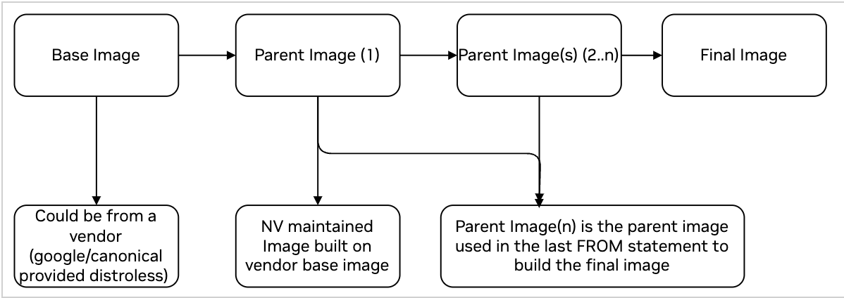
‘Approved’ Parent Image
Largest Common Set of OSS
Ensure approved parent images are meeting compliance requirements for release
Define Ownership for ‘Approved’ parent images
Manage vulnerabilities and VEX creation
Maintain compliance requirements
Manage parent image release cycle
Accelerate development and release cycles for products
Build reusable parent images with largest common set of OSS for a use case to save duplicate efforts on tedious compliance tasks
Notes:
Review Differences between Base, Parent, Final Image

Slide 6
Global VEX
Detection of OSS Patch Versions
Automated Patch Detection: Identifies OSS patches from third-party vendors or internal developments.
Automated VEX Document Creation: Generates VEX documents if the patch is used by a container and applies the VEX to reports
Upgrade Guidance: Provides teams with upgrade guidance when a patch is available.
Notes:
Global VEX is a way for us to globally generate and apply VEX for OSS patches from internal developments or 3rd party vendors. A way for us to manage the usage of OSS patches from internal developments or 3rd party vendors. This includes managing the usage of OSS patches → automating the detection of these patches, generating VEX documents if a patch is used by a container and applying the VEX to reports to reduce noise in the reports so devs can focus on vulns that require attention
We also provide teams with upgrade guidance when patches become available enhancing the visibility and streamlining the adoption of internally available patched software packages, in turn this reduces unnecessary delays associated with vulnerability mitigation

Slide 7
Implementation

Slide 8
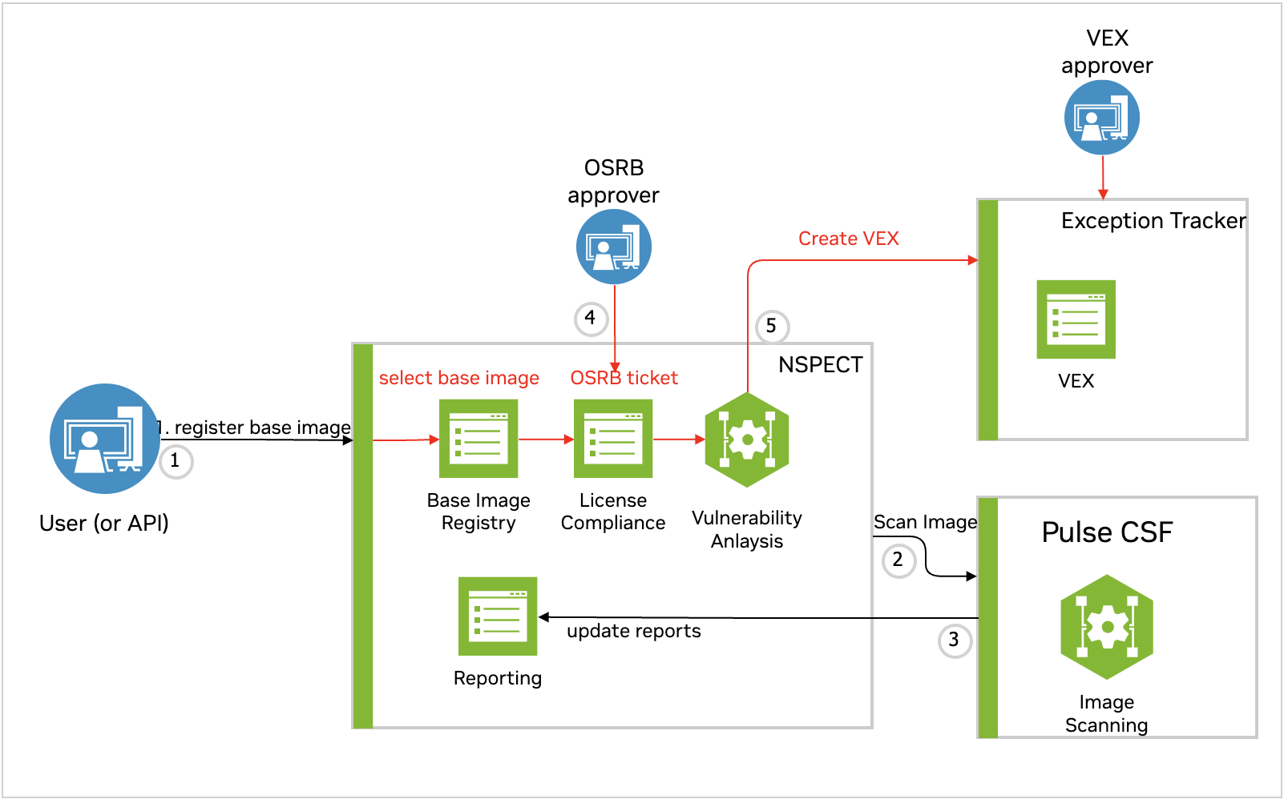
Register Parent Image Workflow
Parent Image Analysis & Compliance Review
Register parent image in the product catalog with use case
Complete OSS license compliance
Scan image for OSS vulns
Generate and approve VEX documents as needed
Repeat steps 1-4 for each parent image.
OSS License
VEX Tooling
Parent
Product Catalog
Parent
Container Scanning Infra

Slide 9
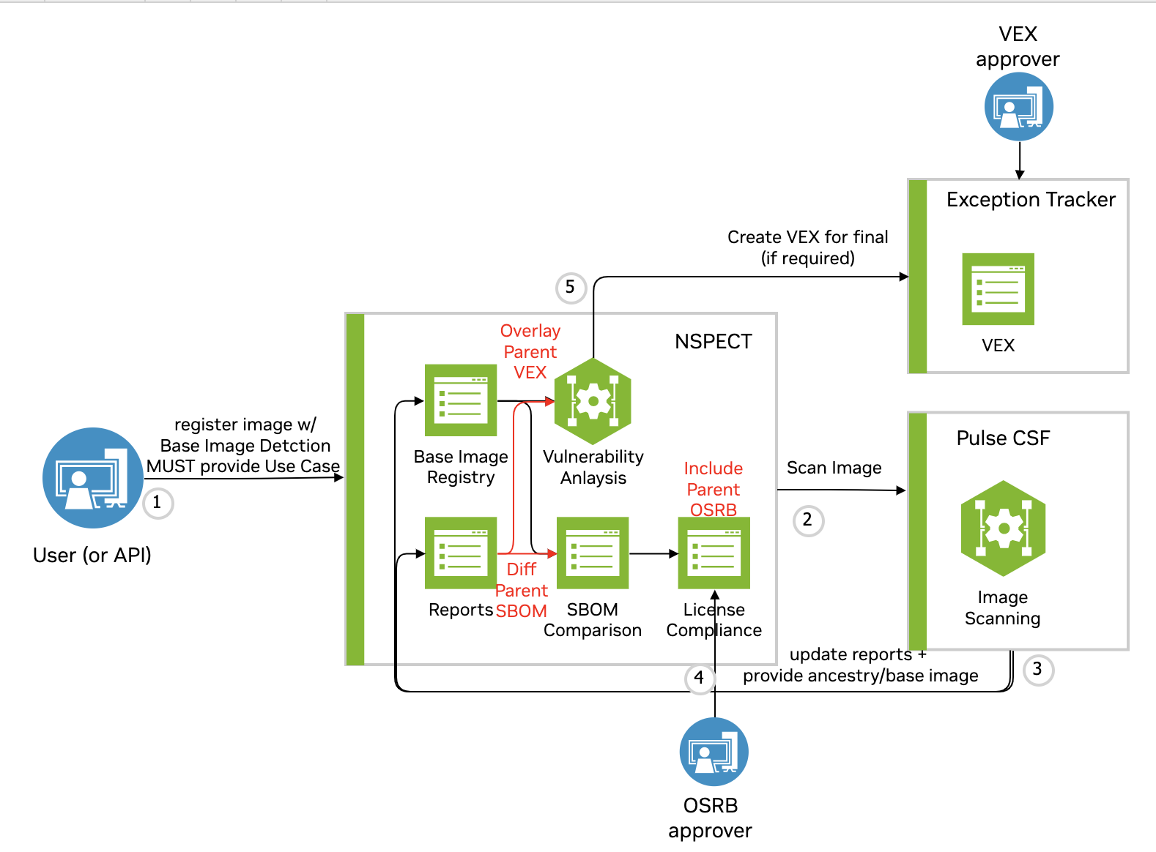
Final Image Workflow
Register image, use case enables detection
Scan image for parent image and OSS
Report detected approved parent image
Report OSS/Vuln difference
final SBOM - parent SBOM
final Vuln analysis required
VEX Tooling
Product Catalog
Parent
Parent
Container Scanning Infra
OSS License

Slide 10
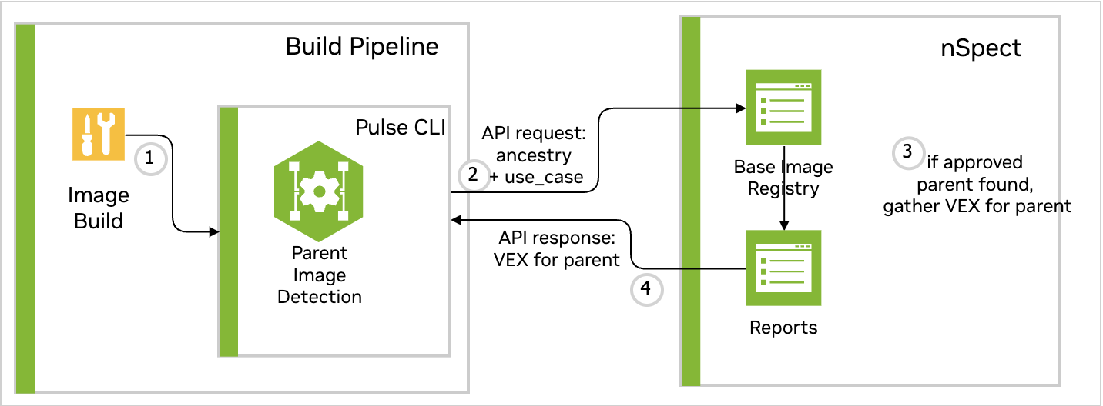
Shifting Compliance Left
In-Pipeline Compliant Builds
*Apply VEX in-pipeline to provide actionable reporting during build time.
Product Catalog
Container Scanning CLI
Notes:
Once the approved parent images are registered in the product catalog, the next part to shift compliance left and provide in-pipeline scanning and detection.
Before build, developers can use the product catalog to find approved parent images that meets their use case.
Pipeline jobs are enabled to:
Detect parent image by use case.
Determine the parent image’s approval status.
If approved, the parent image VEX is applied to the reports.
Reports are provided to show if the final image is using an approved parent image and with remaining vulnerabilities that require triage. These jobs can be used to block pipelines if images are built with non-approved parent images to shift compliance left and get approved parent images integrated early on in the development cycle

Slide 11
Limitations + Conclusions

Slide 12
Limitations with Automated Parent Image Detection
Parent image detection primarily relies on matching image layers to the final image.
Benefits of using registry operations tool (ex: skopeo, crane)
Detection can be unreliable due to various registry storage mechanisms
Workaround: Require in-pipeline build configuration to provide parent image
Notes:
Limitations and Solutions (5 minutes)
Slide: Limitations in Automated Parent Image Detection
• “While this process is robust, it does have limitations:
• Parent image detection relies heavily on registry operations tools like Skopeo or Crane which provide metadata on the image like image layer digests, size, architecture without requiring a docker daemon. However, there have been some cases where detection can be unreliable due to varying registry storage mechanisms.”
• “To address these issues, we recommend integrating build configurations that explicitly provide parent image details.”

Slide 13
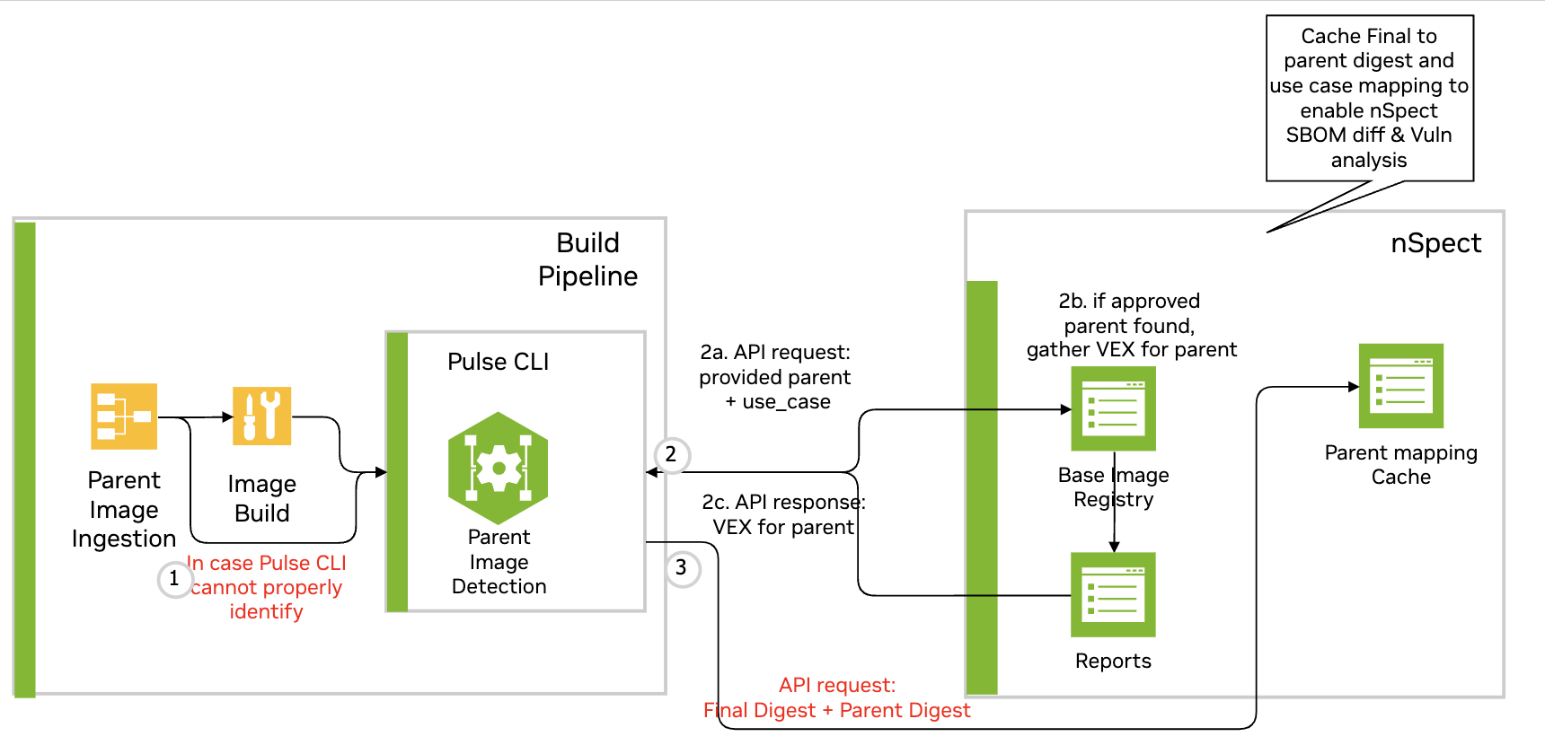
Detection Limitation Workaround
In-Pipeline Compliant Builds
Product Catalog
CLI
CLI can’t properly identify the parent image
Notes:
In cases where the detection fails, we ingest the parent image used from the image build config. In these cases, we must ensure that this config is used in the final image build either through dockerfile scanning or custom build configuration. We continue the same process of checking if this parent image is approved for this use case and applying the parent image VEX if it is. We also cache the parent image and final image association in the product catalog to enable the SBOM diff and VEX inheritance for the release image when it is available in the product catalog.

Slide 14
Non-Inheritable VEX
Configuration
Example of VEX states that require extra review
requires_configuration = exploitability requires a configurable option to be set/unset.
requires_dependency = exploitability requires a dependency that is not present.
requires_environment = exploitability requires a certain environment which is not present.

Slide 15
Conclusion
Pilot: November 2024
Clear definition of parent images and use cases
Product teams vs core Security team
Parent Image = largest common set of OSS shareable between multiple products
Ensure ownership of approved parent image
Patching, release cadence, testing
Next steps… more automation
New parent image releases
Global VEX mappings
Patches using AI
Suggested VEX using Vulnerability Analysis for Container Scanner Agent Blueprint

